Slide 1
The Good Samaritan: A Lesson on Love and Inclusion

Slide 2
Luke 10:25-37
[25] On one occasion an expert in the law stood up to test Jesus. "Teacher," he asked, "what must I do to inherit eternal life?"
[26] "What is written in the Law?" he replied. "How do you read it?"
[27] He answered: " 'Love the Lord your God with all your heart and with all your soul and with all your strength and with all your mind'; and, 'Love your neighbor as yourself.'"
[28] "You have answered correctly," Jesus replied. "Do this and you will live."
[29] But he wanted to justify himself, so he asked Jesus, "And who is my neighbor?"

Slide 3
Luke 10:25-37
[30] In reply Jesus said: "A man was going down from Jerusalem to Jericho, when he fell into the hands of robbers. They stripped him of his clothes, beat him and went away, leaving him half dead. [31] A priest happened to be going down the same road, and when he saw the man, he passed by on the other side. [32] So too, a Levite, when he came to the place and saw him, passed by on the other side. [33] But a Samaritan, as he traveled, came where the man was; and when he saw him, he took pity on him. [34] He went to him and bandaged his wounds, pouring on oil and wine. Then he put the man on his own donkey, took him to an inn and took care of him. [35] The next day he took out two silver coins and gave them to the innkeeper. 'Look after him,' he said, 'and when I return, I will reimburse you for any extra expense you may have.'

Slide 4
Luke 10:25-37
[36] "Which of these three do you think was a neighbor to the man who fell into the hands of robbers?"
[37] The expert in the law replied, "The one who had mercy on him."
Jesus told him, "Go and do likewise."

Slide 5
Animated Version of The Good Samaritan
https://www.youtube.com/watch?v=hGdqKWTSXdU

Slide 6
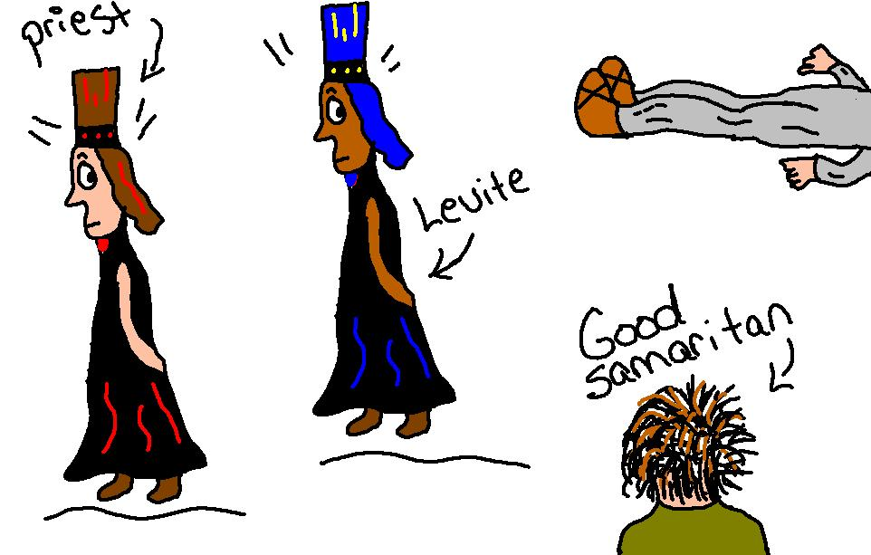

Slide 7
What is a Good Samaritan?
List 3 words that come to mind (ex. qualities you think a Good Samaritan has)
Identify 2 questions you have about Good Samaritans
Create an image or symbol to represent what you think it means to be a Good Samaritan

Slide 8
Lessons Learned from The Good Samaritan
Avoid prejudice:
A “preconceived opinion that is not based on reason or actual experience.” – Oxford Dictionary
Show compassion:
“Sympathetic pity and concern for the sufferings or misfortunes of others.” – Oxford Dictionary

Slide 9
Lessons Learned from The Good Samaritan
Love your neighbour:
We must consider all the people of the world to be our “neighbours.”
Just as God loves all His people, so should we.
Jesus calls us to extend our love even to our enemies.

Slide 10
Group Activity:
Get into the group that you have been assigned.
Read the scripture passage that your group has been assigned.
Complete the placemat questions as a group.
Select a spokesperson.
Share your responses with the class.

Slide 11
Scripture Passages for Placemat Activity
Luke 14: 7-14
Luke 5: 27-32
Luke 19: 1-10
Luke 7: 36-50
Mark 10: 13-16
Matthew 12: 46-50
John 4: 1-42

