Slide 1
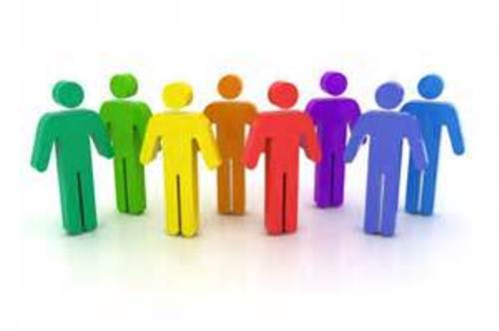
The Physical Aspect of Being Human

Slide 2
Key Concepts
The Incarnation shows us the sacredness of the human body
Jesus affirms the dignity of every person
We are made in the image and likeness of God
The fifth commandment underlies the sacredness of human life

Slide 3
Key Concepts
We are called to co-operate with God in the care of our bodies
God’s creation of us does not end
We constantly change physically and we are called to respect that change in ourselves and others

Slide 4
Discussion
What does “self-image” mean?
In our society, what is the “ideal self-image”?
Is there a big gap between how you see yourself and how you’d like to be?
How does this gap feel? When does it become a “problem”?

Slide 5
Definitions
Self-image: how we see ourselves
Ideal self-image: how we’d like to be; the qualities we admire in others
Image gap: the difference between self-image and ideal self-image

Slide 6
Think-pair-share
With a partner, come up with a list of strategies that can help teens develop a positive self-image (eg. attitudes, behaviours)

