Slide 1
Contracts vs Covenants

Slide 2
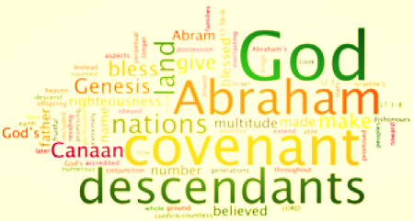

Slide 3
Contracts vs Covenants
Contracts:
Covenants:
Deal with things
Engages the services of people
Made for a stipulated period of time
Can be broken with material loss to the contracting parties
Deal with people
Engage people
Are forever
Cannot be broken, but if violated, they result in loss and broken hearts

Slide 4
Contracts vs Covenants
Contracts:
Covenants:
Are secular (non-religious) affairs and belong to the market place
Are best understood by lawyers
Are witnessed by people with the state who carries out the action
Are sacred affairs and belong to the heart, the temple, or the church
Are appreciated by people who study God
Are witnessed by God, who carries out the action

