Slide 1
Images of the Church

Slide 2
Images of the Church Activity
As we ease into our new unit, we will be taking some time to examine several images that reflect the nature of the Catholic Church.
As you view an image, think about what that picture tells us about the Church. Please jot your ideas down in your notebook.
We will discuss your ideas as a class.

Slide 3
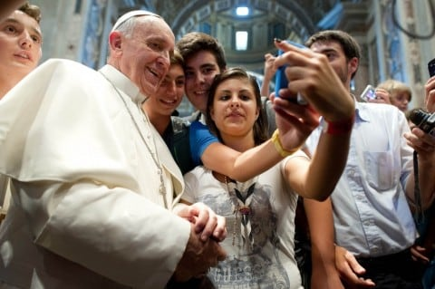
Image # 1

Slide 4
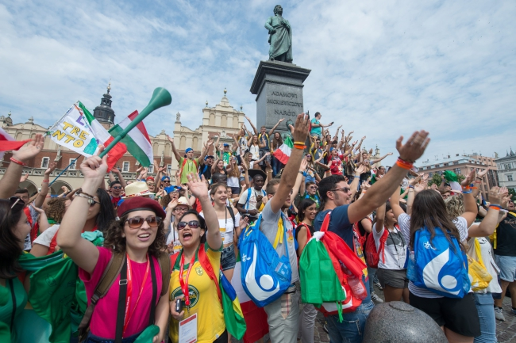
Image # 2

Slide 5
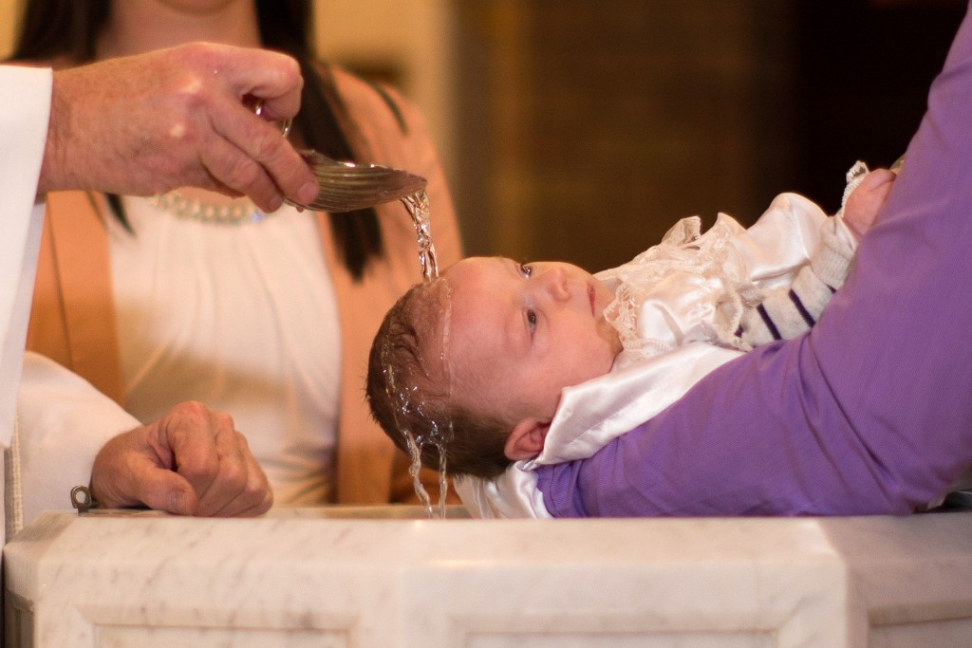
Image # 3

Slide 6
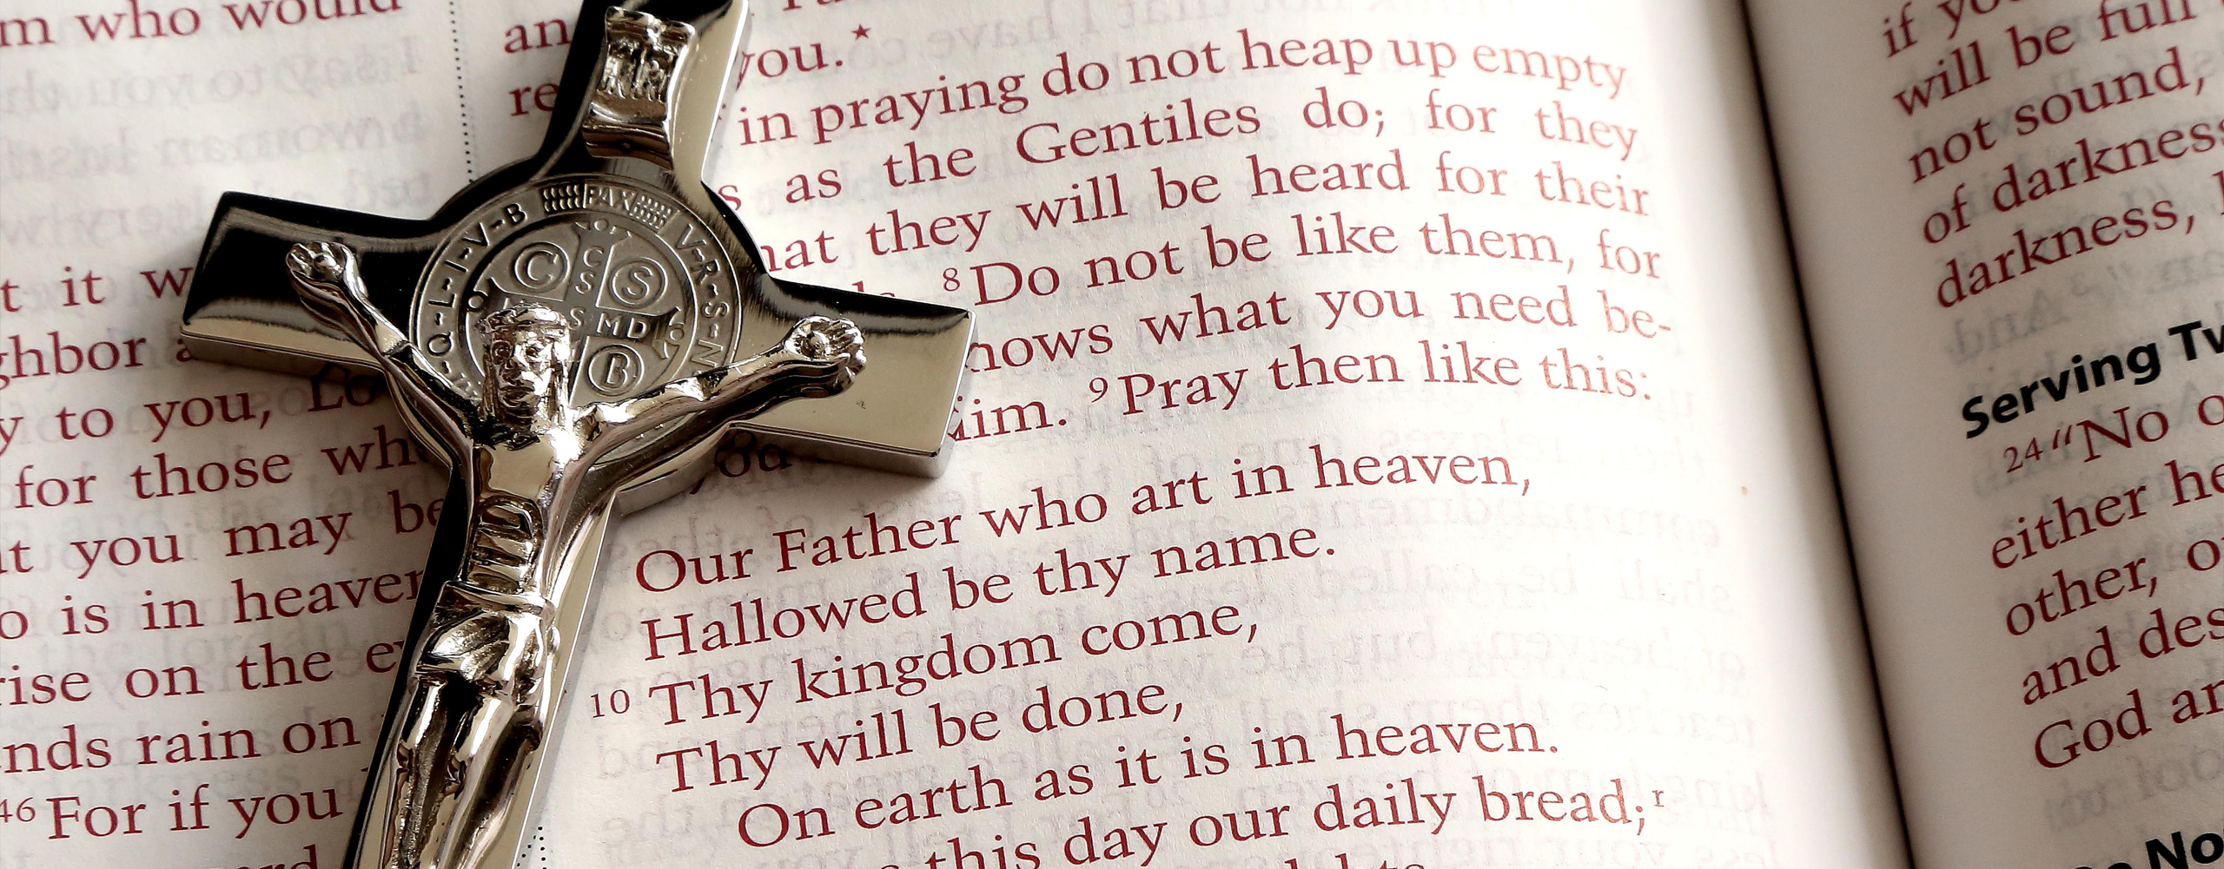
Image # 4

Slide 7
Image # 5

Slide 8
Sources
http://cliparting.com/free-church-clip-art-14734/
https://www.washingtonpost.com/news/worldviews/wp/2014/09/12/a-brief-list-of-pope-selfies-ranked/?utm_term=.bf5544cff513
https://www.google.ca/search?hl=en&biw=1280&bih=893&tbm=isch&sa=1&ei=TP-vWonVJpC15gKEv5aQAw&q=world+youth+day+2016&oq=world+youth+day&gs_l=psy-ab.1.2.0l10.270930.277385.0.281042.30.18.1.4.4.0.250.1324.11j2j1.14.0....0...1c.1.64.psy-ab..15.15.1095...0i67k1j0i13k1.0.UCp7m6Ibg8k#imgrc=qEScoku_QhM8SM:
https://www.newbridgeparish.ie/sacraments/baptism/
http://www.canberratimes.com.au/act-news/catholic-homelessness-hostel-at-120-per-cent-of-capacity-20140717-ztwql.html

