Slide 1
Jesus: A Model of Inclusion

Slide 2
A different Kind of messiah
Prior to Jesus’ earthly mission, there was a strong belief that God would send a Messiah.
Many people believed that this Messiah would be a political leader who would bring power, independence, and freedom to the Jewish peoples.
However, Jesus proved to be a different kind of Messiah.
Although Jesus was a leader, he did not desire the type of political authority that many people had anticipated the Messiah would seek.
He was most concerned with teaching people about the Kingdom of God.

Slide 3
Jesus’ Priority
One important lesson that Jesus emphasized during his earthly mission was the importance of loving our neighbours.
He encouraged people to treat friends and enemies the same.
Jesus did not believe in a social hierarchy.
He reminded people that everyone was made in the image and likeness of God.
Jesus reached out to people of various social rankings.
In a nutshell: Jesus’ message was counter-cultural.

Slide 4
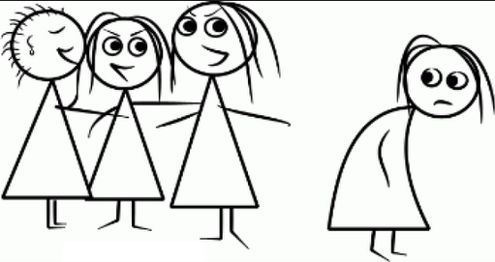
Who do we tend to exclude in our society?

Slide 5
Being a good Samaritan in our society
https://www.youtube.com/watch?v=XaKF3_FwJ3w

Slide 6
Connect
How does the behaviour you just observed connect with what you already know about human behaviour?

Slide 7
Extend
What new insights did you gain about human behaviour through watching the video?

Slide 8
Challenge
Why is it difficult for humans to include everyone?

