Slide 1
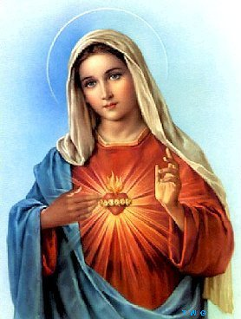
Mary: Mother of the Church

Slide 2
Think-Pair-Share
What words, symbols, actions, or events come to mind when you think about Mary, the mother of Jesus?

Slide 3
What’s the Deal with Catholics and the Virgin Mary?
http://bustedhalo.com/ministry-resources/mary-in-two-minutes

Slide 4
Important Events in the Life of Mary
The Immaculate Conception: Mary was conceived by her parents without the guilt or the stain or original sin.
The Annunciation: The Angel Gabriel appeared to Mary and announced that Mary would conceive the Son of God through the power of the Holy Spirit.
The Assumption: Mary was assumed body and soul into the Kingdom of Heaven.

Slide 5
The Facets of Mary
Mary is most known for being:
A model of faith and obedience
A trustworthy intercessor
Mother of God
Mother of All

Slide 6
A Model of Faith and Obedience
Mary welcomed the tidings and promise brought by the angel Gabriel.
Mary believed that “with God nothing will be impossible.”
She committed to being the handmaid (servant)of the Lord.

Slide 7
A Trustworthy Intercessor
Mary cooperated with the action of the Holy Spirit.
Therefore, the Church loves to pray in communion with the Virgin Mary.
We can pray with and to her but we do not worship her – we venerate her.
Praying in communion with Mary is a way of celebrating the great things the Lord has done for Mary.

Slide 8
Mother of God
Theotokos means “Mother of God.”
The one whom Mary conceived by the Holy Spirit truly became her Son according to the flesh.
Her Son was none other than the Father’s eternal Son, the second person of the Holy Trinity.
Thus, it makes sense that the Church declares that Mary is truly “Mother of God.”

Slide 9
Mother of All
Mary is the perfect figure of the Church.
When we pray to her, we are adhering with her to the plan of the Father, who sends his Son to save all of humankind.
She has become the mother of all the living.

Slide 10
The Rosary
What is the Rosary?

Slide 11
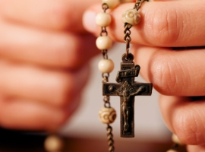
The Rosary
The word rosary comes from Latin and means “a garland of roses.”
The rose is one of the flowers used to symbolize Mary.
The rosary is a devotion in honor of the Virgin Mary.
It consists of a set number of specific prayers.
Through the prayers, we meditate upon various aspects of the lives of Mary and Jesus.

