Slide 1
Power, Authority, and Service

Slide 2
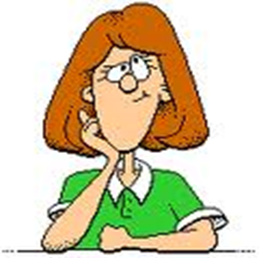
Discussion Question
How would you define power?

Slide 3
Power
Power is our ability to act on the world, and to interact with other people in a way that achieves results.
Using power appropriately, for positive ends, moves us and our communities forward;
Power is everywhere.
Power is found in every relationship – between parent and child, between teacher and student, between friends, between members of society, and between nations.
Power shows itself through one person’s ability to change what another person is doing.
Power also shows itself in helping others.

Slide 4
The “Grey Area”
Often, we live in a “grey area” where our use of power may drift from being positive to being negative
You have probably experienced this in your relationship with your parents and teachers when, all of a sudden, they let you know that you have “crossed the line” and are misusing your power.

Slide 5
Discussion Question
How is authority different from power?

Slide 6
Distinguishing Power from Authority
Authority adds something to, or complements power.
I may have power (ability) to do something, but not necessarily the authority to do so.
In order for my power to be effective, I need others to accept it.
If someone claims the right to wield power within a community without the agreement of the community, that person is using power in an illegitimate way, and without authority.
For this reason, one must be authorized to exercise power in society.

Slide 7
Legitimate Authority
All legitimate authority comes from God
When we do what we can to help the work of those in authority, we are serving God
We should only refuse to obey legitimate authority when it demands that we do something morally wrong
Authority is legitimate when:
It is recognized by the population as a whole
When it serves the common good

Slide 8
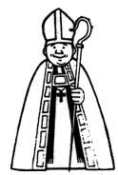
Discussion Question
Who are some people who have legitimate authority?
(eg. Pope)

Slide 9
Service
Service is using our power to help others
It involves giving our time and energy to help others fulfill their needs

Slide 10
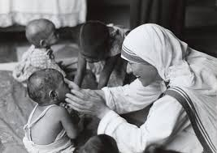
Discussion Question
How can we serve others?

Slide 11
Textbook work
Using the Christ and Culture textbook, do the following:
copy the duties of governments (bolded parts on p. 164)
copy the duties of Catholics to the state (bolded parts on p. 165)

Slide 12
The Duties of the Government
Respect for the dignity of the person
Accept the rule of law
Promote the common good and good order
Protect the family
Safeguard the right to life of every innocent person
Be responsible for the economy and the well being of
citizens
7. Give access to work and a just wage
Ensure religious freedom
Look after the health of citizens
10. Defend the country

Slide 13
Duties of Catholics to the State
The following are some of the key duties of Catholics as citizens of a country:
Obey Civil Authority -treat those who have been given authority with respect;
Vote – exercise our right to vote;
Participate in Public Life – it is our duty to work with civil authority;
Pay Taxes – we must share in the responsibility of the common good;
Welcome Immigrants and Refugees – as a prosperous nation we are obliged to help others;
Defend our Country – we must accept the duty to defend our country.

