Slide 1
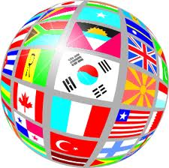
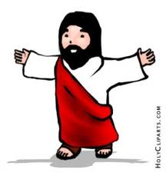
What Does Religion Have to do With Culture?

Slide 2
Let’s Review: What is Culture?

Slide 3
How Would You Define Religion?

Slide 4
A Definition for Religion
Religion is a system of symbols and rituals.
In a religion, people form powerful beliefs, values, meanings, and practices around symbols and rituals to express who they are in relationship to a higher power (eg. God).

Slide 5
Religious Symbols and Rituals
Religious symbols reveal the bond between us and the sacred.
Sacred rituals enact this bond.
We can enter into the realm of the sacred through symbols and rituals.
Religious rituals have the power to open up new ways of living and communicating with a power and energy that is higher or deeper than our own.

Slide 6
Transcendence
Religious experience has to do with our relationship with a God whom we cannot see, hear, taste, smell, touch.
That is, God is beyond, or transcends, our usual physical experience.
God certainly knows that we humans are physical beings and that we relate in a physical way.
That is why God reveals God’s-self to us in a physical way by entering human history as a man, Jesus.
God makes God’s-self known to us through creation, but we must learn to “see” through creation to God, who is the source of all.

Slide 7
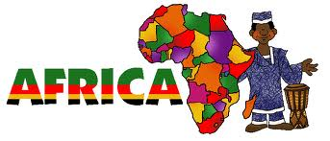
From Earliest Times
Anthropologists believe that the earliest humans came from the African continent. Those who study traditional African religions note that Africans as people are deeply religious.
Religion permeates every aspect of their lives.

Slide 8
Continued…
Anthropologist Arthur Leonard writes
“[Africans] are in the strict sense of the word truly and deeply religious people, of whom it can be said, that they eat religiously, drink religiously, bathe religiously and dress religiously. In fact, all that is sustaining or weakening in African life, has to be anchored in religion, whether it be the individual’s relationship to the family, clan and tribe, or morality, law, worship, politics, social status, economics, etiquette, wars and peace.”

Slide 9
Continued…
The whole of African life is the source of their religion.
If this is true of the descendants of the earliest human societies, religion must be rooted deeply in the very core of who we are as human beings.

Slide 10
Is Religion Still Important in Our Culture Today?

Slide 11
Religion and Culture Today
Nearly everyone has an opinion on religion and usually a strong held opinion at that.
People in our world today are not indifferent about religion.
Most people may rarely go to Church, but they also still hold strong views about religion and its place in society.

Slide 12
The Privatization of Religion in Canada
Something has been happening to the way that Canadian youth – and Canadians in general – live religion.
Statistics show that while most youth see themselves as religious and believe in God, an increasing number no longer participate in the Church.
Canadian youth find the institutional form of religion less and less relevant to their lives.

Slide 13
World Youth Day
What is World Youth Day?
https://www.youtube.com/watch?v=jT1mUa8qb3c
Pope Francis registers for World Youth Day:
https://www.youtube.com/watch?v=98Q1WxFj5-8

Slide 14
Group Discussion Questions
Do you think researchers are correct in their assessment that people are religious, but mostly in a private way? Why or why not?
Why do you think World Youth Day has been such a success for the Church?
If you were a priest in a Catholic parish, what would you do if a couple who never publicly participate in the life of the Church asked to be married or to have their child baptized in the Church?
Do you agree with the statement that you don’t need to go to Church to be a good Christian?

