Slide 1
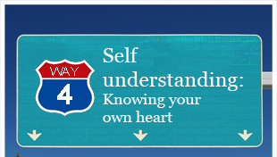
Self Understanding in our Culture

Slide 2
Self-understanding
Self-understanding is also known as self-awareness
Self-understanding is an awareness of one’s own “attitudes, motives, defences, reactions, weaknesses and strengths”
Our culture tends to see the self as isolated from others, and some even think of the self as somehow separate from the body
Self-understanding cannot happen without the other
Psychology Dictionary: What is SELF-UNDERSTANDING? definition of SELF-UNDERSTANDING (Psychology Dictionary)

Slide 3
Identity
Your name is definitely part of your identity, but it does not define you.
Your identity is tied up with what is most important to you.
If you want to know someone’s identity, you will need to know what commitments this person has made.

Slide 4
Self-esteem
Self-esteem is an awareness of one’s own worth
Our culture presumes that you can give this esteem or love of self to yourself
However, esteem can only be fulfilled by others

Slide 5
Self-esteem
In a culture where the self has become isolated and one hardly knows how to live in the gracious recognition of God – it is no wonder that self-esteem is so difficult

