Slide 1
The 7 Tendencies of Individualism

Slide 2
Individualism
Individualism is another name for the isolation of self.
Our culture puts more emphasis on the individual than on the community.
The means conflict between the rights and values of individuals and the common good of society.
Personal and social good must develop alongside each other.

Slide 3
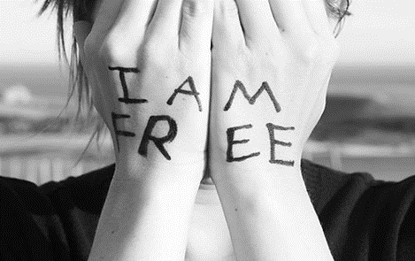
1. I am Free
I am not bound by anything or anyone. Freedom in my highest dignity. I am responsible for myself. You cannot place a claim on my freedom unless I am encroaching on the freedom of another.

Slide 4
2. I Have Rights
I possess rights, which are enshrined in a number of declarations of human rights, including Canada’s charter of rights. These rights protect my freedom and dignity.

Slide 5
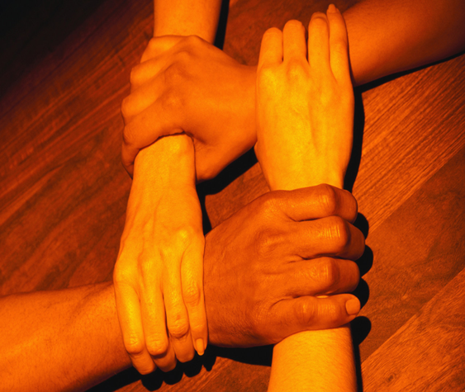
3. I am Equal
I have the same claim to freedom, dignity and rights as everyone else. I must have a voice in government or in decisions that affect them.

Slide 6
4. Only Reason Binds Me
I accept things only when the reasons for accepting them are compelling. I do not accept things without proof. My mind is like my soul- it is what most identifies me. Knowledge is power.

Slide 7
5. I am Isolated from Everything
In relationship to the world and to others, I am an observer. I have to treat the world as an object to observe. I see everything from my own perspective.

Slide 8
6. I am Master of the Earth
The earth is an object. It is no longer God’s creation. I can use it or exploit it as I see fit for my benefit and happiness. In the same way, I am master over my own body.

Slide 9
7. I am Godless
In a world where everything is centered around me, God has no place except at the limits of my life (sickness, death, sorrow)
God is squeezed out of a culture that operates out of self interest.

