Slide 1
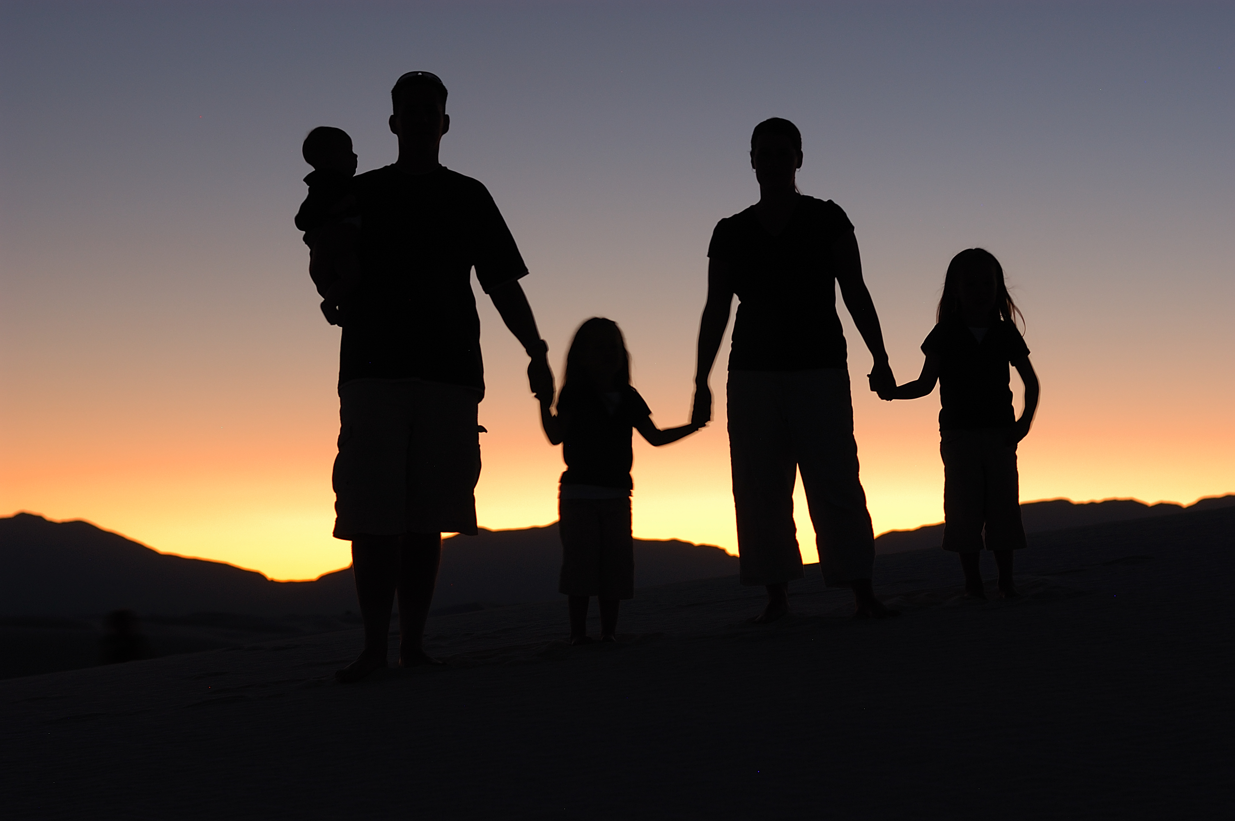
The Family and Culture

Slide 2
What is the Family?
Definition from the Catechism of the Catholic Church:
“The family is the original cell of social life. It is the
natural society in which husband and wife are called to give themselves in love and in the gift of life. Authority, stability, and a life of relationships within the family constitute the foundations for freedom, security, and fraternity within society. The family is the community in which, from childhood, one can learn moral values, begin to honor God, and make good use of freedom. Family life is an initiation into life in society.”

Slide 3
Definition from the Vanier Institute
“… any combination of two or more persons who are bound together over time by ties of mutual consent, birth, and/or adoption or placement; and who, together, assume responsibilities for variant combinations of some of the following:
Physical maintenance and care of group members
Addition of new members through procreation or adoption
Socialization
Social control of members
Production, consumption, and distribution of goods and services
Affective nurturance - love

Slide 4
Beginning Families
The first stage of family life is married couples without children. When a couple marries in the Catholic Church, they promise not only to be faithful to each other, but to begin their family life together. This solemn promise is known as a covenant, made between themselves and God. As part of their covenant with God, they promise to welcome children lovingly from God.

Slide 5
Childbearing Families
The second stage of family life begins with the arrival of a baby. The Catholic Church understands that a person is created at the moment of conception.

Slide 6
Families with Preschool Children
The third stage of family life begins when the oldest child in a family is 2 ½ years, through to 6 years of age.

Slide 7
Families with School Children
This stage of family life begins when the oldest child starts grade 1 (at age 6). This stage of family life continues while the oldest child is in elementary school.

Slide 8
Families with Teenagers
This stage begins when the oldest child becomes a teenager and lasts throughout the teenage years.

Slide 9
Families as Launching Centers
This stage begins when the first child leaves home. The child, now grown up, moves out to their own residence. This happens when the young adult moves to attend post-secondary, or begins a new career. The stage concludes when the last child (adult) moves out.

Slide 10
Families in the Middle Years
This stage covers the empty nest to retirement. When the last child finally leaves home, parents have their home to themselves. They may be close to retirement but they are likely still very active.

Slide 11
Aging Families
This stage of the family life cycle goes from retirement to the death of both spouses. At this stage of life, parents have likely become grandparents, and have time to enjoy their children’s children.

Slide 12
Source
OERB

