Slide 1
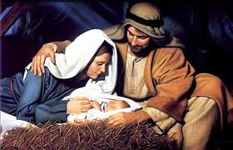
The Incarnation

Slide 2
What is the Incarnation?
The Incarnation refers to God sending His only Son to the earth as a human.
Jesus has always existed.
Jesus has always been the Word of God.
God’s love inspired Him to send His Word to the earth in the form of a human being (Jesus).

Slide 3
John 1: 14
“And the Word became flesh and lived among us, and we have seen his glory, the glory as of a father’s only son, full of grace and truth.”

Slide 4
Source:
“Names of Jesus.” http://www.calvarymv.com/childrensresources/childrensministry/new-testament/20LifeOfChrist/06NamesOfJesus/34NamesOfJesus_Names%20of%20Jesus.pdf

