Slide 1
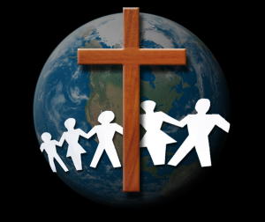
The Principles of Catholic Social Teaching

Slide 2
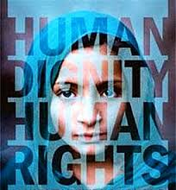
Human Dignity
This principle refers to the value of the human person and the right to have that value respected from the moment of conception to death
This principle teaches us that we have the right to whatever we genuinely need in order to become full human beings (eg. food, shelter, clothing, education)

Slide 3
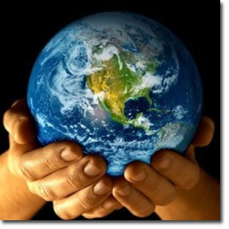
Stewardship
We must care for all that God has made
We must not disrespect the human body or the world’s resources
We need to ensure that we set a good
example for future generations

Slide 4
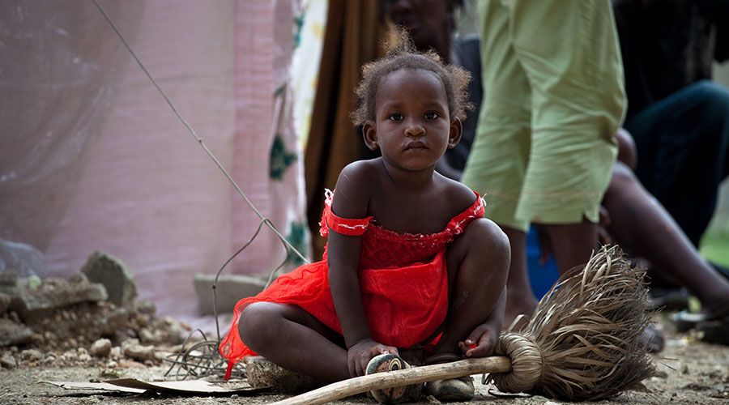
Preferential Option for the Poor
God’s special closeness with the poor is known as the preferential option for the poor
The rich do not share in God’s closeness with the poor
The preferential option for the poor is a call to share AND a call to follow God’s example and give preferential love to the poor when making community decisions
Jesus emphasized that solidarity with the
poor is solidarity with God

Slide 5
Common Good
The common good refers to all the social conditions that allow us to reach our fulfillment more fully and more easily
It is made up of 3 essential elements:
Respect for the person
The social well-being and development of the group itself
Peace (eg. the stability and security of a just order)

Slide 6
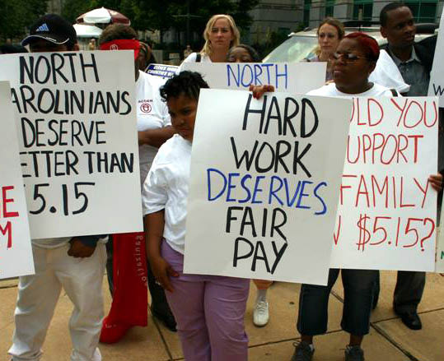
Dignity of Work and the Rights of Workers
We are called to protect the basic rights of all workers
Examples of workers rights include: the right to meaningful employment, fair wages, private property, and the right to organize, join unions, and pursue economic opportunity

Slide 7
Rights and Responsibilities
We have the reciprocal right and responsibility to be involved in the institutions which govern our lives
We are to both serve and be served by the institutions in the world
We must protect the rights that all people have
to those things required in life (eg. food, clothing,
shelter)

Slide 8
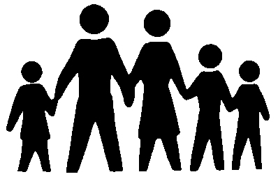
Call to Family, Community, and Participation
We are called to support the family – the principle social institution – so that people can participate in society, build a community spirit, and promote the well being of all

