Slide 1
The Sacramentals

Slide 2
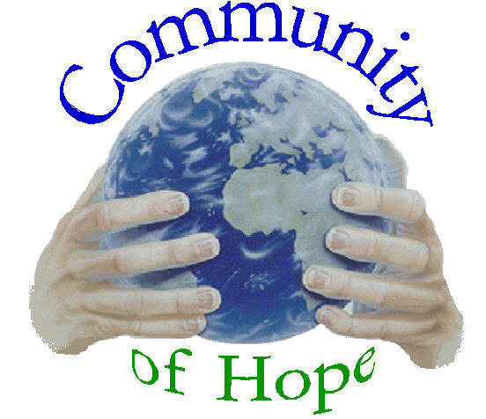
What are Sacramentals?
A sacramental can be understood as any action, object, or prayer that draws one closer to God.
Sacramentals should not isolate believers from their faith community.
They are not meant solely for private devotion.
According to Vatican Council II, sacramentals should be viewed as "liturgical activities and celebrations of the worshipping community."

Slide 3
How are Catholics Sacramental People?
1. Catholics revere the sacraments.
2. Catholics use sacramentals from the Church to grow closer to God and sanctify all aspects of life.

Slide 4
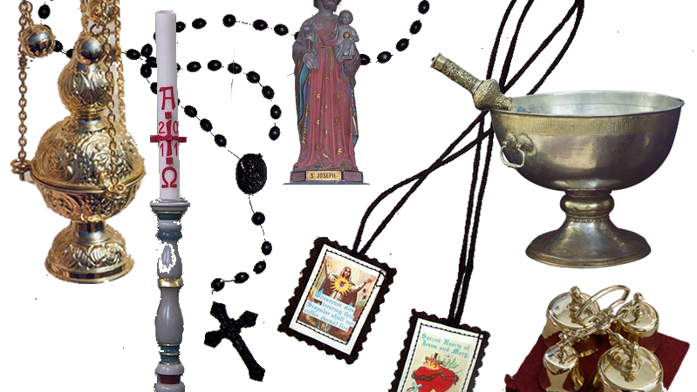
Sacramental Categories
1. Sacred actions
2. Blessings
3. Material objects

Slide 5
What are Sacred Actions?
Sacred actions are rituals that people perform.
They are outward signs of faith.
They often take the form of bodily postures and movements.

Slide 6
The Sign of the Cross
The sign of the cross is perhaps one of the most sacred actions in the Church.
It is an important profession of faith.
Jesus' death on the cross redeemed us.
The cross marks a person as belonging to Christ and a believer of the Trinity.

Slide 7
What are Blessings?
A blessing is a ritual ceremony in which we seek God's help and care for persons, activities, particular needs, or things.

Slide 8
Examples of Sacramentals
Blessed Ashes: They signify mortality, sorrow, and repentance.
Blessed Palms: They are used at the Palm Sunday mass to help represent Jesus' triumphant entry into Jerusalem and his victory over death.
Incense: It helps represent people or things. The fragrance represents Christian virtue and the smoke signifies prayer rising to God.

Slide 9
Examples of Sacramentals
Holy water: It reminds us of Baptism. The water is a symbol of new life and spiritual rebirth.
Candles: They symbolize Christ as the light of the world. They are also a mark of reverence and a sign of joyous celebration when used in liturgical services.
Holy Oils: They symbolize spiritual strength.

Slide 10
Source
Turpin, J. "The Sacramentals: Embracing God Through Creation." (1993). Catholic Update. Cincinnati: St. Anthony Messenger Press.

