Slide 1
Unhealthy Relationships

Slide 2
What are some signs that one is not in a healthy relationship?

Slide 3
Forms of Abuse

Slide 4
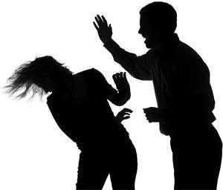
Physical Abuse
The most obvious, ranges from punishing and shoving to hitting, beating, physical abuse with a weapon, torture, mutilation and murder.

Slide 5
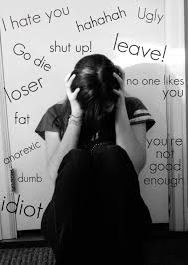
Emotional Abuse
It is also known as psychological abuse.
It involves various tactics to diminish an individual’s self-confidence such as yelling, insults, threats, humiliation, or isolation.

Slide 6
Sexual Abuse
It includes any form of non-consensual sexual activity, ranging from harassment, unwanted touching, to rape.
Consent: It "is when someone agrees, gives permission, or says "yes" to sexual activity with other persons. Consent is always freely given and all people in a sexual situation must feel that they are able to say "yes" or "no" or stop the sexual activity at any point."

Slide 7
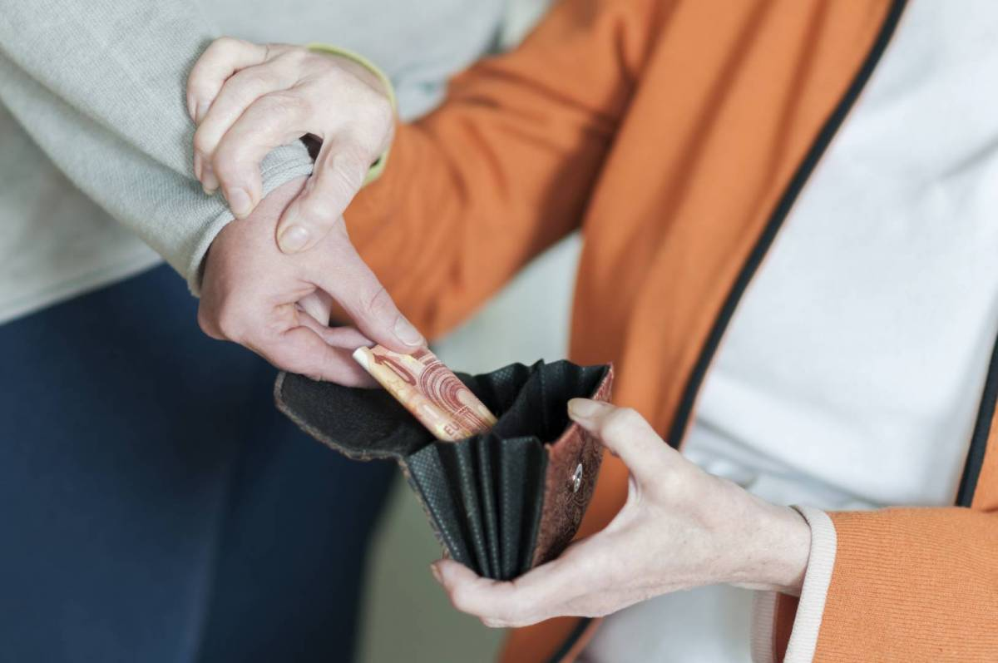
Financial Abuse
It includes tactics used to control an individual’s finances, inheritance, or employment income. It may include denying access to one’s own financial records and knowledge about personal investments, income, or debt, or preventing a partner to take employment outside the home.

Slide 8
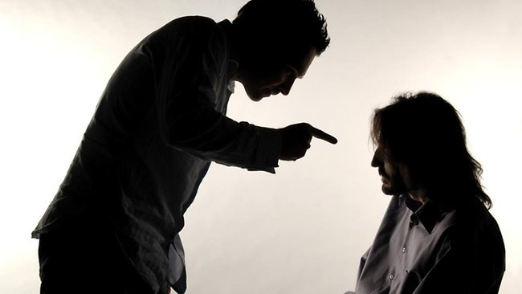
Spiritual Abuse
It involves attempting to destroy an individual’s culture or religious beliefs through ridicule or punishment, forcing someone to practice a religion, or adopt another one.

Slide 9
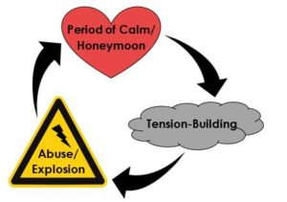
The Cycle of Abuse

Slide 10
The Cycle of Abuse: Stage 1
Stage 1 - Tension-building: The abuser attacks the other partner using insults and other verbal attacks. The victim tries to be compliant and feels helpless.

Slide 11
The Cycle of Abuse: Stage 2
Stage 2 - Violent episode/Exploitation: Built-up tensions erupt into incidents ranging from severe verbal/emotional abuse to physical/sexual abuse and can last from a few minutes to a few days. The victim is most likely to be seriously injured or killed by the abusive partner at this time.

Slide 12
The Cycle of Abuse: Stage 3
Stage 3 - Honeymoon stage: Following a violent episode the abuser is usually apologetic and attentive. The victim once again recognizes the person he or she fell in love with. The victim may accept promises from the abuser that “it will never happen again.”

Slide 13
Teen Dating Violence Videos
https://www.youtube.com/watch?v=8wem8wzU5zw
https://www.youtube.com/watch?v=iwuy5UZy3Gw

Slide 14
Other Warning Signs in Relationships

Slide 15
Other Relationship Warning Signs
Bullying: It is “when someone hurts or scares another person on purpose and the person being bullied has a hard time defending themselves.”
Discrimination: According to the Canadian Human Rights Commission, it is “an action or a decision that treats a person or a group badly for reasons such as their race, age or disability.”
Harassment: The Ontario Human Rights Commission defines harassment as "engaging in a course of vexatious comment or conduct that is known or ought reasonably to be known to be unwelcome.”

Slide 16
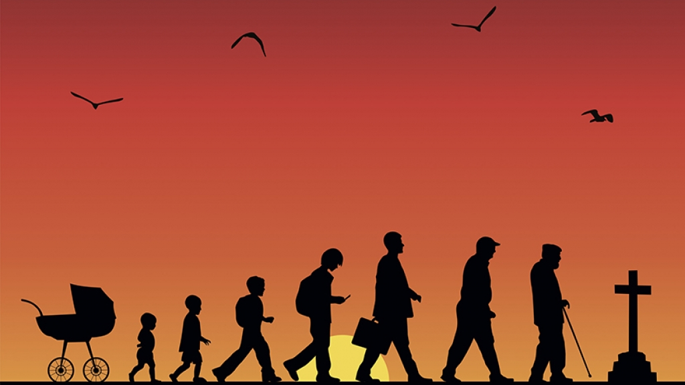
Human Dignity

Slide 17
Human Dignity
When relating to one another, the Catholic Church calls us to respect human dignity.
In the Catechism of the Catholic Church, it states:
“Every person, from the first moment of his/her life in the womb, has an inviolable dignity, because from all eternity God willed, loved, created, and redeemed that person and destined him for eternal happiness.”

Slide 18
Human Dignity: Key Teachings
Every human being has worth.
Humans have value from the moment of conception onward.
One’s social, physical, intellectual, emotional, spiritual, or financial state does not determine his/her worth.
In God’s eyes, every person is equal and deserving of happiness.

Slide 19
Other Signs of Healthy Relationships
Mutual respect
Trust
Loyalty
Honesty
Compromise
Individuality
Good communication
Anger control
Problem solving
Understanding
Self-confidence
Being a good role model
Unconditional love
Forgiveness
Patience

Slide 20
Source
https://sapac.umich.edu/article/49
https://www.bullyingcanada.ca/what-is-bullying

