Slide 1
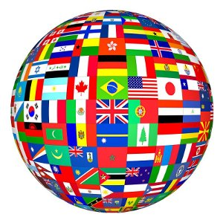
What is Culture?

Slide 2
What is Culture?
List 3 words that come to mind
Write 2 questions that come to mind
Create a metaphor or simile (eg. “Culture is like…)

Slide 3
Who’s got culture?
We usually think of artists, painters, concert pianists, poets, and writers as having culture. They are very important to the life of any culture.
Culture is literally everything; it pervades all we do, how we think, how we speak, how we act, how we dress, how we eat, what games we play, what songs we sing and so on.
When something is close to us it is difficult to define it. The same thing is true of culture.

Slide 4
How to Define Culture
Culture is the set of meanings, beliefs, values, and rules for living shared by groups and societies as the source of their identity.

Slide 5
The Components of Culture

Slide 6
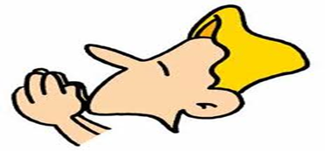
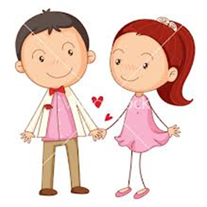
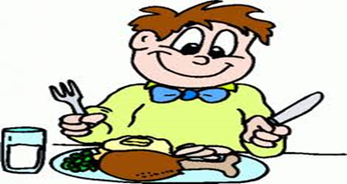
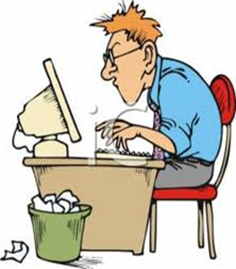
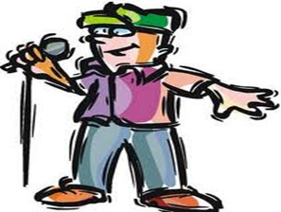
1. Culture has to do with human actions
Examples include:
Speaking
Working
Dating
Praying
Eating
Playing

Slide 7
2. Culture is a set of meanings, beliefs, values, and practices of society
Example: Culture influences the way we eat
meal preparation and service
beliefs about what foods should and should not be eaten
time(s) of day food is eaten

Slide 8
3. Culture identifies me as belonging to a particular group
Example: How do we perform these actions in our family, our Church, in our School, in Canada?
On Canada Day, our town always…..
For Sunday dinner, our family always…..
At Christmas, our parish always…..
Before we begin our meals, our family always…..

Slide 9
Seven Traits of Culture
1. Humans create culture
Only humans have it. Culture is unique to humans.
2. Culture consists of ways of doing things
It is a set of meanings or beliefs about how things should be done.
3. Culture is public
Culture is not about how I do things; it is about how we do things as a group.

Slide 10
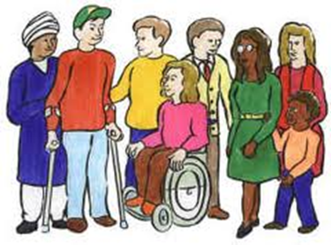
Seven Traits of Culture - continued -
4. Culture arises from tradition
Many of our ways of doing things we inherited from our parents or ancestors. We call these ways traditions.
5. Culture is made up of rule-governed actions
Because many of our ways of doing things come from tradition, we feel that we have a certain duty to keep them. They function like rules.
6. Culture becomes established in institutions
-Over time, these ways of doing things become established and society reaches a consensus about them.

Slide 11
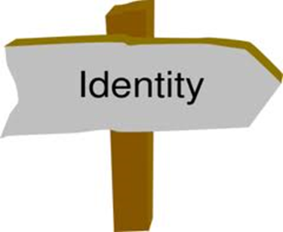
Seven Traits of Culture - continued -
7. Culture gives us identity
The way we do things are the source of our cultural identity. They set us apart from other cultures.

