Slide 1
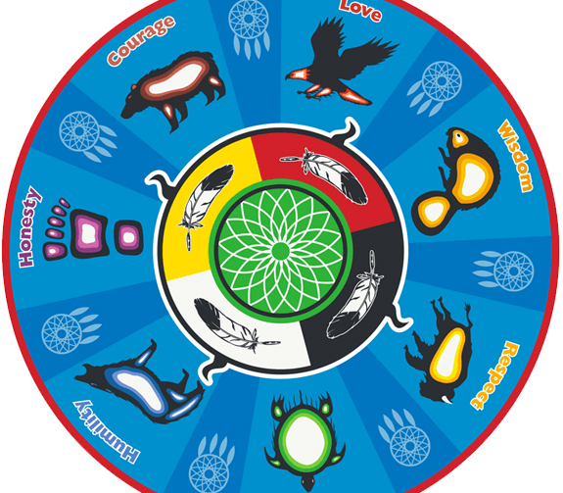
The 7 Grandfather Teachings vs The Beatitudes

Slide 2
Q: What are the Beatitudes?

Slide 3
What are the Beatitudes?
The Beatitudes are important virtues within the Catholic faith.
The Beatitudes bear many similarities to the Seven Grandfather teachings.
From a Christian standpoint, the Beatitudes are stepping-stones to the Kingdom of God.
Jesus first shared the Beatitudes during his famous sermon on the mount.
Let's watch some short videos to review these teachings:
https://www.youtube.com/watch?v=BTO7-Jarl-E
https://www.youtube.com/watch?v=wxWCspyE7lg

Slide 4
Your Task:
You and 1-2 of your classmates will be assigned one of the Beatitudes.
Using your knowledge and the reference sheets, complete the following activities:
1. Identify one Grandfather Teaching that you think is similar to your assigned Beatitude. Explain why you see similarities between the two virtues. You may list your ideas on the chart paper that is provided.
2. Identify one value that you think is the opposite of the Grandfather teaching and Beatitude you matched up (ex. Dishonesty, greed, hate).
3. Identify one example of how the Grandfather Teaching/Beatitude you compared can be put into practice.
4. Present your ideas to the class.

