Slide 1
Central Beliefs of Buddhists

Slide 2
The Three Jewels
The Buddhist creed can be summed up as the Three Jewels.
The Three Jewels are central to Buddhists and refer to:
The founder of Buddhism (the Buddha)
The Buddha’s teachings (dharma)
The Buddhist community (sangha)
* Buddhists believe that meaning can be found in our troubled world through the Three Jewels.

Slide 3
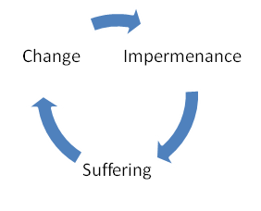
The Three Marks of Existence
The Buddhist view of the material world is based on three understandings, or marks, of existence:
Impermanence (Anicca)
Nothing in the world stays the same
Everything is in a “process of flux” (coming into being and passing out of being endlessly)

Slide 4
The Three Marks of Existence
2. Suffering (Dukka)
Suffering is an inevitable part of life (eg. Birth, old age, death, etc.)
We need to detach ourselves from improper behaviour (eg. Seeking pleasure)

Slide 5
The Three Marks of Existence
3. No self (Anatta)
There is nothing enduring about animals or humans
Nothing has a soul
There is no permanent self because every being is constantly changing
Every being is a bundle of energy
Our energy moves to a new body when we die
Scientific support for this theory: no molecule in our body was part of us 7 years ago

Slide 6
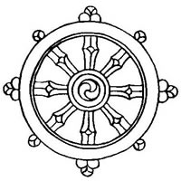
Samsara
Means “the wheel of rebirth”
Refers to the Buddhist belief that our existence is a like a cycle: we live, die, and are reborn
The cycle of rebirth is one of endless suffering
Reaching Nirvana liberates a person from Samsara

Slide 7
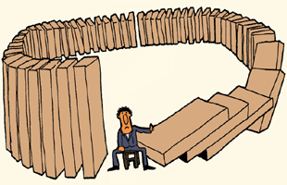
Karma
Means “action”
Refers to the “Law of cause and effect
Our current status is the direct result of our previous lives
Buddhists believe that the decisions, behaviours, and attitudes from our previous lives influence our current life
Good karma helps free us from the cycle of rebirth

Slide 8
Nirvana
Means “blowing out”
Buddhists believe nirvana frees us from Samsara (cycle of rebirth)
All selfish desire and suffering cease to exist in Nirvana
One experiences eternal bliss in Nirvana
Nirvana is the ultimate goal for Buddhists

