Slide 1
Jewish Symbols and Sacred Objects

Slide 2
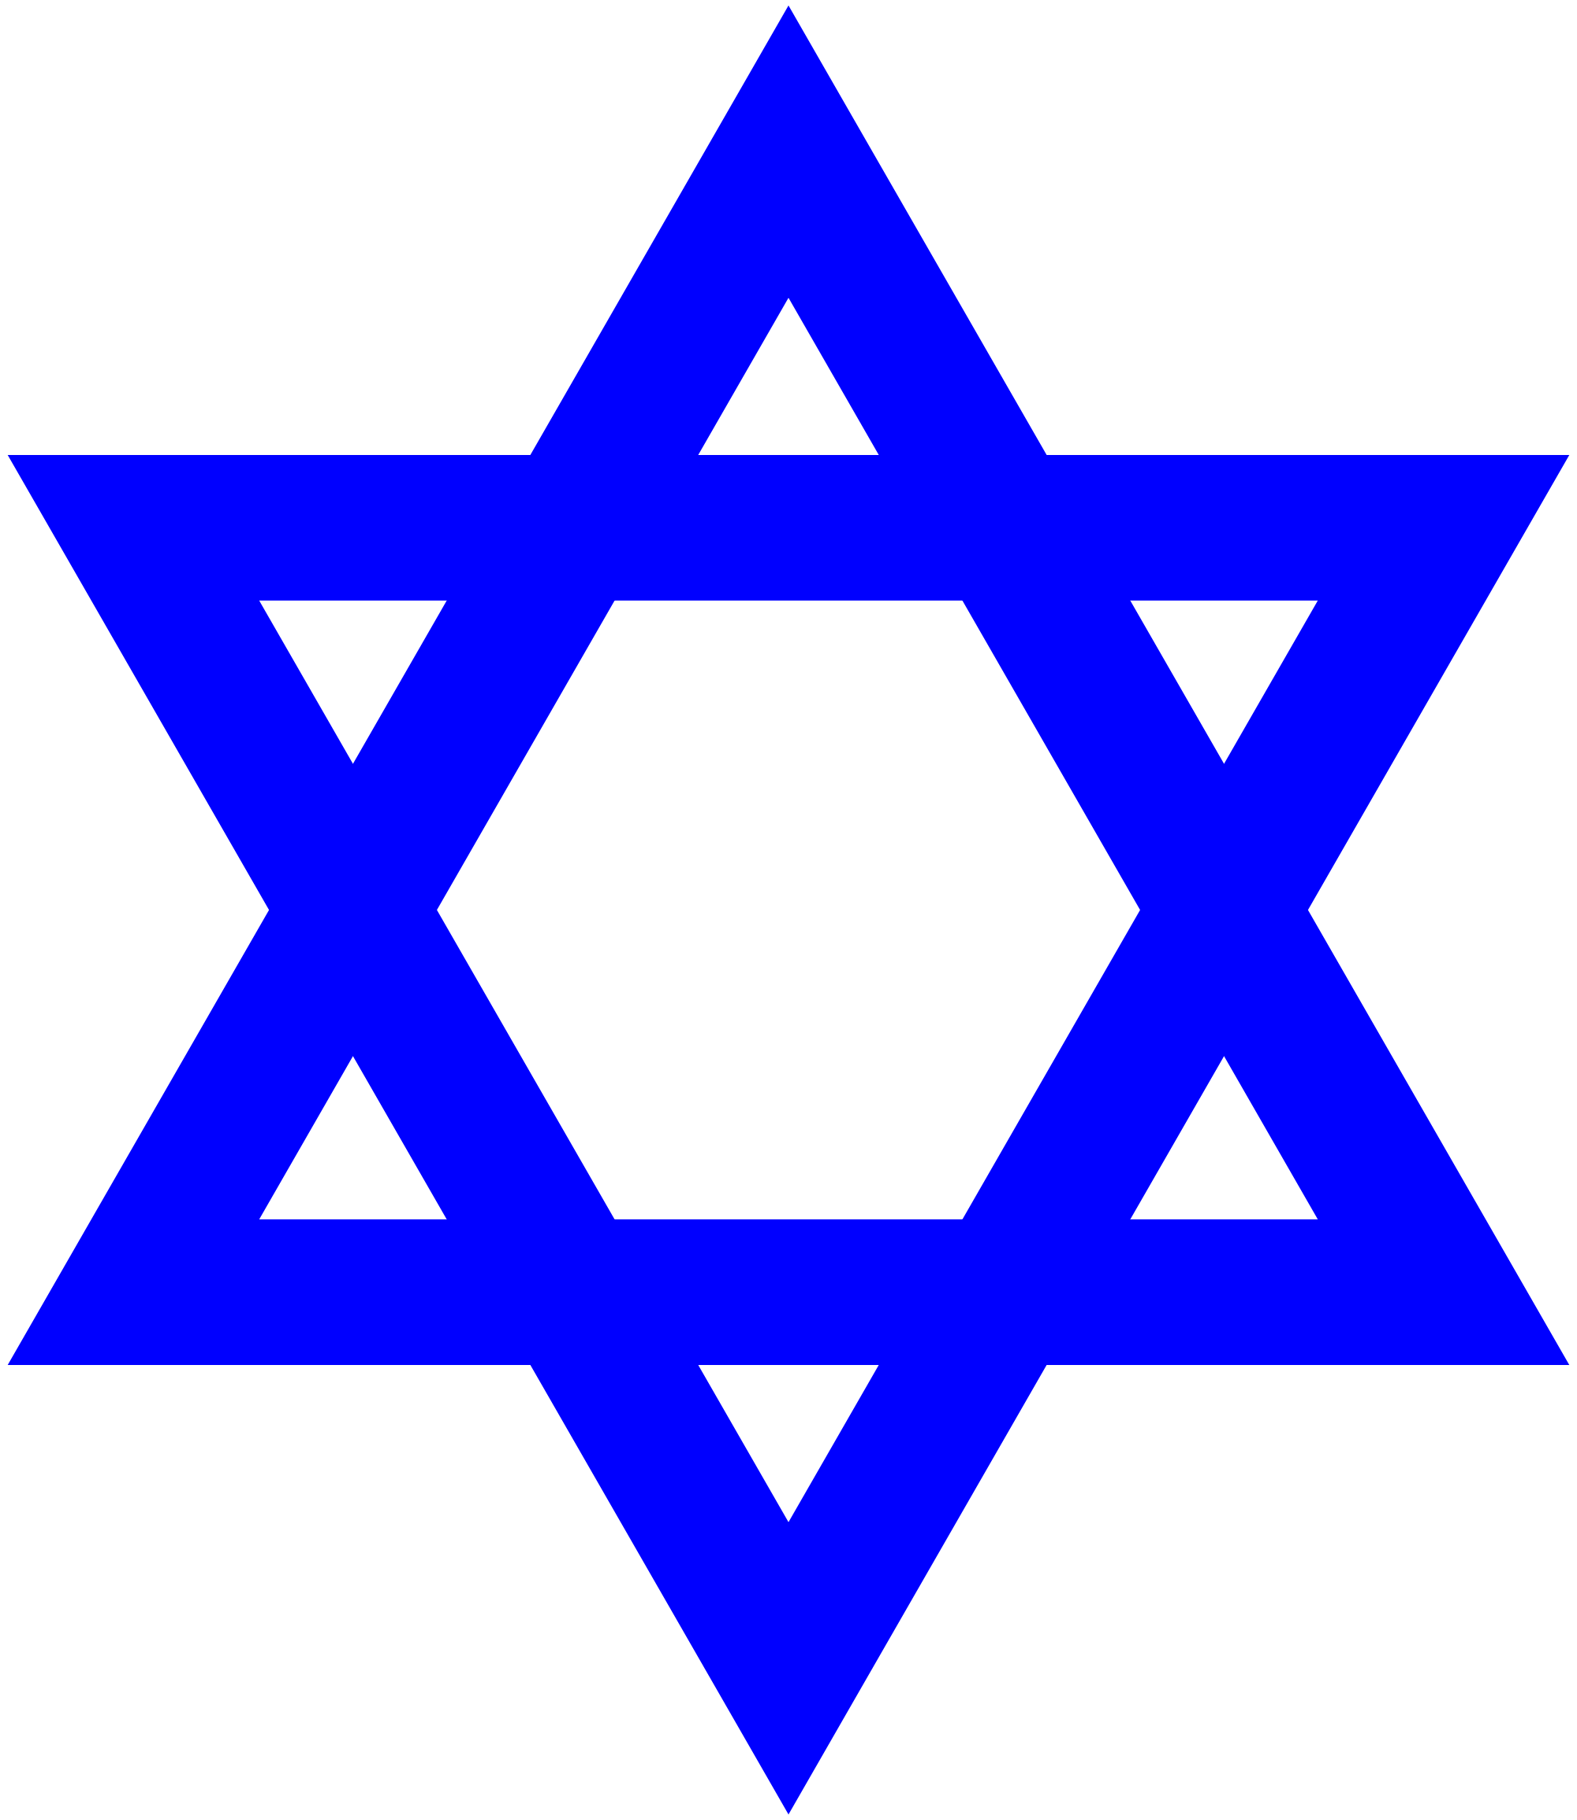

Slide 3
The Star of David
Significance
When/Where It is Used
7 spaces recognizing the 7 days of creation
Used on the Shield of King David to win battles
Used on: 1) the shield of David, 2) Israeli Flag, and 3) symbol of Jews

Slide 4
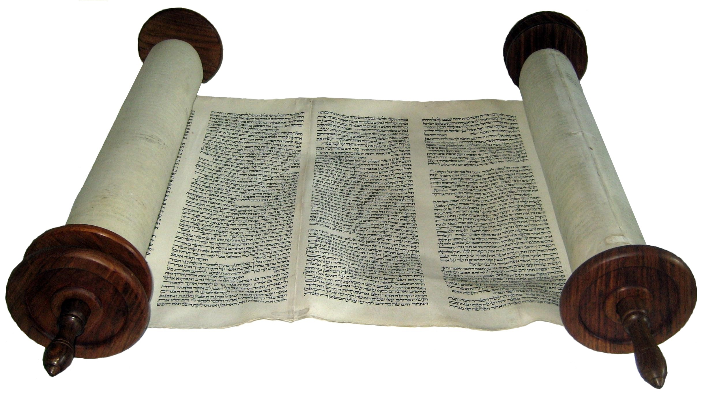

Slide 5
Torah Scrolls
Significance
When/Where it is Used
Contains the Torah (teaching) and is central to the Jews
Most important object used at synagogue services
Used to study for Jews
Recited from at Bar/Bat Mitzvah

Slide 6
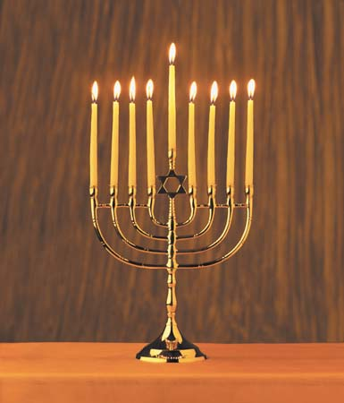

Slide 7
Menorah
Significance
When/Where it is Used
7 branched candelabra
Recognition of the miracle of Maccabees when the oil lasted for 7 days
Used in the synagogue to represent Israel as “the light unto nations”
Central symbol of Hanukkah

Slide 8
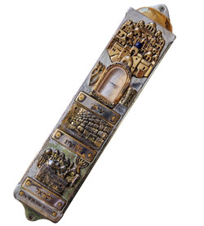

Slide 9
Mezuzah
Significance
When/Where it is Used
A special box that contains the Shema, the central prayer of the Jews
Means God is present in the house
Mounted on right side of door frames (except bathroom doors)
Strict Jews touch it as they pass by and kiss their fingers to express love of God

Slide 10
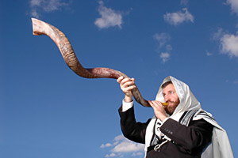

Slide 11
Shofar
Significance
When/Where it is Used
A ram’s horn blown as a celebration of God’s Creation and heralding the Messiah
Used as a “Call to Prayer” on special occasions like Rosh Hashanah and Yom Kippur

Slide 12
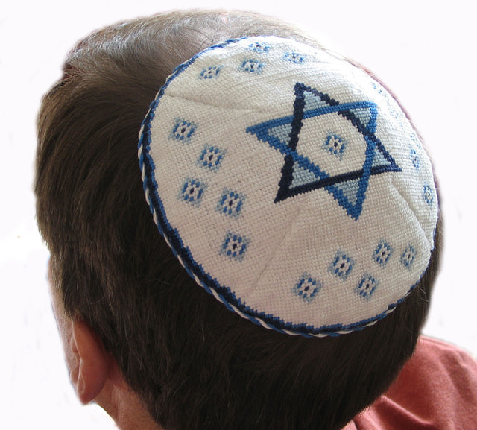

Slide 13
Kippah/Yarmulke
Significance
When/Where it is Used
A skull cap that beautifully embroidered and worn as respect for God by covering the head.
Worn during prayer/Torah study and synagogue services
Strict Jewish males wear them all the time

Slide 14
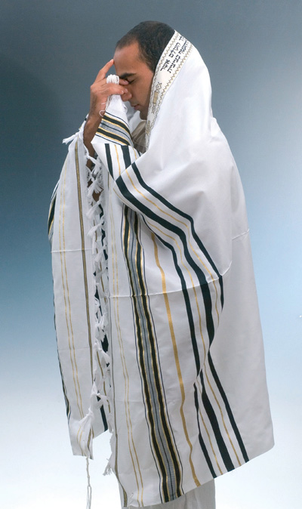

Slide 15
Tallit
Significance
When/Where it is Used
A prayer robe/shawl made of silk/wool with 613 tassels on the fringe for the Commandments
Worn during prayer/Torah study and at mourning synagogue services

Slide 16
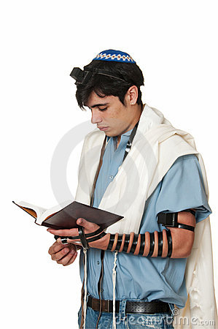

Slide 17
Tefillin
Significance
When/Where it is Used
A leather strap with two leather boxes attached (1 by heart and 1 on forehead) containing quotes from the Torah and/or the Shema
Worn during prayer/Torah study at a synagogue service
To represent God is in our mind and in our heart

