Slide 1
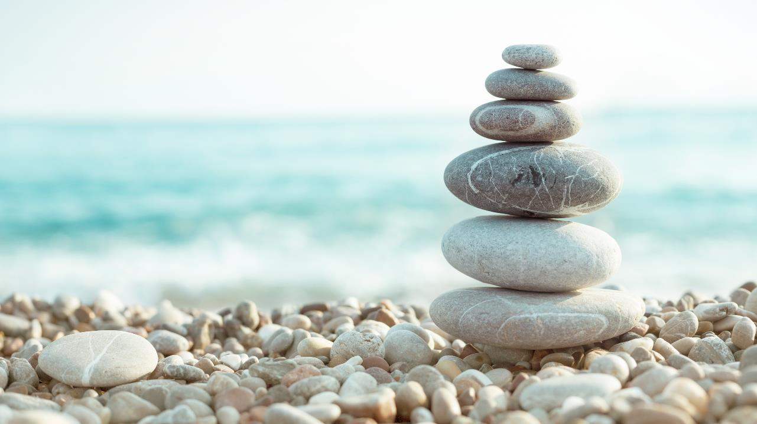
Aboriginal Spirituality:
Common Rituals

Slide 2
Your Task:
Read page 79 – 84 in the textbook and make notes on the following Aboriginal rituals using the handout:
Smudging
Sacred Pipe Ceremony
The Sweat Lodge
Birth and naming rituals
Vision Quest
Death rituals
Harvest Feast
The Powwow
Giveaways and the Potlatch

Slide 3
An Overview of Aboriginal Rituals
*Instructions: Please take out the notes you made on the Aboriginal rituals that were listed during our previous class.

Slide 4
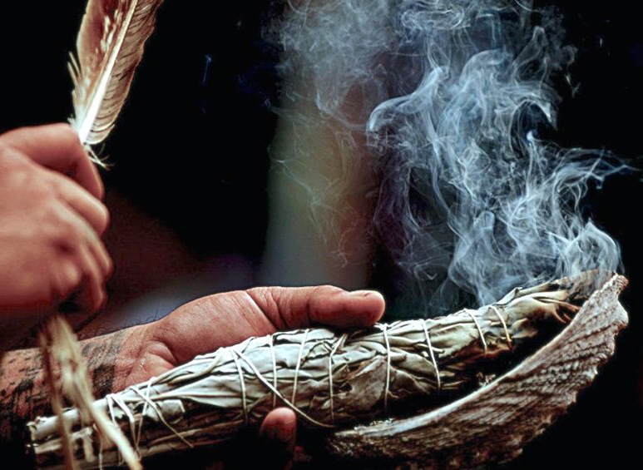
Smudging
What is the purpose of smudging?
What happens during a smudging ceremony?
https://www.youtube.com/watch?v=ut65c91FLKI

Slide 5
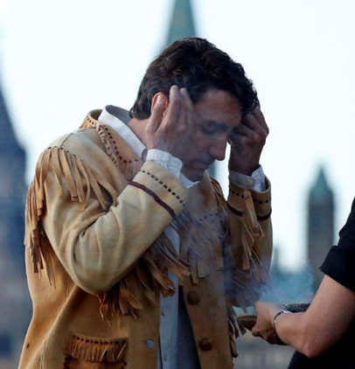
Smudging
Smudging is a holy act.
Sacred herbs are burned in a shell or earthen bowl, and then the smoke is brushed or washed over the eyes, mouth, ears, hands, heart, and whole being of each participant.
The cleansing smoke can purify people and places before important events.
The ashes are holy.
The ashes are returned to the earth after the ceremony.

Slide 6
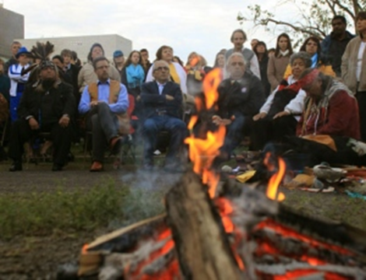
The Sacred Pipe Ceremony
What happens during a Sacred Pipe Ceremony?
What are the symbolic elements in this ceremony?
https://www.youtube.com/watch?v=-gFeXjCIVpQ

Slide 7
The Sacred Pipe Ceremony
It is one of the most powerful and sacred spiritual rituals for Aboriginal .
Pipe symbolizes unity and harmony of the world.
Pipe carrier will pray that the whole universe and all it contains will be transferred to the pipe.
The Great Spirit is all that the pipe contains when it is lit.
Stone bowl of the pipe represents truth.
Stem represents the way we are to live (eg. In harmony with nature)
Bowl represents the woman and stem represents the man.
Joining the bowl to the stem symbolizes unity and balance between man and woman.

Slide 8
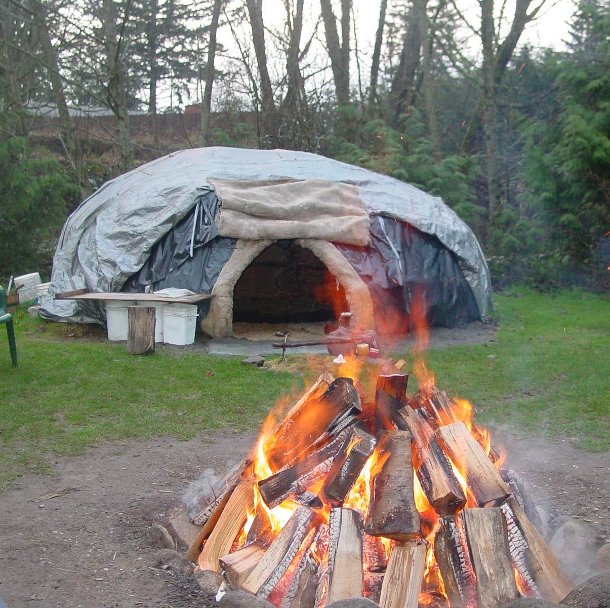
The Sweat Lodge
What are the goals of this ceremony?
What is a sweat lodge?

Slide 9
The Sweat Lodge
The goals of this ceremony are to purify the body, mind, spirit, and heart, and to restore right relationships with self, others, the Creator, and all of creation.
A sweat lodge is a closed structure built around a pit into which rocks are placed during the ceremony.
The sweat leader pours water onto the hot rocks to create steam.
Participants return to the womb and the innocence of childhood.

Slide 10
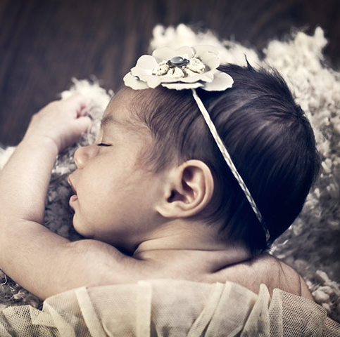
Birth and Naming Rituals
Who is often asked to be the name-giver of an infant?
Ultimately, who inspires the name of an infant?

Slide 11
Birth and Naming Rituals
Usually a grandparent or elder will name a child.
The name-giver will often go into a period of fasting, meditation, prayer, or dreaming for inspiration.
The name that the name-giver is inspired to give the child is the name the Great Spirit selected.

Slide 12
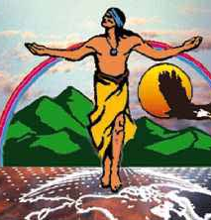
The Vision Quest (Puberty)
Are vision quests meant for young or old members of the Aboriginal community?
What is the purpose of the vision quest?

Slide 13
The Vision Quest
A vision quest is a journey that is undertaken by a young person.
It is a journey that allows a young person to come of age and be accepted as an adult in the community.
It has been described as an intense, solitary, and spiritual experience.
Traditionally the young person who is on the quest prays and deprives themselves of food and sleep until they encounter a spirit helper who gives them guidance for the future.
The spirit helper usually appears through a dream, vision, or phenomenon of nature.

Slide 14
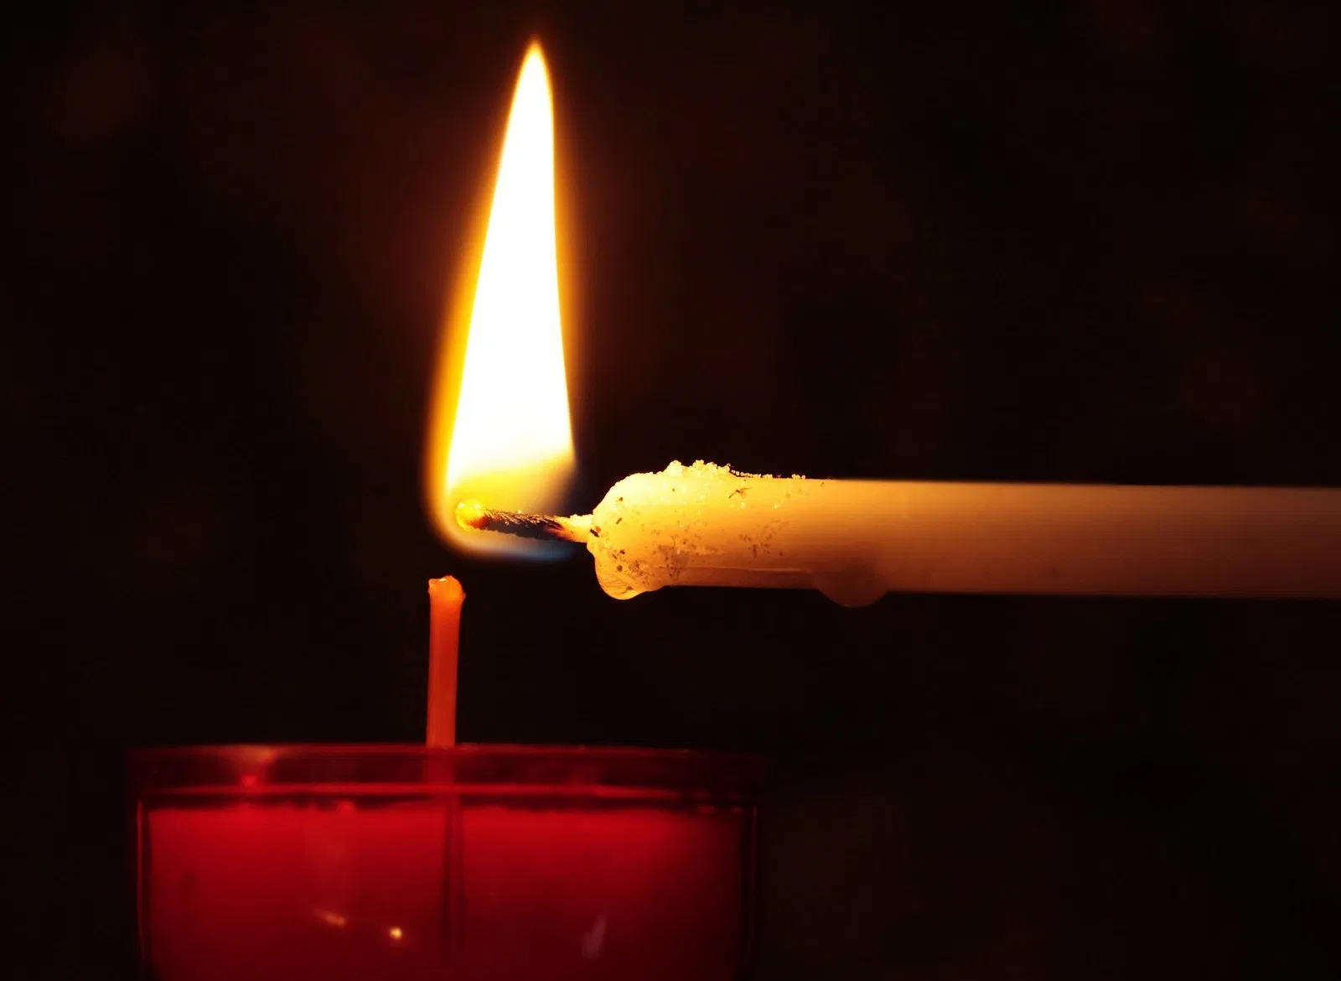
Death Rituals
What are some rituals that may be held to honor the dead?

Slide 15
Death Rituals
A Death Feast may be held for the spirit of the person who has passed away (after the individual has been given a suitable amount of time to become refamiliarized with being a spirit).
A wake may be held to help someone who has died return to the body of mother earth. This may involve a round dance. A round dance is a ceremony to commune with spirits who have passed to the spirit world.

Slide 16
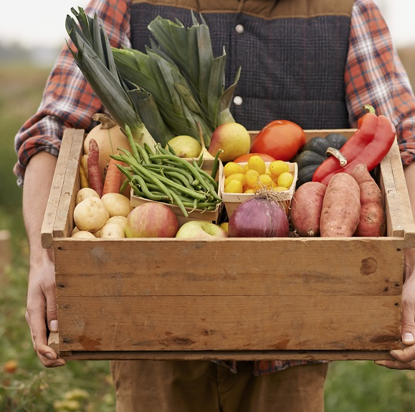
Harvest Feast
When does the Harvest Feast take place?
What is the purpose of this Feast?

Slide 17
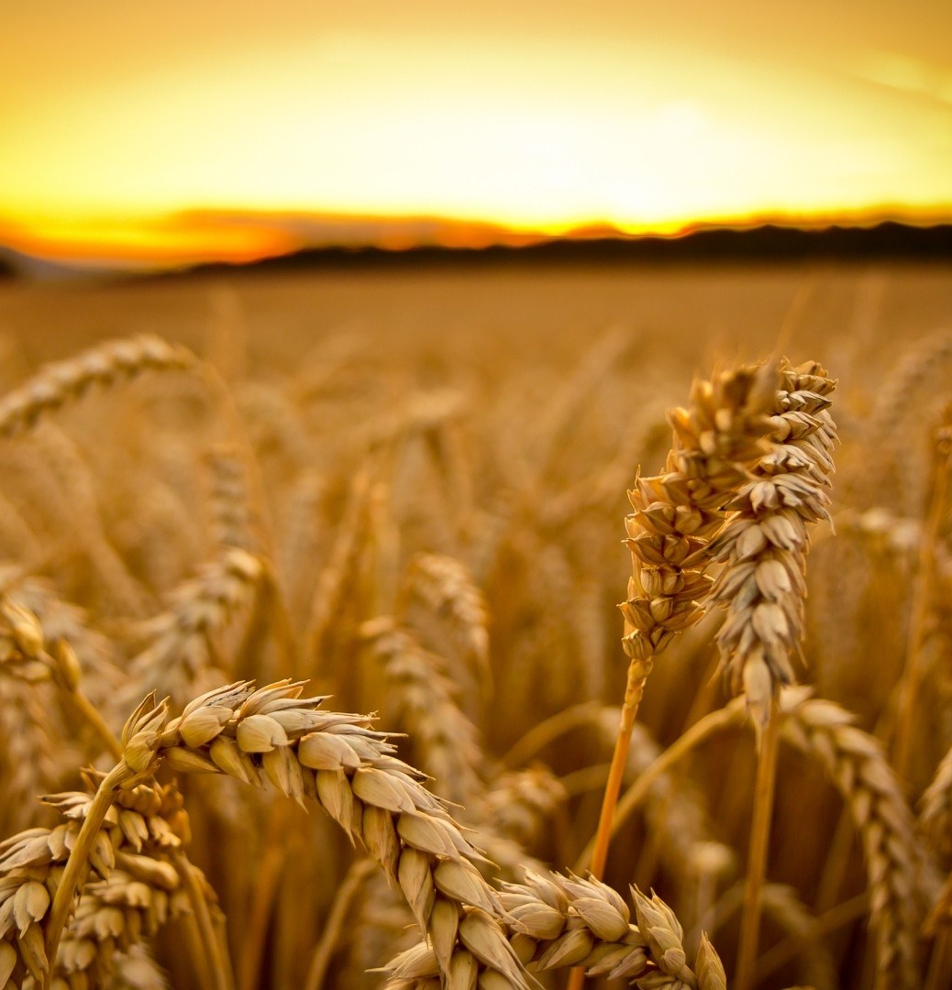
Harvest Feast
The Harvest Feast occurs during harvest time.
This is a time for Aboriginals, especially farmers, to celebrate the harvest from the field and forest.
Aboriginals believe that the spirits must be credited with providing them with food.
It is also a time to renew the earth with prayers, chants, and dances.

Slide 18
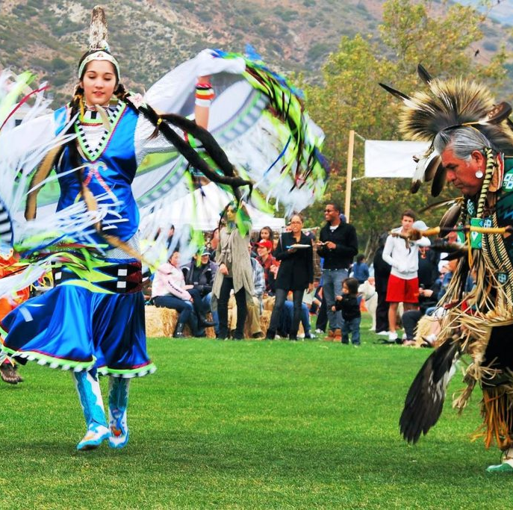
The Powwow
What is celebrated?
What happens during this dance?
What does the drumbeat symbolize?
https://www.youtube.com/watch?v=on9bnvuOLtE

Slide 19
The Powwow
This is a special Aboriginal dance that promotes the renewal and restoration of right relationships and the healing of all creation.
Community members come together to sing, dance, and celebrate their identity, heritage, and language.
Powwows occur in a circle formation.
Dancers and singers enter the circle from the direction the sun rises (east) and then move in a clockwise direction (the same direction the sun moves).
A drum will be beaten to symbolize the solemn rhythm of creation, the heartbeat of Mother Earth, and the heartbeat that all hear in their mother's womb.

Slide 20
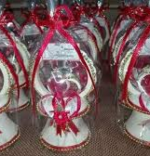
Giveaways and Potlatches
What are potlatches like in mainstream society?
How are Native potlatches different than those experienced in mainstream society?

Slide 21
Giveaways and Potlatches
The Giveaway: This is a ritual that may be held in honor of a special event (ex. A birth or wedding) or in honor of someone who has died. Gifts are commonly given out during giveaways. Dancing and singing may also accompany these rituals.
Potlatches: These rituals may also commemorate important events. The individual who hosts a potlatch may see their social status increase. Members of the community may use the opportunity to recognize the generosity, wealth, and power of the person hosting the potlatch.

Slide 22
Source
World Religions: A Canadian Catholic Perspective. Nelson Education.

