Slide 1
Religious vs Secular Views

Slide 2
Atheist vs Agnostic Outlooks *Please copy the definitions.
Atheism
Agnosticism
This is the belief that there is no such thing as the sacred.
It means "without God belief."
Agnosticism does not believe it's possible to know one way or the other whether there is a sacred realm.
There might be a God or there might not.

Slide 3
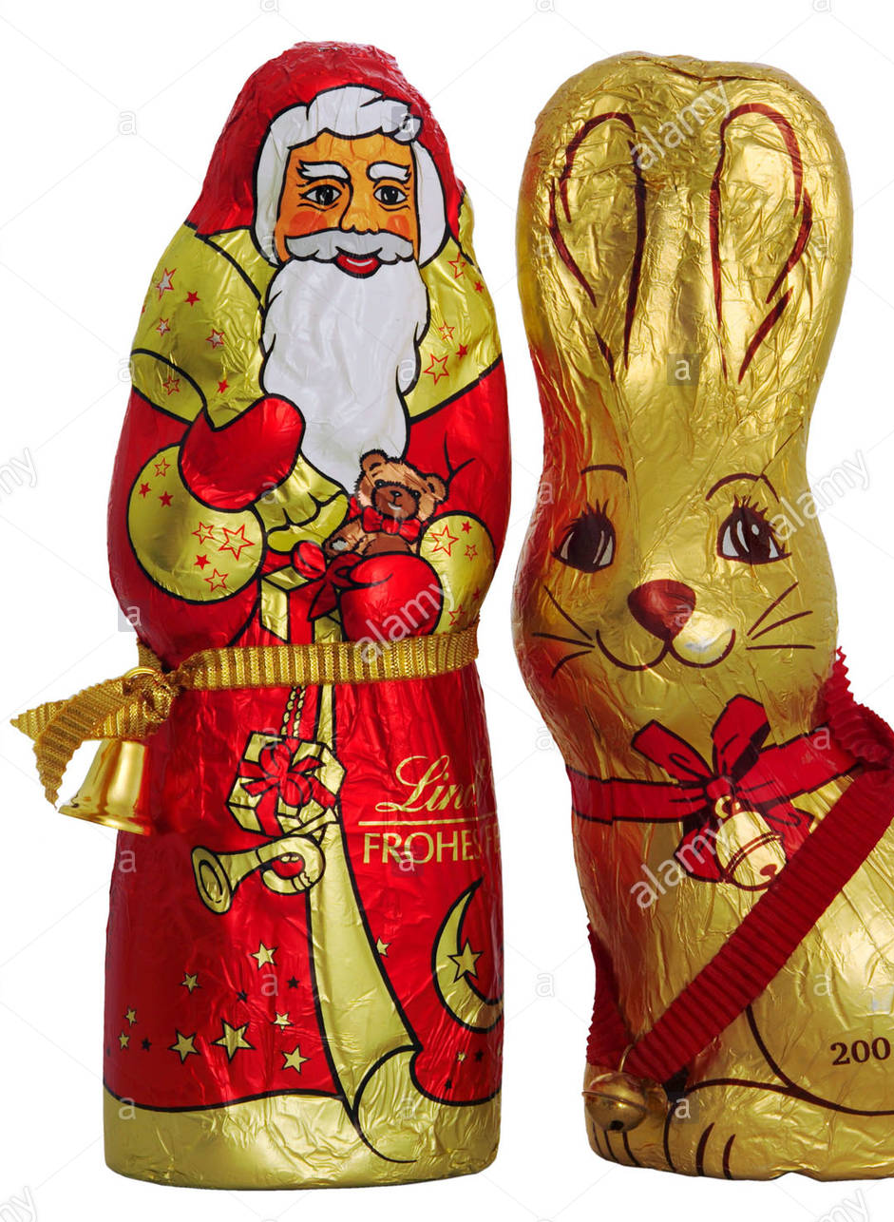
Activities
You will be placed in a group.
Please sit with your group and then complete the following tasks using the chart paper and markers that are provided:
- Identify reasons why some people are falling away from their faith and developing a secular outlook.
- Identify examples of ways that Christmas and Easter are becoming secular.
3. Be prepared to share your ideas with the class.

