Slide 1
The Holocaust

Slide 2
Discussion:
What words come to mind when you think about the Holocaust?

Slide 3
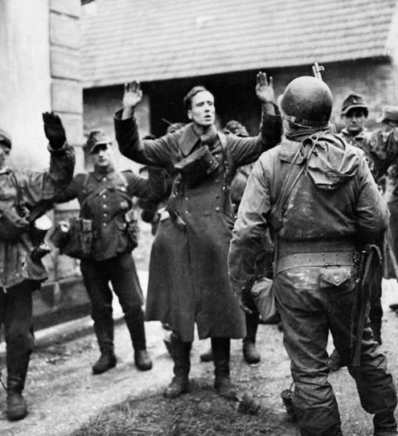
What was the Holocaust?
The Holocaust refers to the Nazis’ attempt to exterminate Jewish people.
Shoah is a Hebrew word that is often used to identify the Holocaust.
Shoah comes from the Hebrew word for “catastrophe,” “calamity,” or “holocaust.”

Slide 4
Why were Jewish People Targeted?
Adolf Hitler became chancellor of Germany in 1933.
Hitler considered Jews to be from an “inferior race” and declared them enemies of the state.
Hitler also blamed Jews for Germany’s loss in World War I and for Germany’s economic problems during the Great Depression of the 1930’s.

Slide 5
How were Jewish people mistreated?
Jews were imprisoned, starved, forced to do heavy manual labour, medically experimented on, tortured, and killed.
Many Jewish people were sent to concentration camps. These camps were set up to:
imprison people who the Nazis viewed as a security threat
eliminate Jewish individuals and groups (away from the public eye)
use Jewish people to do forced labour (fill the labour shortage)

Slide 6
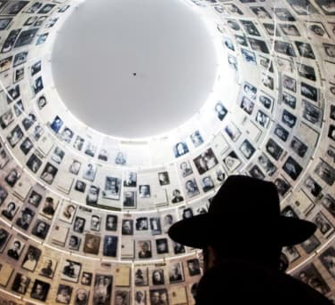
How Many Jewish People Lost Their lives?
It is estimated that 6 million Jewish people died as a result of the Holocaust.

Slide 7
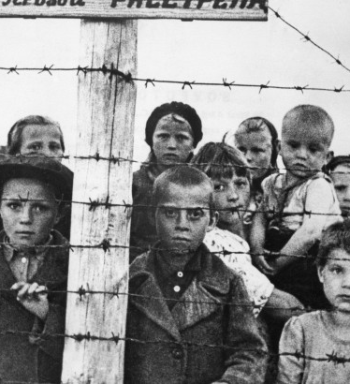
What is Anti-Semitism?
Anti-Semitism refers to opposition to and discrimination against Jews.
The Holocaust is an example of Anti-Semitism.

Slide 8
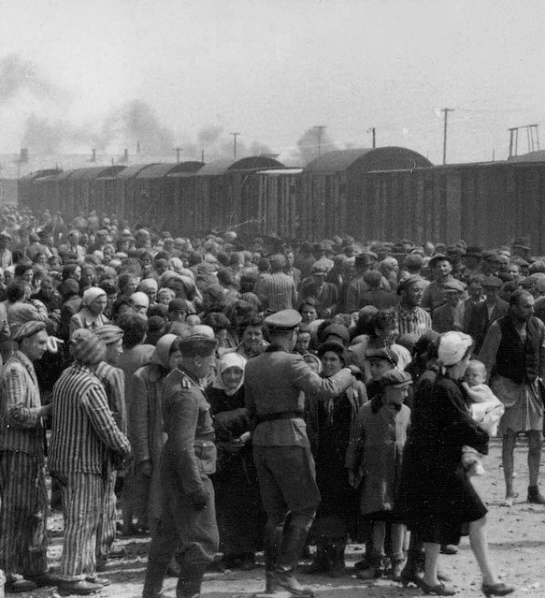
Was the Holocaust an act of Genocide?
Yes, the Holocaust was a deliberate and systematic attempt to destroy Jewish people.

Slide 9
Textbook Work:
Read p. 114-116 and do the following in your notebook:
Identify the effects of the Holocaust on the Jewish community.
Define Zionism.
Identify what the UN decided to do in 1947 and how this decision affected Arabs living in Palestine.
Identify what happened on May 14th, 1948 and the consequences of this event.

Slide 10
Sources
Concentration Camps 1933-39. Retrieved from: https://encyclopedia.ushmm.org/content/en/article/concentration-camps-1933-39

