Slide 1
The Residential School System

Slide 2
What comes to mind when you think about the residential school system?

Slide 3
A Brief Visual Reminder of Residential Schools (Heritage minute)
https://www.youtube.com/watch?v=v_tcCpKtoU0

Slide 4
Why were residential schools opened?
A movement to educate Aboriginal children was initiated by a group of European settlers.
These Europeans believed that Aboriginals should be assimilated into the European way of living.
The Europeans believed that the Aboriginal culture was backwards and wrong.
Review: what is assimilation?

Slide 5
Who operated residential schools?
The residential schools were operated by four different churches.
These churches include:
The Roman Catholic Church
The Anglican Church
The United Church
The Presbyterian Church

Slide 6
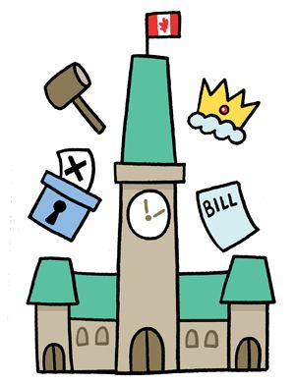
Who funded Residential schools?
The federal government funded the residential schools system from the 1840s to 1969.
Note: The last residential school did not close until 1996.

Slide 7
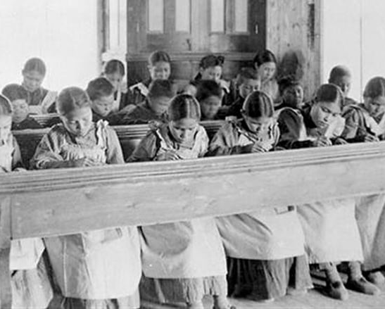
How many Aboriginal children attended residential schools?
Approximately 100, 000 to 150,000 Aboriginal children attended residential schools.

Slide 8
How did residential schools try to assimilate aboriginals into mainstream society?
Students were forbidden from practicing their culture.
Students were separated from their families.
Harsh discipline was used to “keep the children in line.”
Examples: isolation cells, flogging, whipping, and humiliation.

Slide 9
Activity: 5 minutes
Either list or draw all the things that are important to you in your life right now. Try to draw or list things that are tied to your identity.

Slide 10
Imagine…
What would it feel like if your identity was taken away?

Slide 11
What were the effects of residential schools on the students?
Loss of Aboriginal language, traditional spirituality, and culture.
PTSD: some children were physically, mentally, or sexually abused.
Detachment from family: children lost parental love and attention during their most formative years.

Slide 12
A Government apology
https://www.youtube.com/watch?v=p8CCAJzaT3I

Slide 13
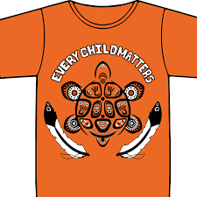
What is the story behind Orange shirt day?
https://www.youtube.com/watch?v=o3P3TzGpicA

Slide 14
One of many stories shared:
Chief Robert Joseph shares his experience as a residential school system survivor and the road to reconciliation:
https://www.youtube.com/watch?v=2zuRQmwaREY

