Slide 1
Agents of socialization

Slide 2
Agents of Socialization
Primary Agents of Socialization
Secondary Agents of Socialization
Family
School
Peer groups
The workplace
Media
Religion

Slide 3
Group Activity:
In groups of 4-5, you will be asked to consider how either families, schools, peer groups, workplaces, media, or religions shape our beliefs, skills, values, and behaviours.

Slide 4
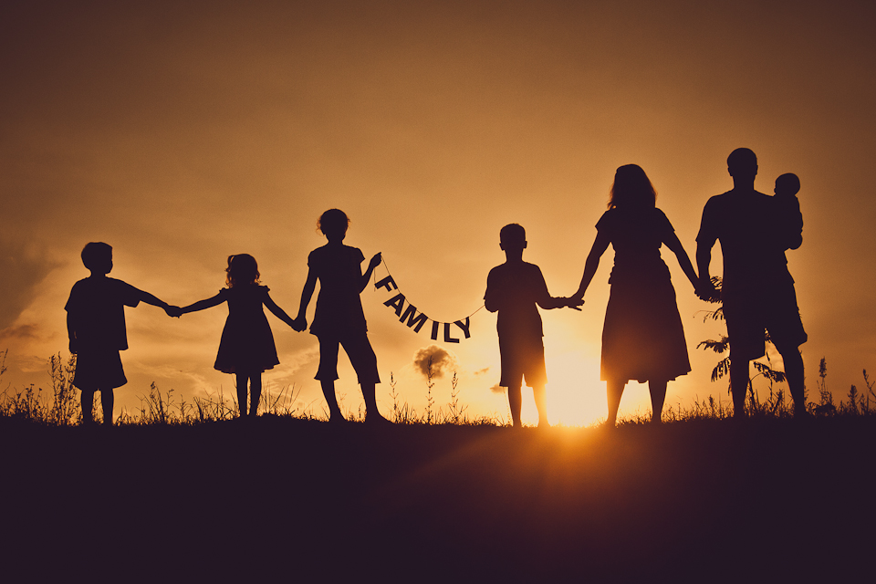
The Primary Agent of Socialization: The Family
The family is the primary agent of socialization because it shapes one’s behaviour throughout life.
The family is expected to meet an individual’s most basic needs and provide the beliefs needed to survive in this world.
An individual learns about social
behaviour from their family.

Slide 5
Defining Family
According to the Vanier Institute of the family, “a family is any combination of two or more people who are bound together over time by ties of mutual consent, birth, and/or adoption or placement and who, together, assume responsibilities for some or all of the following:
Physical maintenance and care of group members
Addition of new members through procreation or adoption
Socialization of children
Social control of members
Production, consumption, and distribution of goods and services
Affective nurturance (love)

Slide 6
Family Structures
Nuclear Family:
A family that consists of spouses and their dependent children.
Extended Family:
A family system in which several generations live together in one household.
Lone-parent family:
A family that consists of one parent living with one or more dependent children.

Slide 7
Family Structures
Blended family:
A family in which divorced partners with children from a previous union marry.
Same-sex family:
A family that consists of two individuals of the same gender with children.
Interracial family:
A family that consists of parents from different racial or ethnic backgrounds with children.

Slide 8
School
Schools generally transmit a set of standard knowledge and skills to students
A hidden curriculum is taught at school
It models a certain set of beliefs and attitudes and endorses specific behaviour in different situations
Praise and positive reinforcement are essential

Slide 9
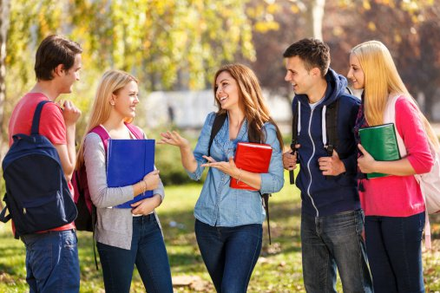
Peer Groups
Peers are especially influential during adolescence
New skills can be gained or honed in peer groups (eg. communication, compromise, etc.)
Adolescent peer groups often teach individuals about sexual relationships, gender, and culture
Peer groups often cling to beliefs and values promoted in the media
https://www.youtube.com/watch?v=ExkY_fGcD78

Slide 10
The Workplace
The workplace can be a valuable
learning environment
It can teach one how to collaborate with a diverse group of people
Individuals are often actively setting and achieving goals
The importance of making a living and supporting a family are learned

Slide 11
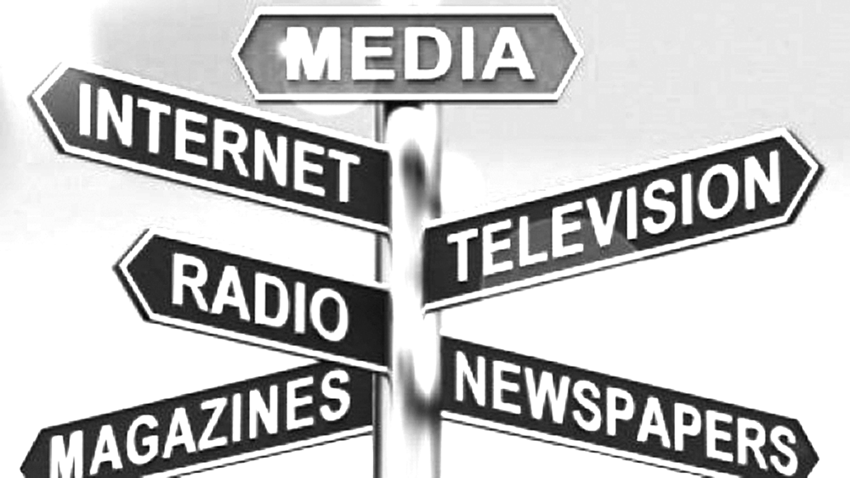
Media
The media can shape our identity
and self-esteem
One’s personal appearance may be
influenced
Media may spark new goals
The media often normalizes certain behaviours (eg. violent acts)
The media can be a bridge to discovering new cultures and ideas
Creativity and expression can be sparked through exposure to certain forms of the media

Slide 12
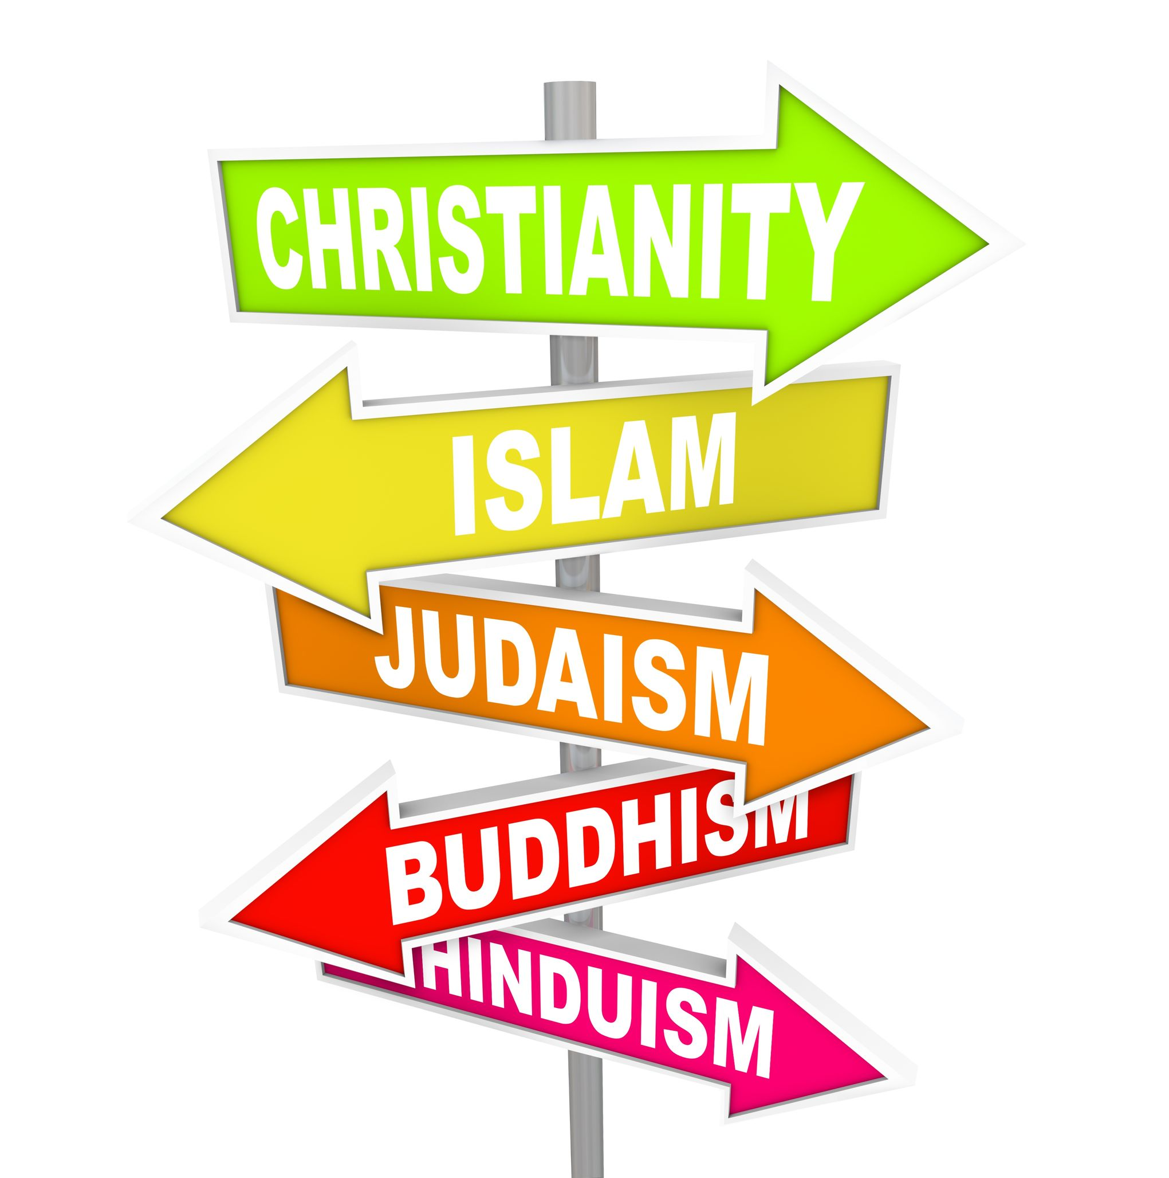
Religion
Religions are influential because they:
have moral codes
set standards of behaviour for
members
teach responsibility for others
encourage charity

Slide 13
Sources:
Social Science: An Introduction. Canada: McGraw-Hill Ryerson, 2011, p. 124-127.

