Slide 1
An Introduction to Socialization

Slide 2
Think-Pair-Share:
With your elbow partner, discuss the following quote. Consider what it means and whether or not it is true.
“Youth, like pristine glass, absorbs the prints of its handlers.”

Slide 3
Sociology and Socialization
Sociologists are interested in how we learn to function in society.
Socialization is a word commonly used to describe the process where an individual learns:
1. basic skills (ex. good hygiene)
2. socially accepted goals (ex. employment)
3. roles and behaviours (ex. how to behave in school)

Slide 4
The Categories of Socialization
The process of socialization can be divided into four categories:
Primary socialization
Secondary socialization
Anticipatory socialization
Resocialization

Slide 5
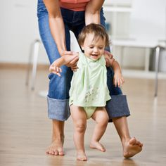
Primary Socialization
This is the process of learning the basic skills needed to survive in society.
Examples: hygiene, eating with utensils, how to use language, and how to dress appropriately.

Slide 6
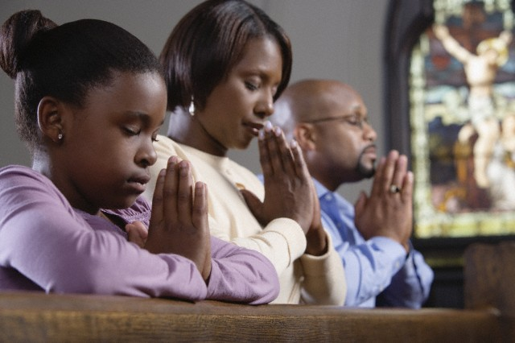
Secondary Socialization
This is the process of learning how to behave appropriately in group situations.
Examples: how to behave in a sacred space like a church or how to behave while taking public transit.

Slide 7
Anticipatory Socialization
This is the process of learning how to plan the way to behave in new situations.
Example: Using your prior knowledge of special occasions to think ahead and anticipate the type of clothing, language, and behaviour required for your cousin’s wedding.

Slide 8
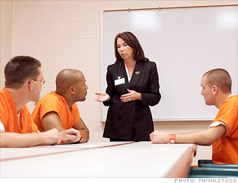
Resocialization
This is the process by which negative behaviour is transformed into socially acceptable behaviour.
Example: a criminal released from prison is given the opportunity to practice new behaviour.

Slide 9
Q: What happens when people are not socialized properly?
Consider this question and then jot down some signs that might indicate someone was not socialized according to today’s social norms.

Slide 10
Your Task:
Complete the worksheet, Abnormal Socialization, independently using the textbook.

