Slide 1
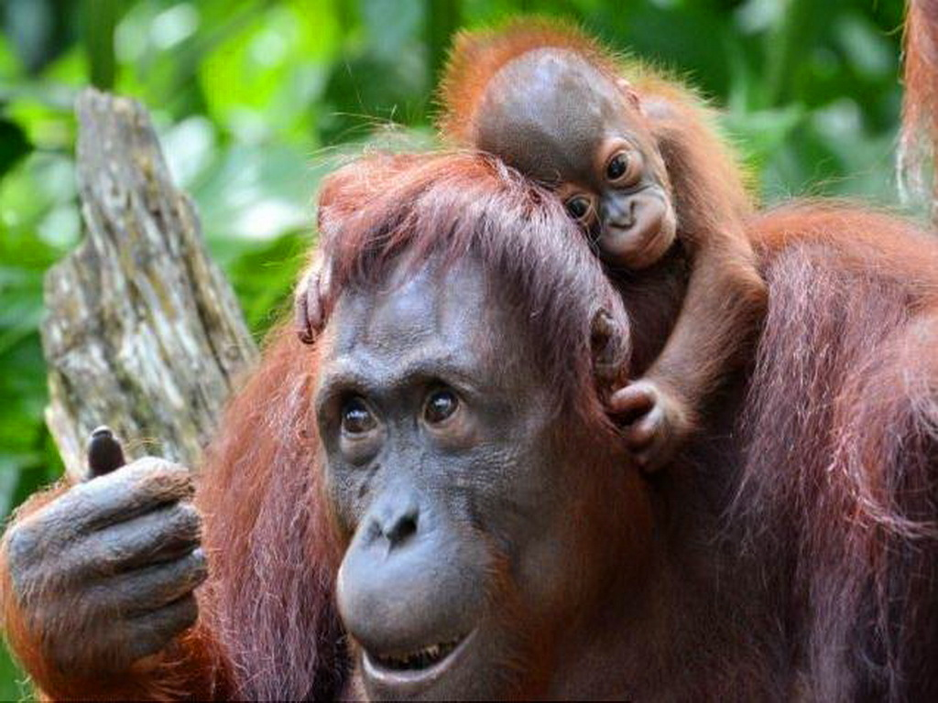
An Overview of Pioneers in Primatology

Slide 2
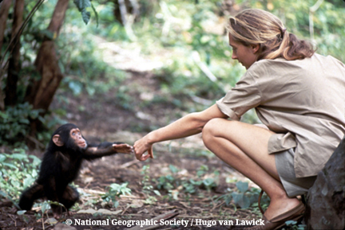
Jane Goodall

Slide 3
Jane Goodall
Early History
Interested in animals at an early age (eg. reading Tarzan).
Met the famed paleoanthropologist, Louis Leakey, at age 23.
Leakey took Goodall on as an assistant and asked her to spearhead a study on chimps in Gombe, Tanzania in 1960.

Slide 4
Jane Goodall
Education
Attained a PhD at Cambridge University in Ethology.

Slide 5
Jane Goodall
Discovered
Discovered that chimps eat meat, use and make tools, and are capable of cooperation, altruism, sorrow, joy, and cruelty.
Made most of her discoveries through observing chimps in Gombe at the Gombe Stream Research Centre.
Prior to her discoveries, it was thought that chimps were vegetarian and not intelligent enough to construct tools or work together.

Slide 6
Jane Goodall
Other Interesting Facts
Did not have a college degree prior to enrolling at Cambridge to attain her PhD.
Co-founded the Gombe Stream Research Centre.

Slide 7
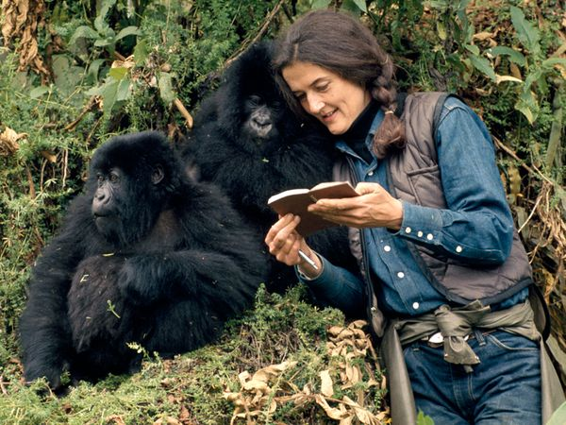
Dian Fossey

Slide 8
Dian Fossey
Early History
Alienated by her parents.
Turned to animals for love and acceptance as a child.
Began tending to livestock when she lived on a farm.
1963: went on trip to Africa.
met Louis Leakey and took an interest in mountain gorillas.
1967: Leakey hired her and she headed to Rwanda to study gorillas.

Slide 9
Dian Fossey
Education
Attained a bachelor’s degree in occupational therapy.
Earned a PhD at Cambridge University.

Slide 10
Dian Fossey
Discovered
Often imitated gorillas to get close to them.
Identified gorillas by their nose prints when studying them.
Was able to conduct many studies on gorillas through the Karisoke Research Centre.
Discovered that gorillas are “dignified, highly social creatures with individual personalities and strong family relationships.”

Slide 11
Dian Fossey
Other Interesting Facts
Began her career as an occupational therapist.
Founded the Karisoke Research Centre.
Set up The Digit Fund after her favourite gorilla was killed by poachers.
Raised money for active conservation programs for gorillas.

Slide 12
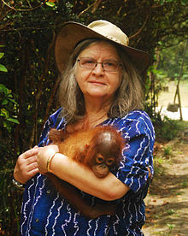
Birute Galdikas

Slide 13
Birute Galdikas
Early History
Observed animals as a child.
Was curious about human evolution and the great apes.
Was working on a masters in anthropology when she met Louis Leakey.
Convinced Leakey to allow her to spearhead a study on orangutans in Indonesian Borneo.

Slide 14
Birute Galdikas
Education
Studied anthropology.

Slide 15
Birute Galdikas
Discovered
Discovered that female orangutans only have offspring once every 8 years and the babies stay with their mothers for the first 8 years.
Helped researchers understand the birth cycles of orangutans and why orangutans are at risk of extinction.
Discovered that orangutans sleep in tree nests and eat over 400 different kinds of food.

Slide 16
Birute Galdikas
Other Interesting Facts
Has conducted one of the longest studies of a contingent wild animal population.
Has made over 100, 000 hours of orangutan observations with colleagues.
Established the concept that non-human animals can have culture too.
Believed that certain behaviours were passed down from generation to generation through observation and imitation.

Slide 17
What Do All Three Women Have in Common?
Showed us that humans are not as unique as once thought.
Helped us realize that our primate relatives are complex and capable of human communication, emotions, and behaviours.
All three were very determined and never gave up.
They helped pave the way for new generations of female biologists and conservationists.

Slide 18
Sources
SciShow. (2013, June 11). Goodall, Fossey & Galdikas: Great Minds. Retrieved from: https://www.youtube.com/watch?v=0VRdDFwxwTg
(2014, April 2). Dian Fossey. In Biography Online. Retrieved from: http://www.biography.com/people/dian-fossey-9299545#synopsis

