Slide 1
Behaviourism

Slide 2
What is Behavioural Psychology?
It is based on the belief that psychologists need empirical evidence in order to understand and change human behaviour.
Behavioural psychologists use experimentation to obtain empirical evidence.
It emphasizes the importance of observable behaviours and phenomena, as well as using scientifically proven intervention procedures.
Behavioural psychology can be applied to individuals with a wide variety of mental disorders, as well as to groups such as those in the workplace.

Slide 3
Ivan Pavlov (1849-1936)
Pavlov was a Russian scientist.
He was awarded a Nobel Prize for his contributions to behavioural psychology.
Pavlov is most known for his work with classical conditioning.

Slide 4
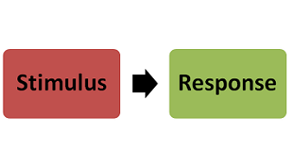
What is Classical Conditioning?
It is a type of learning where a once neutral stimulus comes to produce a particular response after pairings with a conditioned stimulus.

Slide 5
Pavlov’s Research
Pavlov’s research with dogs showed that they would drool as soon as he put food in their mouths.
He also noticed that dogs would also drool during other times (eg. seeing a white lab coat).
Pavlov devised an experiment to see if other things could make a dog drool.
See the handout, “Pavlov and Classical Conditioning.”

Slide 6
B.F. Skinner (1904-1990)
Skinner is credited with having developed true behaviourism.
He was concerned with only observable behaviours, not the mental processes behind them.
Using rats and pigeons, Skinner examined how the use of rewards and punishment can influence behaviour.
This became known as operant conditioning.

Slide 7
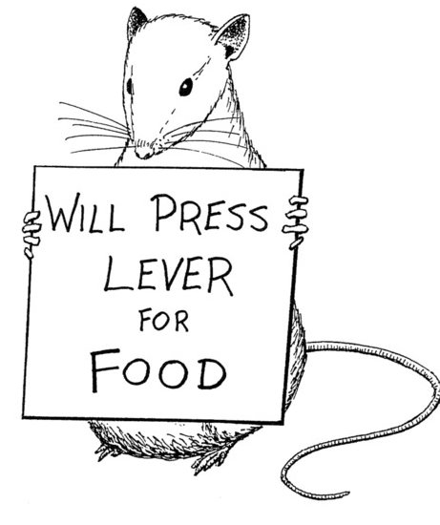
What is Operant Conditioning?
It is a type of learning that uses rewards and punishment to achieve a desired behaviour.
The Big Bang Theory and Operant
Conditioning:
https://www.youtube.com/watch?v=LhI5h5JZi-U

Slide 8
The Skinner Box
Skinner developed an operant conditioning chamber, also known as the Skinner box.
A rat was placed in the box.
Over time, the rat would learn that he or she would receive food for pushing a lever.
If the rat did not get any food for pushing the lever, extinction would occur.
Extinction: in operant conditioning, the diminishing of a conditioned response due to a lack of reinforcement.

Slide 9
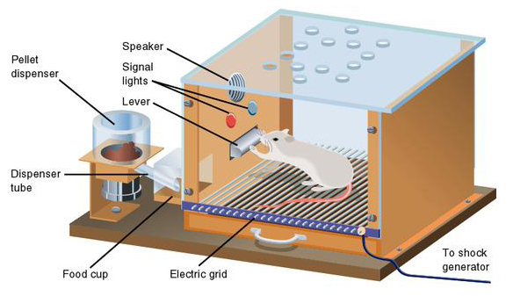

Slide 10
Classical vs. Operant Conditioning
https://www.youtube.com/watch?v=todfl9HWkyk

Slide 11
Source:
Haskings-Winner, J. et al. (2011). Social Science: An Introduction. Toronto, ON, Canada: McGraw-Hill Ryerson, p. 64-66.

