Slide 1
Primatology: What Makes Us Human?

Slide 2
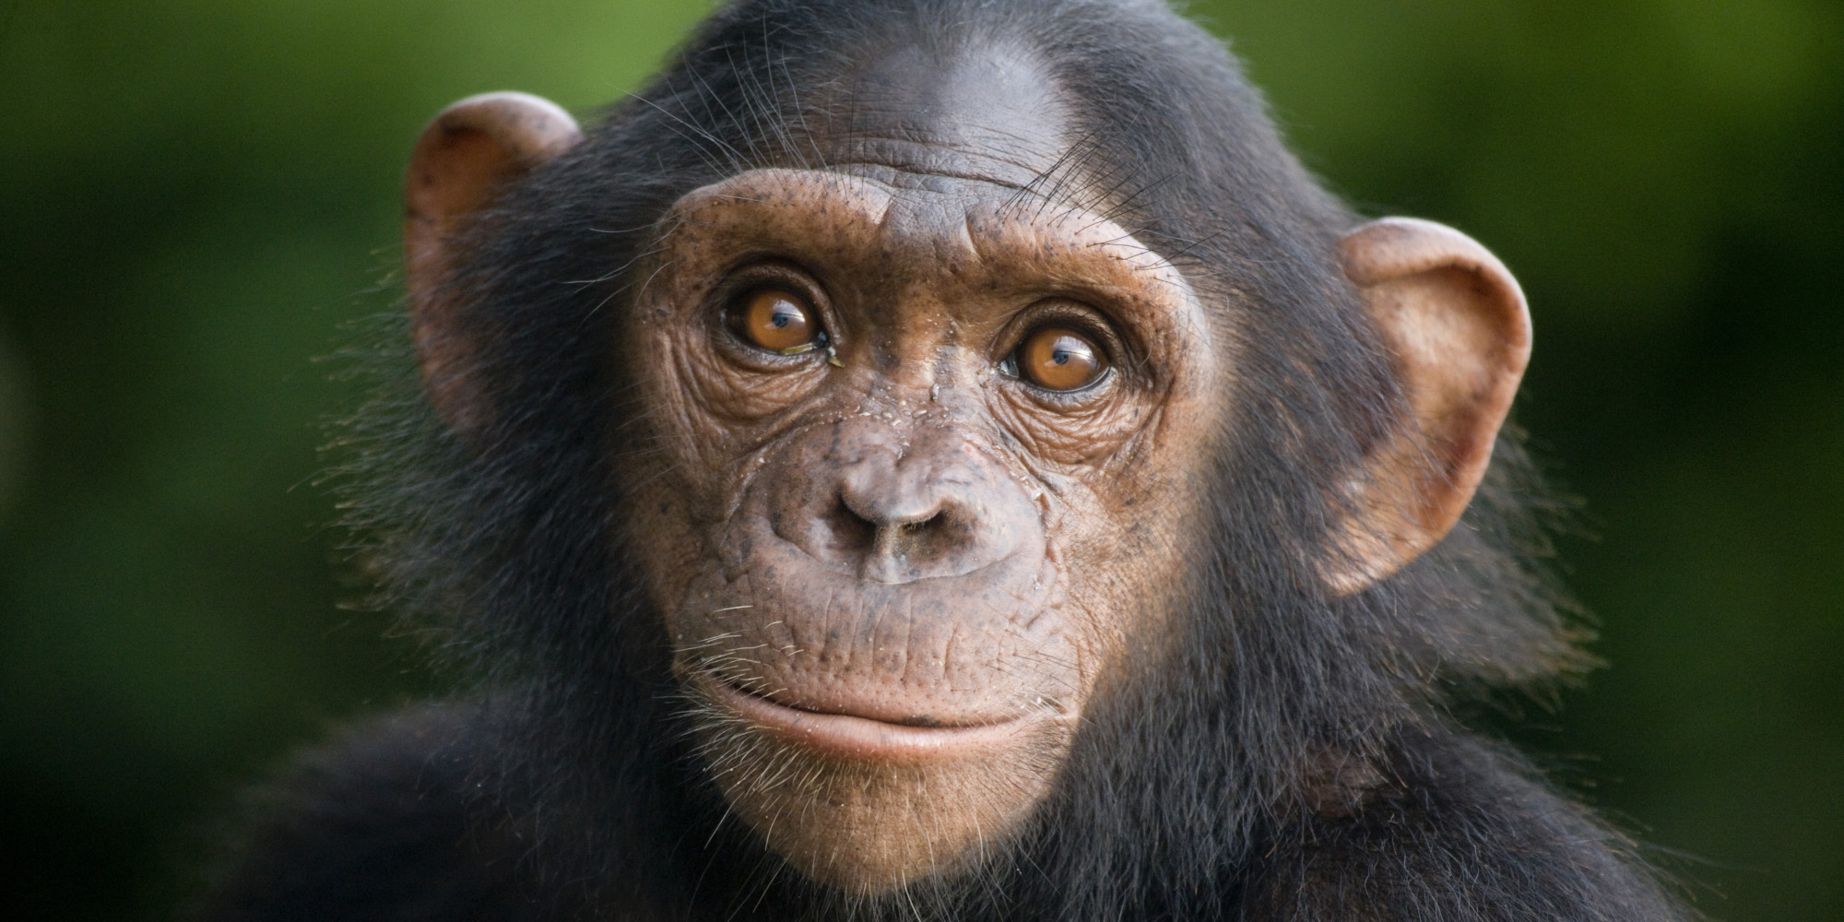
What is specific to Chimpanzees?

Slide 3
What is specific to Chimpanzees?
Large canine teeth
Body covered in thick hair
Average life span 50 years
Long arms, short legs
Big feet and opposable toes
Strong muscles

Slide 4
What is Specific to Humans?

Slide 5
What is Specific to Humans?
Complex language
Larger skull and brain capacity
Develop long term partnerships
Straight, upright posture
Technological achievements
Long childhood

Slide 6
What is Similar between Chimps & Humans?
Ability to develop culture
Affectionate
Omnivorous (eats plants & meat)
Have vocal chords
Groom others
Desire to teach others
Live in communities
Practice aggressive behaviour
Ability to make tools

