Slide 1
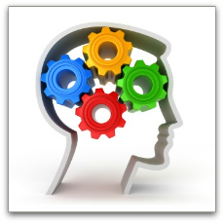
Cognitive Psychology

Slide 2
What is Cognitive Psychology?
Cognition refers to the mental processes of the brain.
Cognitive psychology is the study and application of how the brain learns.
Cognitive psychologists are interested in our beliefs, motivations, and desires.
Cognitive psychology often supports behavioural psychology to create methods of treating people with certain mental illnesses and neurotic disorders.

Slide 3
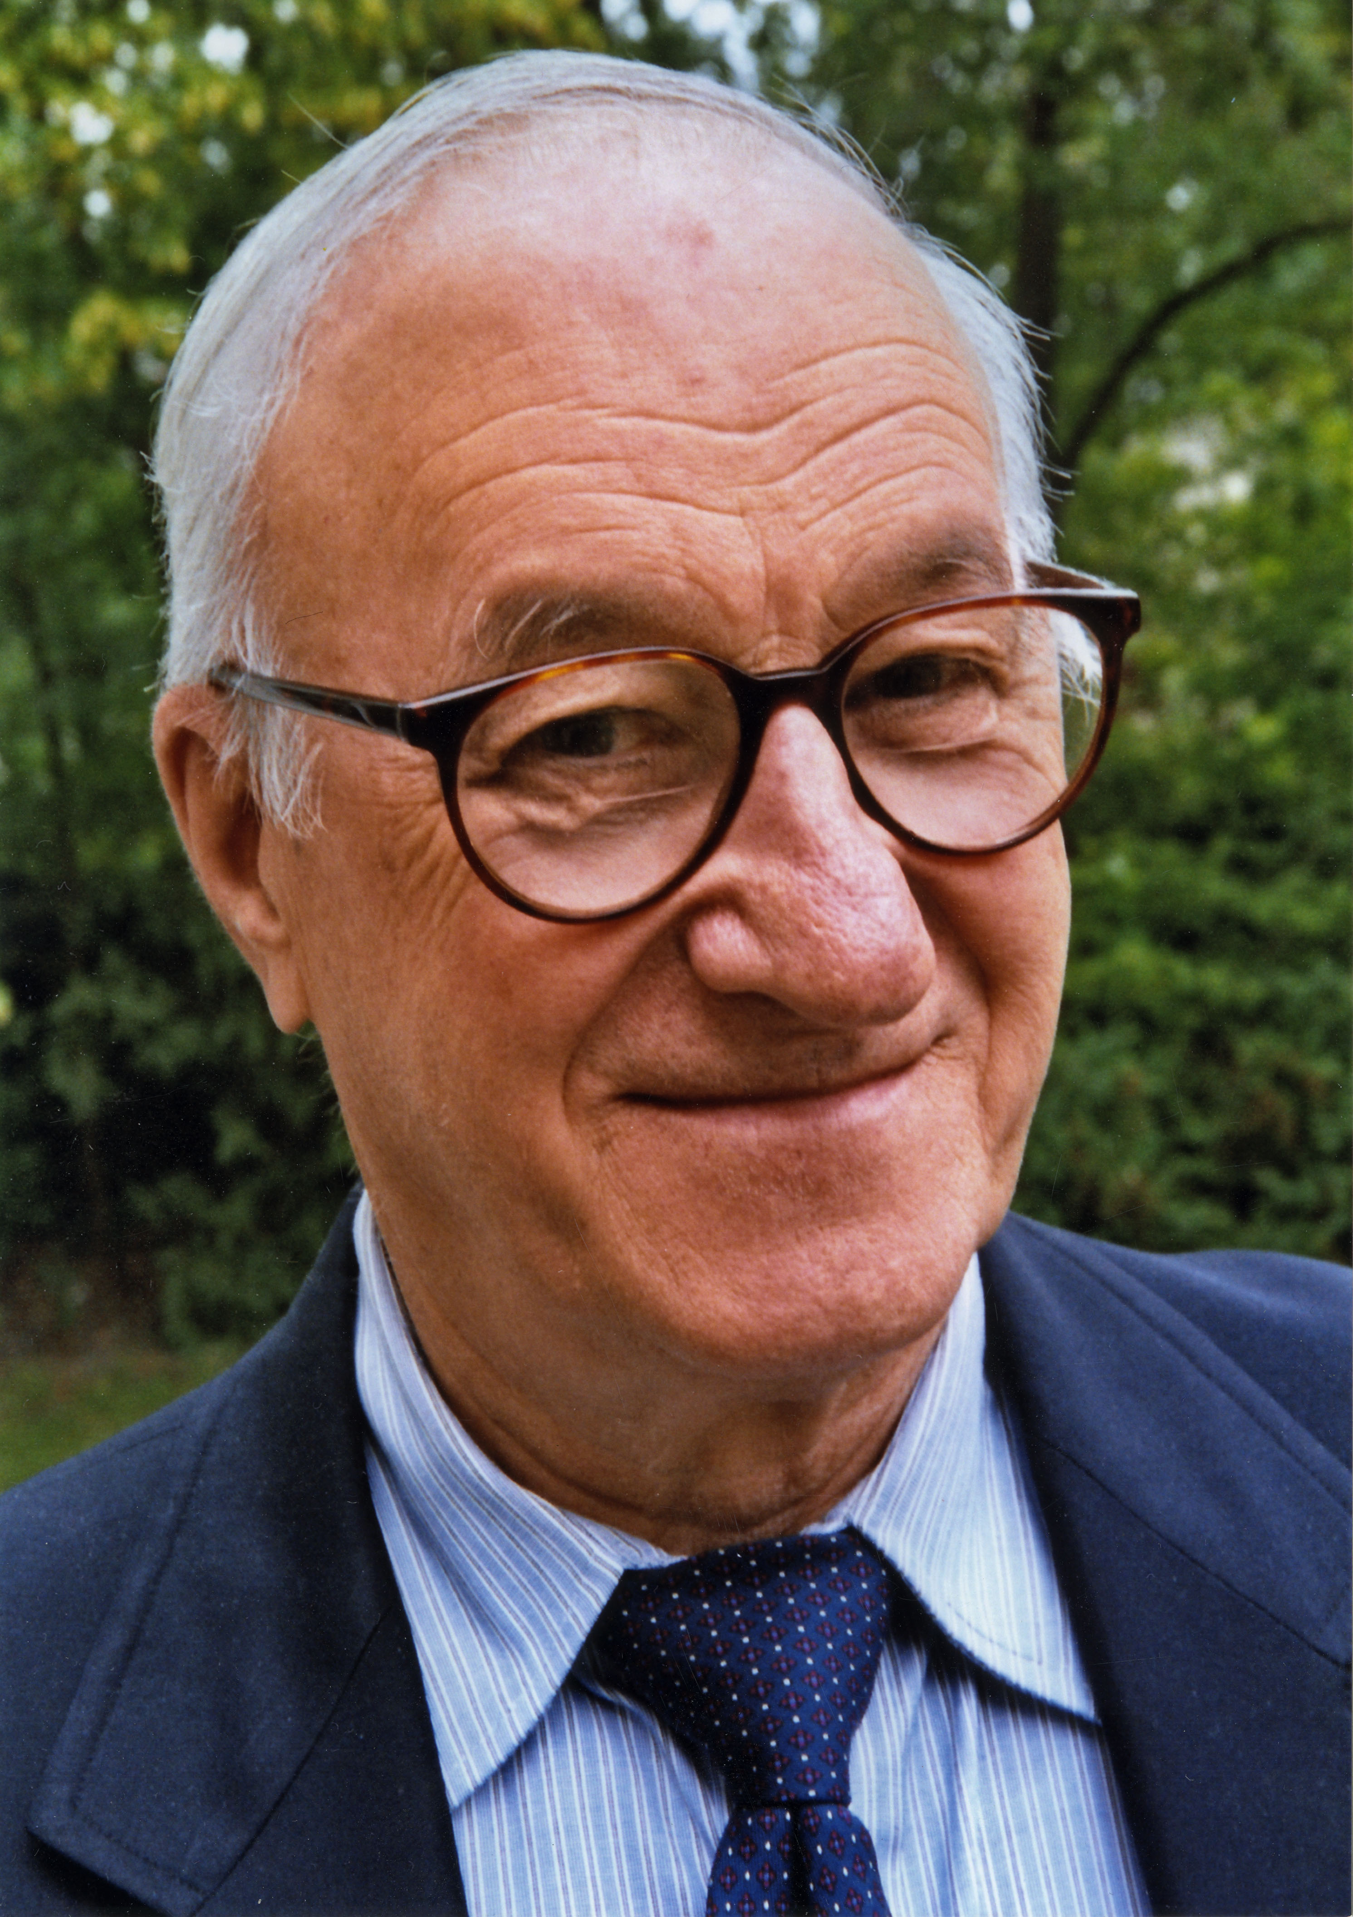
Albert Bandura (1925 -)
Albert Bandura is a Canadian psychologist.
Bandura questioned why the same situation could trigger different responses from different people or even the same person.
Bandura developed the Social-cognitive Theory:
It is a perspective on personality that takes a person’s motivation, environment, and behaviour into account.
He believes that people learn behaviour by watching and then imitating others.

Slide 4
The Bobo Doll Experiment
Bandura created this experiment to see if his assumption was correct: Do people learn behaviours by watching others and then imitating?
Bandura had children watch a video in which an adult acted aggressively toward a rubber Bobo doll.
The children who had viewed the video were then allowed to interact with the doll and other toys in the room.
The other toys were both aggressive and nonaggressive.

Slide 5
The Results:
The children who had watched the video behaved just as aggressively as the adult in the video and were more likely to play with the aggressive toys in the room.
The children in the control group who did not view the video and were less likely to behave aggressively and less likely to choose aggressive toys to play with.

Slide 6
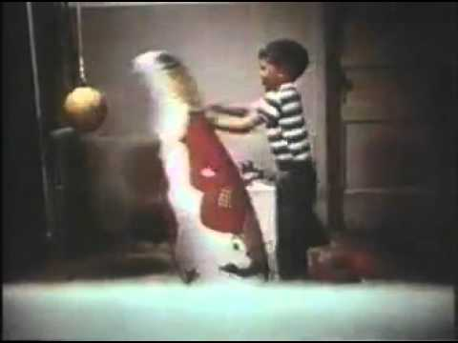
Bobo Doll Video Clips
http://www.simplypsychology.org/bobo-doll.html

Slide 7
Thoughts?
Why do you think the children who viewed the video imitated the behaviour they observed?
Do you think Bandura’s experiment would be considered ethical by today’s standards? Why or why not?

Slide 8
Group Activity:
In groups of 3-4 people, create a skit that demonstrates an individual or group watching then imitating a behaviour.

Slide 9
Elizabeth Loftus (1944 -)
Elizabeth Loftus is interested in our memories and why we repress certain memories and sometimes develop false memories.
Loftus proved that people can be led to remember their past in various ways, and even “remember” a past that didn’t happen.

Slide 10
Sources:
Haskings-Winner, J. et al. (2011). Social Science: An Introduction. Toronto, ON, Canada: McGraw-Hill Ryerson, p. 72-73.

