Slide 1
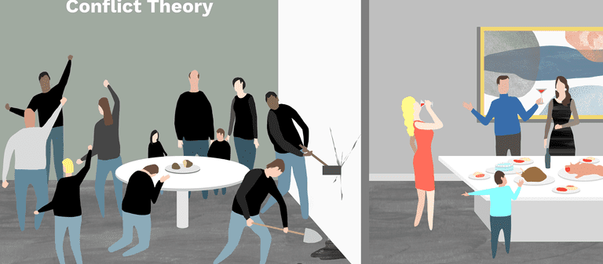
Conflict Theory

Slide 2
Think-Pair-Share:
What tends to cause conflict between two individuals and groups?

Slide 3
What is Conflict Theory?
Conflict theory believes that:
There is often competition between various groups for power.
Competition for power is caused by the struggle between those who have economic and political power and those who do not.
The imbalance between the wealthy class of owners and the poor class of workers is the source of constant conflict in society.
Institutions also alienate the poor, making them feel powerless.

Slide 4
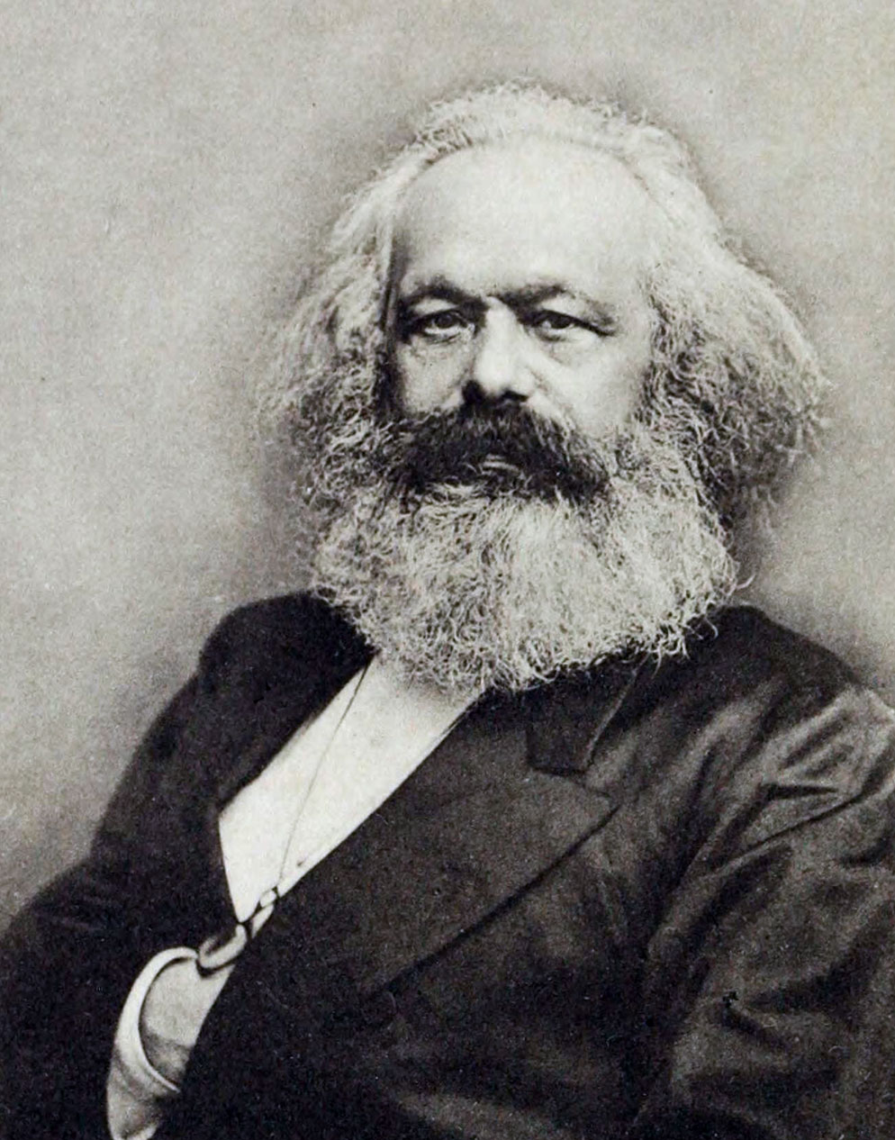
Karl Marx (1818-1883)
Karl Marx was a German philosopher who was mainly interested in economic history.
The Conflict Theory is modelled on the work of Marx.
Marx’s theories focus on the idea of class conflict, its role in social evolution, and its usefulness in understanding social issues.
Marx lived during the time of the Industrial Revolution and witnessed how factory owners exploited workers who earned a low wage and had poor working conditions.

Slide 5
Marx Continued..
Marx believed that society was based on fierce competition for power and wealth.
He felt that the wealthy class would make it impossible for the poor to ever achieve economic equality.
He predicted that the lower-class workers would revolt in order to attain power.
Marx believed that the conflict between social classes created isolation which would lead to disruption and change.
Conflict + revolution = societal evolution according to Marx.

Slide 6
Is Conflict Theory a Macro and Micro Theory?
It is a macro theory of sociology.

Slide 7
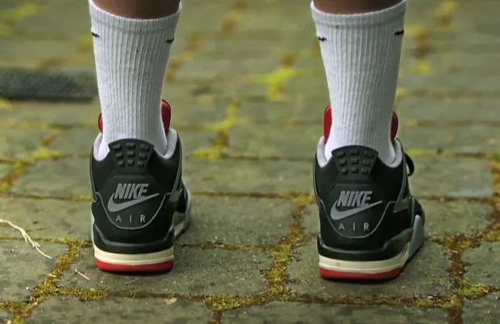
Macklemore and Conflict Theory
Let’s watch Macklemore’s music video,
“Wings.”
As you watch, consider how the video
relates to the Conflict/Marxist theory.
https://www.youtube.com/watch?v=gAg3uMlNyHA

Slide 8
Macklemore and Conflict Theory
Macklemore’s video depicts competition and inequality.
We see a younger version of Macklemore wearing his first pair of Nike shoes.
In the lyrics, Macklemore mentions that his friends couldn’t afford Nike shoes and that his friend Carlos’ brother was murdered for his shoes.
In the video, we see a group of older boys steal Macklemore’s Nike shoes.
This depicts a competition for power and wealth.
In the lyrics, Macklemore says “we want what we can’t have, commodity makes us want it.”
The video depicts the mentality that material goods (wealth) = power.

Slide 9
Commodity Fetishism
Commodity Fetishism is the process of ascribing magic “phantom-like” qualities to an object, whereby the human labour required to make that object is forgotten once the object is associated with a monetary value for exchange.
Under capitalism, once the object emerges as a commodity that has been assigned a monetary value for equivalent universal exchange, it is fetishized, meaning that once consumers come to believe that the object has intrinsic value in and of itself.
Macklemore believed that his Nike shoes would make him into a superstar athlete like Michael Jordan.

Slide 10
Textbook Work:
Read “William Foote Whyte and the Street Corner Society” on p. 106 and respond to the questions at the bottom of the page.

Slide 11
Source:
Social Science: An Introduction. Canada: McGraw-Hill Ryerson, 2011, p. 105.

