Slide 1
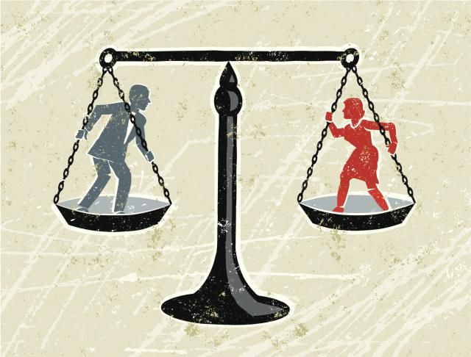
Feminist Sociology

Slide 2
What is Feminism?
Feminist sociologists are interested in gender inequality.
In the 20th century, feminists reached the conclusion that women are marginalized, deprived of power, and without equal membership in society.
Many societies are patriarchal according to feminists.

Slide 3
What does Patriarchal Mean?
Patriarchal societies favour men above women.
Male authority dominates in patriarchal societies.

Slide 4
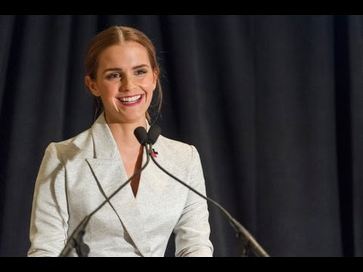
Emma Watson’s UN Speech
https://www.youtube.com/watch?v=p-iFl4qhBsE
Your task: Watch Emma Watson’s UN speech and consider how her message aligns with the core principles of Feminist Sociology.

Slide 5
Activity:
In your group, find images and words in magazines that represent the expectations today’s society has for men and women. Be prepared to share your ideas with the class.

Slide 6
Dorothy Smith (1926 -)
Dorothy Smith is a Canadian sociologist.
Smith believes that culture is socially constructed to favour men.
She believes that the ideas imposed on women in a society are socially constructed on concepts that favour men.
Smith wants women to have more a voice in society.

Slide 7
The “Third World Woman”
Chandra Talpade Mohanty is credited with researching this theory.
This is the idea that women from different cultures and countries ultimately have one identity.
It sees all women as victims of oppression.
All women are oppressed in the same way.

Slide 8
Is Feminist Sociology a Macro or Micro Theory?
Many people classify it as both a macro and micro theory.

Slide 9
Other Video Clips
First male covergirl
https://www.youtube.com/watch?v=v2gbJYMu2Kg
Always #Likeagirl
https://www.youtube.com/watch?v=XjJQBjWYDTs

Slide 10
Source:
Social Science: An Introduction. Canada: McGraw-Hill Ryerson, 2011, p. 107.

