Slide 1
Humanism

Slide 2
What is Humanism?
Humanism became a popular psychological approach during the second half of the 20th century.
Humanist psychologists believe that the client should take an active role in his or her own recovery.
According to humanists, the client should not be dependent on the therapist’s interpretation of the issues.
It does not support quantitative research methods (eg. experiments).
It prefers qualitative methods (eg. diary accounts, open-ended questionnaires).

Slide 3
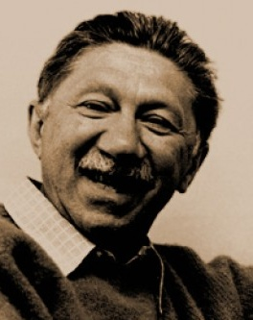
Abraham Maslow
Abraham Maslow is considered one of the founding fathers of humanist psychology.
Maslow studied “self-actualizing” people and their “peak experiences.”
These are people who have realized their full potential.
Maslow was interested in how these individuals had achieved success.

Slide 4
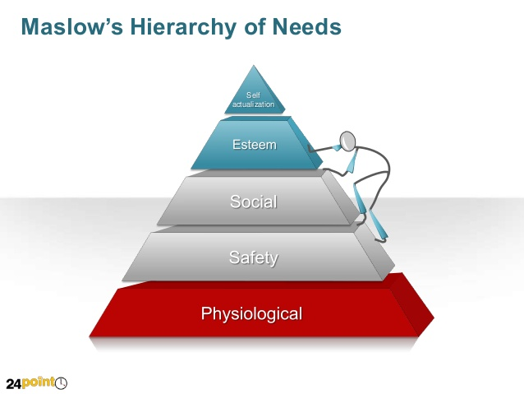
Maslow’s Hierarchy of Needs
Maslow is most known for his Hierarchy of Needs.
He based this theory on observing clients rather than on experimentation.
Basic needs (physiological) must be fulfilled before higher-order needs become important.
Each need must be met before moving on to the next one.

Slide 5
Your Task:
Fill in the missing information on Maslow’s hierarchy of needs diagram while viewing the following slideshow.

Slide 6
Textbook Work:
Read p. 69-71 and then complete the following questions:
What did Viktor Frankl observe during his time in Auschwitz?
Describe logotherapy, Frankl’s form of therapy.
Describe Carl Rogers’ client-centred therapy.
How has humanist psychology impacted society?

Slide 7
Source:
Haskings-Winner, J. et al. (2011). Social Science: An Introduction. Toronto, ON, Canada: McGraw-Hill Ryerson, p. 68-71.

