Slide 1
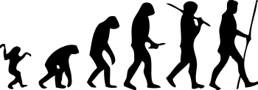
Paleoanthropology

Slide 2
Textbook Work:
Read p. 38 – 40 and complete the following:
Define: hominin, fossil, and bipedalism
What did paleoanthropologist Donald Johanson discover in 1947? Why was this discovery significant?
Who was Charles Darwin? What is he known for?
What did Louis and Mary Leakey find in 1959? What did it prove?
Read “In Focus: Who Were the Neanderthals?” on p. 42 and answer #1-2 at the end of the reading.

