Slide 1
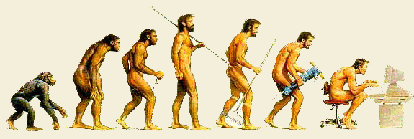
Physical Anthropology

Slide 2
What is Physical Anthropology?
Physical anthropologists want to know the answers to the following questions:
As a species, where did humans come from?
How has the human body evolved over the ages?
What makes humans unique?

Slide 3
Major Fields of Physical Anthropology
Paleoanthropology
Primatology
Human Variation

Slide 4
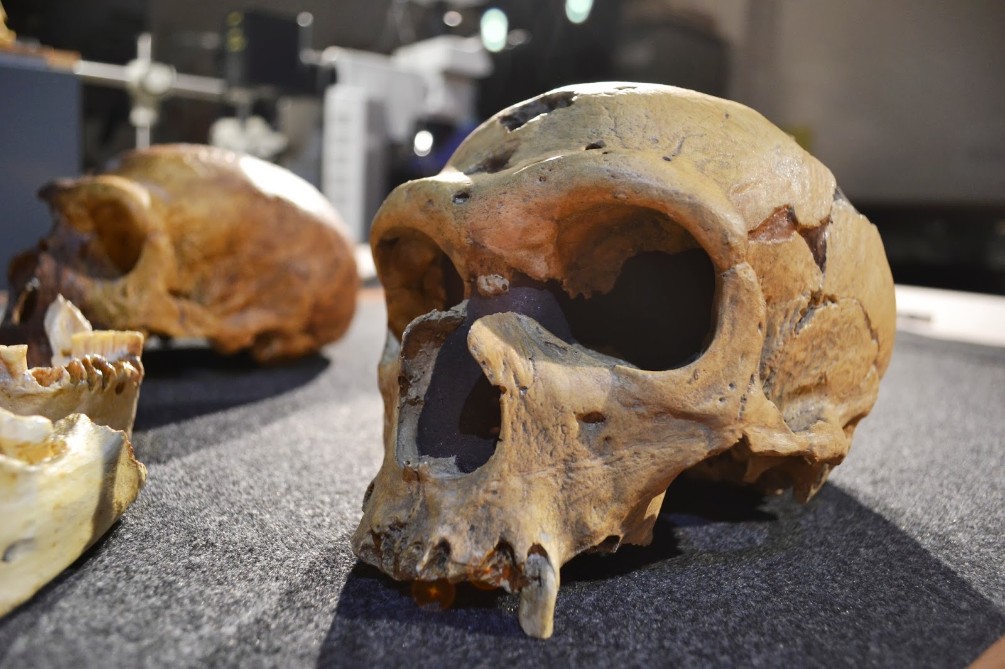
Paleoanthropology
Paleoanthropologists study bone and stone remains of our ancient ancestors from millions of years ago.

Slide 5
Primatology
Primatologists study primates.
A primate is “any member of the group of animals that includes human beings, apes, and monkeys.”

Slide 6
Human Variation
It is the study of the physical differences and similarities of existing human populations.

Slide 7
Sources:
Haskings-Winner, J. et al. (2011). Social Science: An Introduction. Toronto, ON, Canada: McGraw-Hill Ryerson, p. 37.
Primate. Merriam-Webster. Retrieved from http://www.merriam-webster.com/dictionary/primate

