Slide 1
Psychoanalysis

Slide 2
What is Psychoanalysis?
It emerged early in the 20th century.
It was developed as an approach to therapy.
It was inspired by Sigmund Freud’s psychoanalytic theory.
This is the theory that all human behaviour is influenced by early childhood and that childhood experiences influence the unconscious mind throughout life.
Theories that fit into the category of psychoanalysis are called psychodynamic theories.
These theories are based on the belief that unlocking the unconscious mind is the key to understanding human behaviour and relationships.

Slide 3
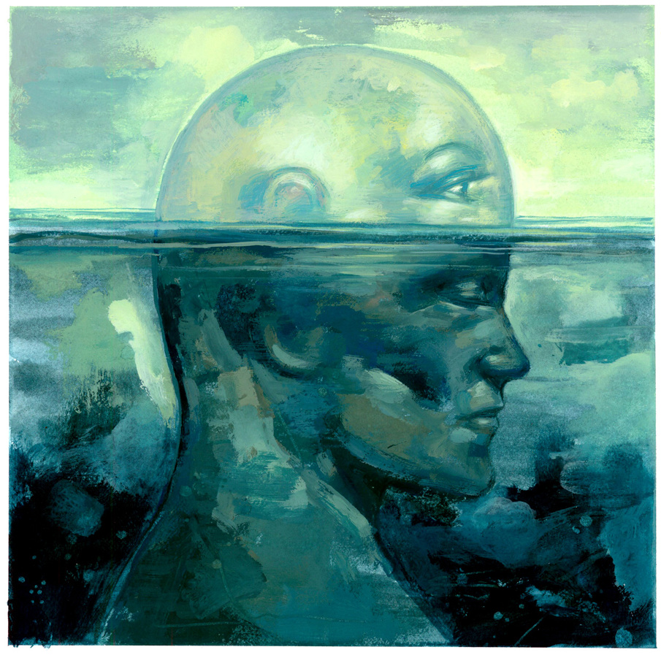
What is the Unconscious Mind?
It refers to information processing in our mind that we are not aware of.
Freud believed that our unconscious
mind holds our unacceptable thoughts,
feelings, and memories.
Carl Jung, a student of Freud, believed
that our unconscious mind includes
patterns of memories,
instincts, and experiences common to all.

Slide 4
Sigmund Freud (1856-1939)
Freud believed that human consciousness consists of three parts:
Freud believed that human personality results from the ego’s efforts to resolve conflicts.
The ego | It is the rational part of the mind, which operates on the reality principle. It often suppresses the urges of the id.
The id | It is the instinctual part of the mind, which operates on the pleasure principle.
The superego | It is the moral centre of the mind. It acts as the mind’s conscience.

Slide 5
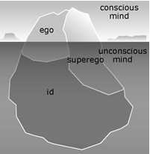
The Mind as an Iceberg
Freud compared the mind to an
iceberg.
Our conscious mind is above the
water; the unconscious mind is below
the surface.
The id is completely unconscious
and the ego and superego straddle both
sides of the iceberg, operating consciously and unconsciously.

Slide 6
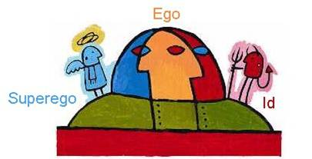
A Visual Representation of Freud’s
http://ed.ted.com/on/pPGWjX7f

Slide 7
Textbook work:
Read p. 60 and define the following: defence mechanisms, repression, denial, displacement, free association, and projection.
What are neo-Freudians? (p. 60)
According to Jung, what are the two parts to the unconscious? (p. 61)
What are archetypes? (p. 61)
What are some symbols that tend to reoccur? (p. 61)

Slide 8
Source:
Haskings-Winner, J. et al. (2011). Social Science: An Introduction. Toronto, ON, Canada: McGraw-Hill Ryerson, p. 59 - 60.

