Slide 1
Nature vs. Nurture & Psychological Development

Slide 2
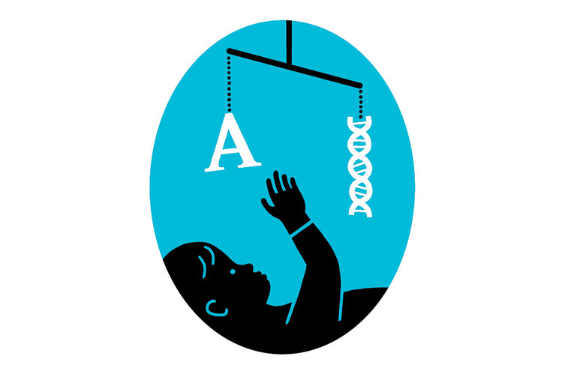
Introduction
Psychologists often examine the role that heredity and environment play in shaping us.
The nature vs. nurture debate centers on the following question: Do hereditary factors or environmental factors have a bigger influence on one’s psychological development?

Slide 3
What are Hereditary Factors?
Heredity refers to the physical characteristics and aspects of personality and behaviour that are passed down genetically from your relatives.
The nature side of the debate.

Slide 4
What are Environmental Factors?
Environment refers to the people, experiences, and conditions one is exposed to.
The nurture side of the debate.

Slide 5
Think-Pair-Share:
With your elbow partner(s):
Identify 5-7 examples of things we may inherit genetically from our relatives.
Identify 5-7 examples of environmental factors.

Slide 6
The Human Genome Project
It identified all 3 billion DNA subunits and determined that humans share 99.9 % of the same nucleotide bases (the structural units of DNA).
DNA: the molecule that carries genetic information in all living systems and provides the most basic explanation of the laws of genetics.
Despite this commonality in genetic make-up, psychologists do not believe that our personalities and behaviour are 100 % dependent on our genes.

Slide 7
The Edith Experiment
In the 1950’s, Aaron Stern designed an experiment to prove that the right environment and strategies could create a genius.

Slide 8
Stern’s Methods and Results
Stern used his daughter, Edith, to prove his theory.
He played classical music to her and showed her flash cards from infancy.
By the time Edith was 5, she could read the entire Encyclopedia Britannica and at age 18 attained a PhD.

Slide 9
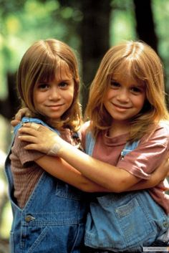
Twin Studies
In the search for understanding what is inherited, psychologists have often turned to studying twins-two people who are born from the same pregnancy.
New research suggests that environmental factors cannot explain all differences between twins.

Slide 10
Twin Studies
New research suggests that females are more likely to display differences that are linked to genetics because they have two X chromosomes, while males have one X and one Y.
In females, to avoid duplication, one of the X chromosomes is often dominant.
Therefore, it is possible that the X chromosome dominant in one twin sister is not the same X chromosome dominant in the other twin sister.

Slide 11
Intelligence: Hereditary or Environmental?
Alfred Binet applied the idea that intelligence could be measured to create an intelligence test.
Binet’s test was revised by Stanford University and became known as the Stanford-Binet Intelligence Test.
Studies have shown that twins who were raised in different homes have a statistically significant similarity in their IQs.
Studies have also shown that environmental factors such as nutrition and schooling can influence IQ scores.

Slide 12
Conclusions: How Influential are Heredity and Environment?
Psychologists do not have an exact answer but they do have some ideas.
The formation of who we are involves a complex combination of inherited and environmental factors.
Research shows that any psychological trait can be heritable; it’s how each of us chooses to show these traits that accounts for differences in us all.
Example: Researchers have discovered that genetics play a role in whether a person is likely to be religious, but the religion that person believes in is largely based on environmental factors.

Slide 13
Source:
Haskings-Winner, J. et al. (2011). Social Science: An Introduction. Toronto, ON, Canada: McGraw-Hill Ryerson, p. 200-204.

