Slide 1
Cultural Anthropology

Slide 2
What is Culture??
List three words that you associate with culture.
Identify two questions that you have about culture.
Create one metaphor or simile for culture (eg. “Culture is like …”).

Slide 3
Culture
Culture is the set of meanings, beliefs, values, and rules for living shared by groups and societies as the source of their identity.

Slide 4
Major Fields of Cultural Anthropology
Ethnology
Linguistic Anthropology
Archaeology

Slide 5
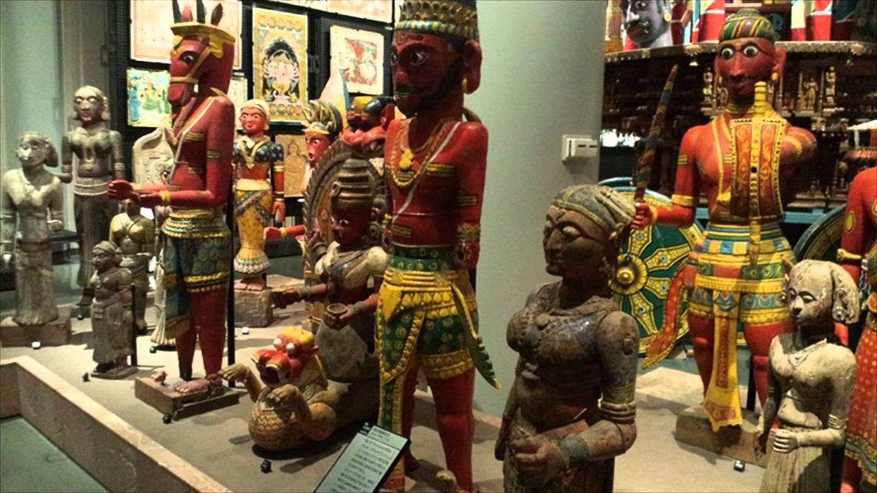
Ethnology
Ethnology is the study of the origins
and cultures of different races and peoples.
Ethnologists often focus on topics such as marriage customs, kinship patterns, political and economic systems, religion, art, music, and technology.
Ethnologists study culture through participant observation.
This is the careful watching of a group, in some cases living with its members and participating in their culture.

Slide 6
Linguistic Anthropology
Linguistic anthropologists study the history and structure of language and the ways humans use language.
Three major areas in this area include:
historical linguistics
structural linguistics
sociolinguistics

Slide 7
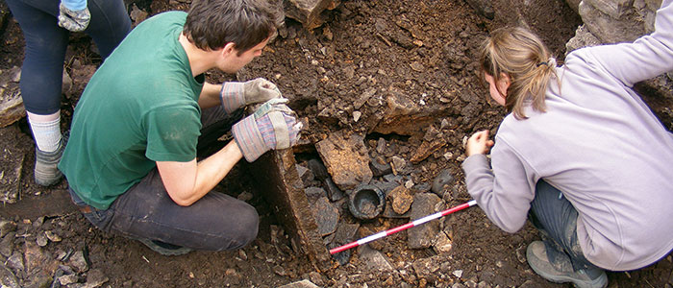
Archaeology
Archaeologists study the physical remains of a past culture through excavation and reconstruction.

Slide 8
Source
Haskings-Winner, J. et al. (2011). Social Science: An Introduction. Toronto, ON, Canada: McGraw-Hill Ryerson, p. 18 - 35.

