Slide 1
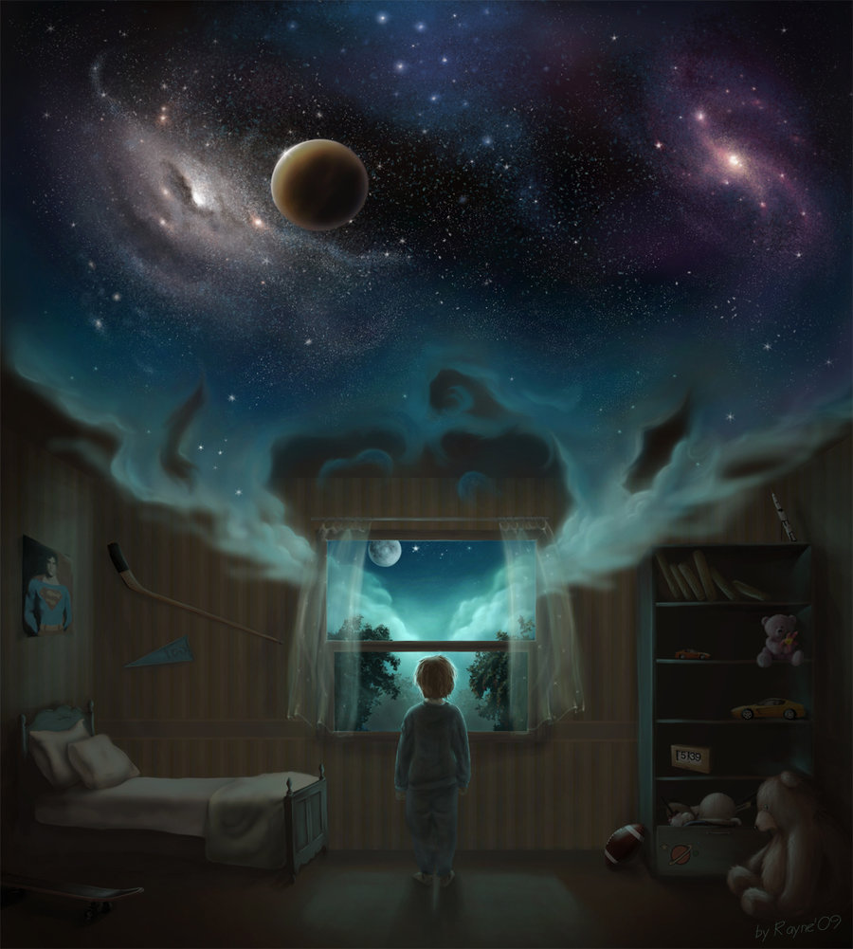
Why do we Dream?

Slide 2
Let’s a watch a video to understand some of the reasons why we dream:
As you watch the following video, please make notes on the reasons why we dream.
http://ed.ted.com/lessons/why-do-we-dream-amy-adkins

Slide 3
Why do we Dream?
We dream to fulfill wishes:
Freud believed that our dreams are a collection of images from our daily conscious lives.
Freud was certain that dreams have symbolic meaning.
He said that everything we remember from our dreams is a symbolic representation of our unconscious primitive thoughts.
Through analyzing the remembered elements of our dreams, Freud said that the unconscious elements would be revealed to our conscious mind.

Slide 4
Why do we Dream? Con’t…
We dream to remember
There are certain memory processes occurring only when we sleep.
We dream to forget
While sleeping (REM phase), your neo-cortex reviews the neural connections that were made during the day and dumps the unnecessary ones.
The “unlearning process” results in dreams.
We dream to keep our brain working
The Continual Activation Theory emphasizes that our dreams result from the brain’s need to consolidate and create long-term memories.
Your dreams are like a random screen saver that prevent your brain from shutting down.

Slide 5
Why do we Dream? Con’t…
We dream to rehearse
The Primitive Instinct Rehearsal Theory emphasizes that dreams allow us to practice our fight or flight instincts.
We dream to heal
Dreaming takes the edge off painful experiences to allow for psychological healing.
We dream to solve problems
Dreaming helps us grasp problems and formulate solutions.

