Slide 1
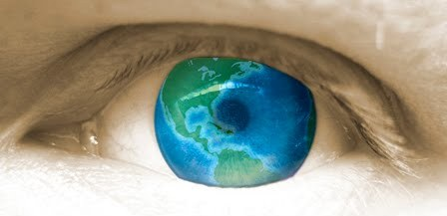
Faith & Culture: Exploring Major Worldviews

Slide 2
Your task:
Copy any information that is purple.

Slide 3
Faith Vs Culture
Faith
Culture
Faith is a deeply personal relationship individuals have in experiencing the sacred or the divine.
Examples: prayer, beliefs, scripture, festivals, etc.
Culture is the collective ideas, customs, and social behaviour of a particular group.
Examples: pop culture, values, norms, fashion, economy, education, etc.

Slide 4
Faith and Culture
Let’s look at some common worldviews and try to identify any parallels between these outlooks, faith, and culture.

Slide 5
Cosmocentric
Views nature as an expression of God.
Believes people are connected to nature and have a duty to honor nature.

Slide 6
Theocentric
Views God as the source and centre of life.
Believes that all meaning comes from our relationship with God.
Sees the purpose of life as a path of discovery that ultimately leads to union with God.

Slide 7
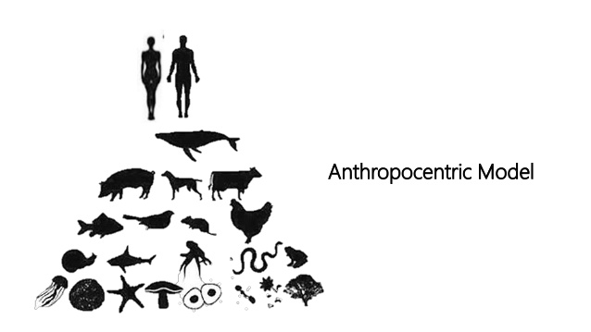
Anthropocentric
Views humans as the centre of the universe.
Individual humans and communities are of the utmost importance.
Human dignity and worth are the most important things.
Takes three forms: Christian humanism, scientific humanism, and secular humanism.

Slide 8
Secular
Views the values of the present-day society as the centre of the universe.
Does not support eternal truths.
Secular comes from the Latin word, “saeculun,” meaning “time” or “age.”
The concerns of religion are separated from one’s value system.
Believes that there is no need to involve God in human activities.
One must follow what is acceptable in society.

Slide 9
What Would You Do In this Situation?
https://www.youtube.com/watch?v=s4SkVFrQFW4&t=41s

