Slide 1
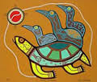
Native Canadian Spirituality
Introduction

Slide 2
What do you know?
Watch this short video on Aboriginals in Canada.
Video Intro:
What does the average Canadian know about Aboriginal people? Let’s watch as CBC reporter Connie Walker interviews Canadians on the streets for a segment called Aboriginal 101.
Stereotypes videos:
What are some of the common stereotypes members of the Aboriginal community must deal with? Let’s watch:
https://www.youtube.com/watch?v=tSNvfk0zFNc
https://www.youtube.com/watch?v=20EmLfHTVlw

Slide 3
Origins
Archaeologists have found Aboriginal artefacts dating back beyond 10 000 years.
Two theories of Aboriginal origin/history in the Americas:
They “came out of this ground,” meaning they were here before any record.
They migrated from Asia to North and South America by crossing a land bridge over the Bering Strait (between Alaska and Russia) 35 000 years ago.

Slide 4
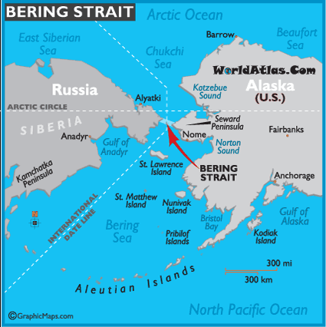

Slide 5
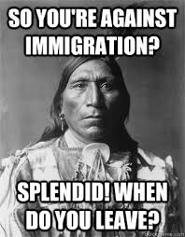
Thoughts?

Slide 6
Aboriginal Spirituality Around the World
No single founder.
Huge diversity of Aboriginal spirituality.
Indigenous peoples live on every continent.
13% of the world’s aboriginals live in North
and South America.

Slide 7
Aboriginal Nations
Aboriginal peoples of Canada are culturally diverse and each cultural group has its own myths and sacred stories.
There are over 1 Million Aboriginals in Canada.
The three largest groups that make up the Aboriginal community are:
First Nations
Metis
Inuit

Slide 8
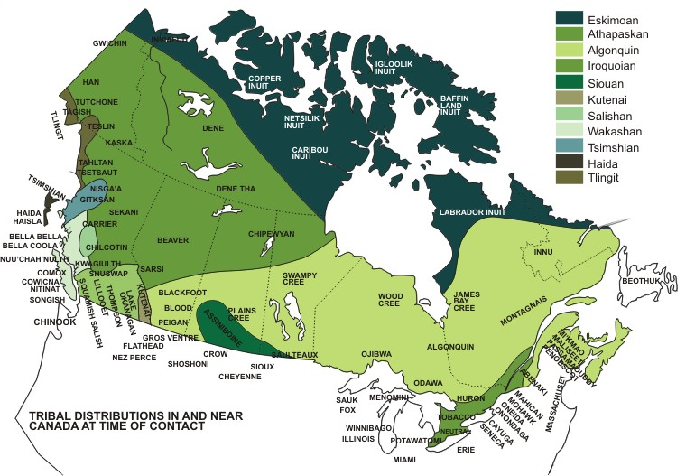

Slide 9
Beliefs – Death/Afterlife
In general, Native religions have no precise belief about life after death.
Some believe in reincarnation as a human or animal after death.
Others believe humans return as ghosts, or that people go to another world. Others believe that nothing definitely can be known about one's fate after this life.
Combinations of belief are common.

Slide 10
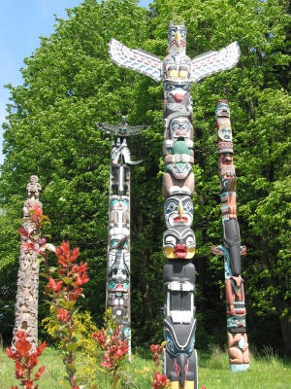
Beliefs – Totems
Links Aboriginal peoples to their ancestors. A totem is any supposed entity (plant, animal or mythical being) that watches over or assists a group of people, such as a family, clan, or tribe
Ojibwa identify each totem group by the name of a bird, fish, animal, or reptile.
Totem poles can tell stories or represent the totems of a clan or tribe, (more totem poles)

Slide 11
Canadian Aboriginal Spirituality
There are religious Dynamics at play in contemporary Aboriginal spirituality
Aboriginal Christianity has adapted in some cases to include aspects of traditional Aboriginal practices
E.g., Since 1984 Catholic church allows Aboriginal ceremonies like “smudging” to be a part of mass

Slide 12
Source
World Religions: A Canadian Catholic Perspective. Nelson Education.

