Slide 1
An Introduction to Hinduism

Slide 2
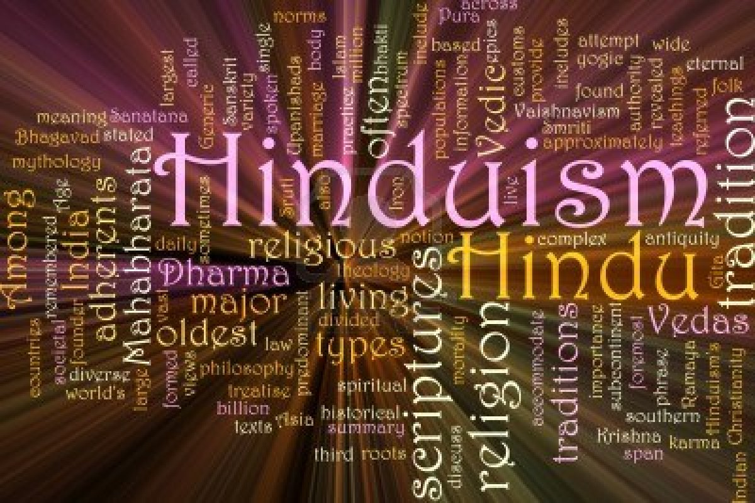
Look at the word collage below. What do you think these words reveal about Hinduism?

Slide 3
What is Hinduism?
Let’s watch the following video to gain some insight into what it means to be a member of this religion:
https://www.youtube.com/watch?v=Hfhka-OvLSA

Slide 4
What did you learn about Hinduism through watching the video?

Slide 5
How do we categorize Hinduism?
Monotheistic:
According to Hindus, there is only one divine entity who is simultaneously at one with the universe and who transcends it as well.
Hinduism recognizes only one supreme God: Brahman.
Brahman is the ultimate reality.

Slide 6
How do we categorize Hinduism?
Polytheistic:
Hindus worship multiple deities: gods and goddesses.
Trinitarian:
Brahman is simultaneously visualized as a triad: one God with three persons
1. Brahma: the Creator
2. Vishnu: the Preserver
3. Shiva: the Destroyer

Slide 7
How do we categorize Hinduism?
Henotheistic:
Hinduism recognizes a single deity and recognizes other gods and goddesses as facets, forms, manifestations, or aspects of that supreme God.

Slide 8
Source:
Hindu Beliefs and Deities. Retrieved from http://www.markville.ss.yrdsb.edu.on.ca/history/religion/Hinduism_files/frame.html

