Slide 1
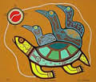
Canadian Aboriginals
Sacred Beliefs, Myths, and Stories

Slide 2
Beliefs - Animism
Everything in the world is alive.
All living things reside in close connection and harmony with one another and move in cycles.
Animism: all things, human and non-human, have spirits or souls, and that person or animal lives on after death through the presence of that spirit.

Slide 3
Beliefs - Animism
Most Aboriginal peoples believe in a supreme Creator.
Other spirits have power to guide human activity.
Inuit call the sea “Sea Woman.”
Iroquois call the sky “Sky Woman.”
Algonquin call the sky “Grandfather.”

Slide 4
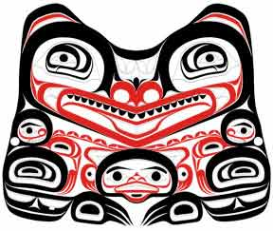
Beliefs –Storytelling
Traditional Aboriginal storytellers had to earn the right to be a storyteller.
They were important in teaching and in preserving the history of the group.

Slide 5
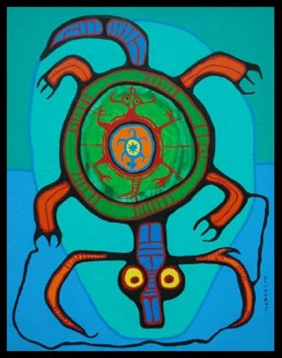
Myths and Legends
Traditionally told orally.
Offers a response to questions
of existence:
Why certain things in the environment are the way they are…
Where do we come from?
Where do we go when we die?

Slide 6
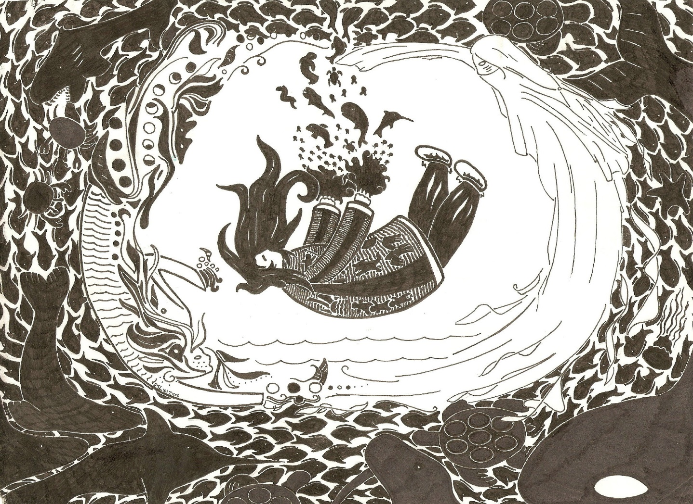
Story of Sedna
https://www.youtube.com/watch?v=GGHgTseVzyw

Slide 7
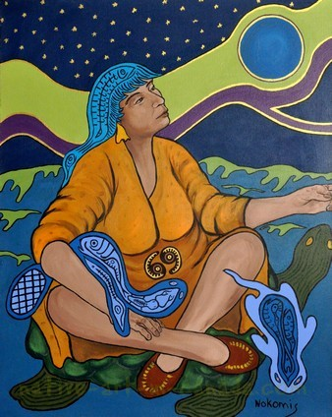
Earth Diver Creation Myth
Click Here

Slide 8
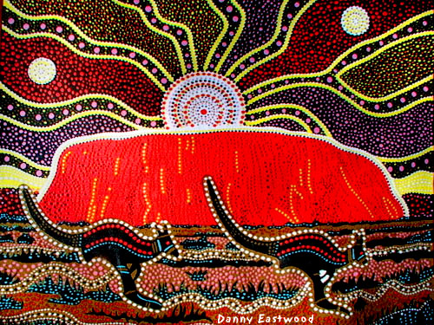
Watch this ancient Australian Aboriginal Myth
Click Here

Slide 9
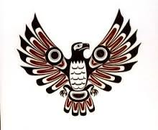
Native American Creation Myth
Click Here

Slide 10
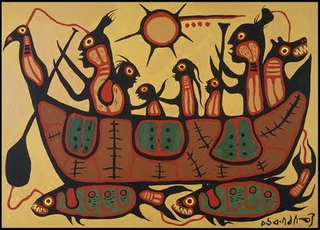
Watch this Ojibyway Creation Story to deepen your understanding of the nature of a myth.
Click Here

Slide 11
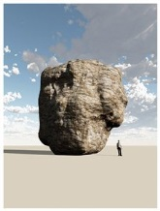
THE BIG ROCK STORY
Watch this myth told to explain the existence of a big rock out in B.C.
Click Here
https://www.youtube.com/watch?v=4kLlk4MmJKw

