Slide 1
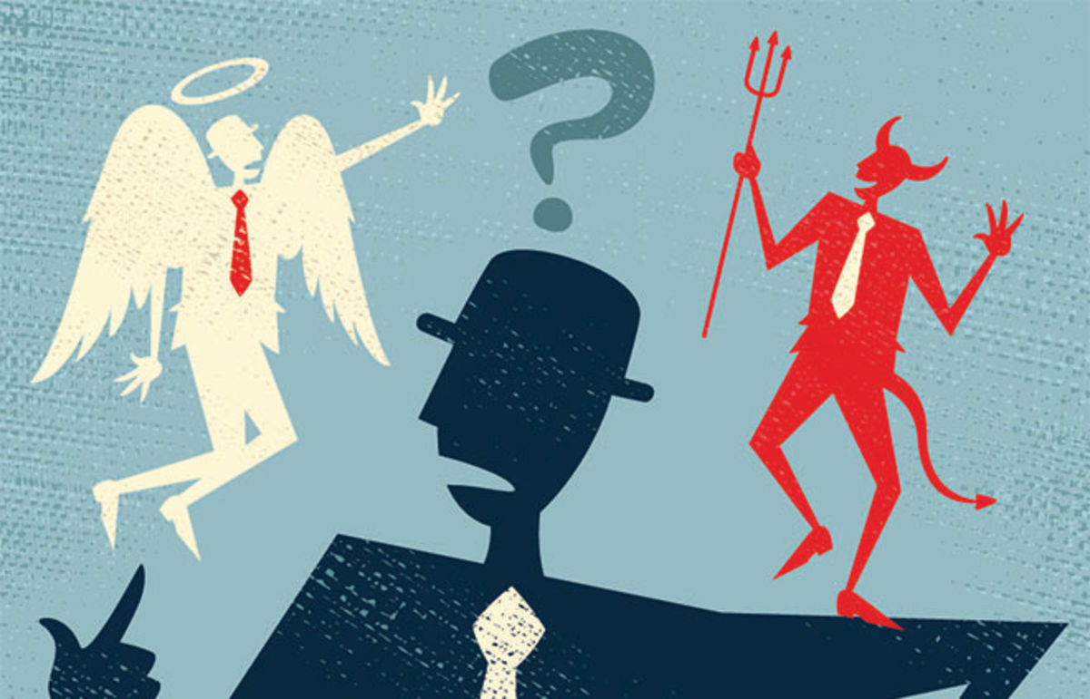
Moral and Spiritual Teachings
Native Spirituality

Slide 2
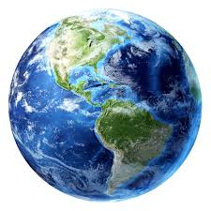
Aboriginal Moral Teachings Continued
The Earth is understood to have sacred value and humans must care for the earth.
Human beings do not control nature.
All life is interconnected – humans, animals, and plants.

Slide 3
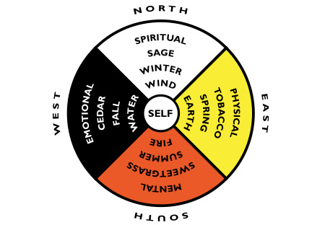
Aboriginal Teachings Continued
When we lose our interconnectedness there will be no balance.

Slide 4
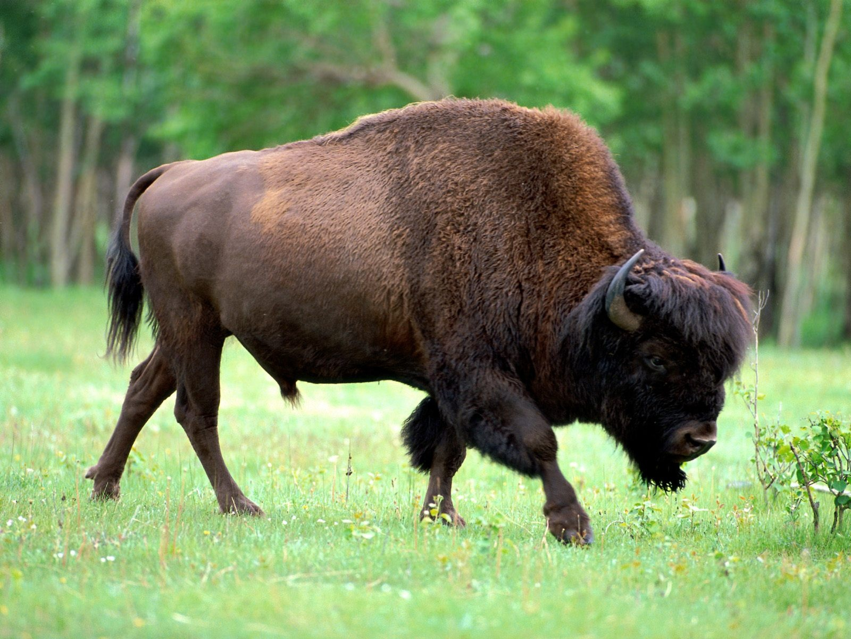
When taking the life of a plant or animal of the earth, a person must pay respect to the spirit of that plant, animal etc.
Buffalo Scene - Dances with Wolves

Slide 5
Your beliefs should be reflected in your actions.
All spiritual beliefs should be respected.
Do not interfere (model behaviour and show by example).
Everything is shared. Take only what you need.

Slide 6
Community and family are valued greatly, including extended families and older generations.
Respect must be shown to every individual and all people are equal (children, adults, elderly etc.).

Slide 7
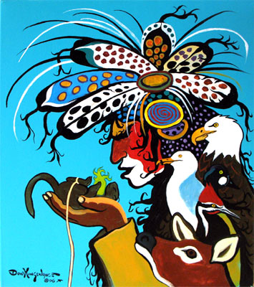
Spiritual Teachings
The universe is home to forces or spirits, some small some great, some good and some dangerous.
Humans must act to keep these spirits in harmony.

Slide 8
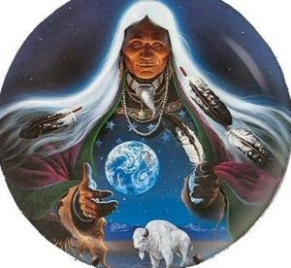
Spiritual Teachings Continued
The Great Spirit created the universe and is present in all of creation.
Other Spirits become guardians of people’s spirit lives.
Consider the Catholic belief in the existence of guardian angels.

Slide 9
Names for the Great Spirit
Tribal Group | Name
Siouan People | Wakan Tanka
Haudenosaune (Iroquois) | Orenda
Algonkian | Manitou

Slide 10
The Creator and other Spirits
Great Spirit
Mother Earth
Sky Woman
Nanabush
(Trickster)
Aniwye

Slide 11
Textbook Work
Please make notes on the following topics from your textbook:
The Great Spirit (p. 86-87)
The Trickster (p. 87)
Shaman (p. 88)
The Medicine Wheel (p. 88-89)

