Slide 1
The Quiet Revolution & Separatism

Slide 2
What was the Quiet Revolution?
It refers to the period of time between 1960 – 1966 in Quebec.
It was an era where Quebec experienced steady, non-violent reform.
During the years leading up to the Quiet Revolution, Quebecers had been pushing for change and modernization.

Slide 3
Early Signs of Trouble
“Co-operation always, assimilation never.”
This was the philosophy of Maurice “Le Chef (Chief)” Duplessis, Quebec’s long-standing Premier.
Duplessis was the leader of the Union Nationale Party in Quebec up until 1959.
Prior to the Quiet Revolution, he encouraged Quebec to seek autonomy from the rest of Canada.
He also frequently used bribes and kickbacks to govern the province.
The older generation of Quebecers accepted Duplessis’ tactics but the young generation were ready for change.

Slide 4
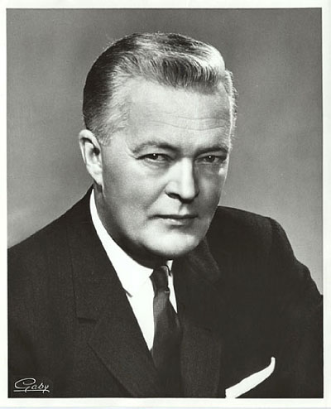
A Change in Leadership
The tide changed in Quebec in 1960 when Jean Lesage became Premier.
He was the leader of the Liberal Party.
His “Things Must Change” campaign resonated with a lot of Quebecers.

Slide 5
Goals of Lesage’s Government
Facilitate the speedy modernization of Quebec.
Achieve full equality in the Canadian partnership.
Place the Quebec economy in the hands of the citizens of Quebec.

Slide 6
Opposing Views
As time passed, Quebec became divided over how to achieve the goals of the Quiet Revolution. The following groups emerged:
Federalists: saw having more influence on the federal government as the best way to go.
Nationalists: supported independent decision-making for Quebec and fewer ties to the rest of the country.
Militants: regarded violent revolution as the best way to achieve total independence.
Separatists: they advocated full independence as the only real solution for Quebec.

Slide 7
The Parti Quebecois
The Parti Quebecois was a Quebec political party that formed in 1968.
It was made up of individuals from various separatist groups.
Rene Levesque became the 1st leader of the party.
Levesque had previously been a part of the Quebec Liberal party.
The party was elected in 1976.

Slide 8
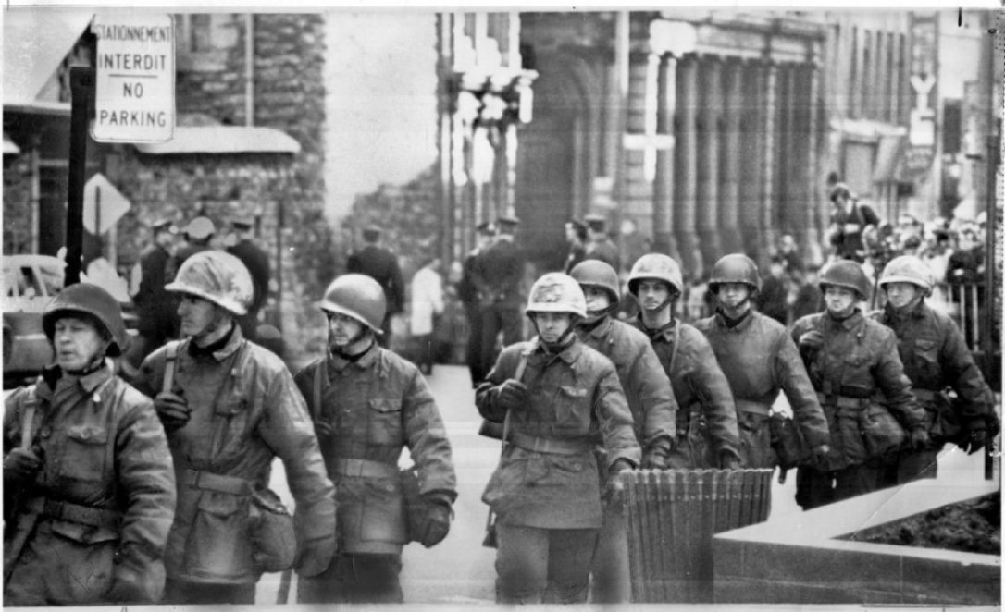
The Rise of Urban Terrorism
Over time, a group of militant separatists in Quebec emerged.
The group came to be known as the Front de Liberation (FLQ).
They believed that the only way Quebec would truly be independent from British control was through the use of violence.

Slide 9
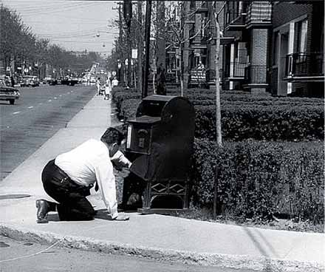
Violence Erupts
The FLQ carried out many acts of terrorism.
In particular, they set up bombs in a number of mailboxes in predominantly English-speaking neighbourhoods in Montreal.
In February of 1969, they set off a bomb in the Montreal Stock Exchange.
An anti-terrorism squad was formed and a number of arrests were made.

Slide 10
Quebec Referendums
In 1980 and 1995, Quebec had a referendum.
A referendum is “a vote in which all the people in a country or an area are asked to give their opinion about or decide an important political or social question.”
Quebecers were asked whether or not Quebec should become an independent country.
The majority of Quebecers voted “no” on both occasions.

Slide 11
Sources:
Bolotta, Angelo, Hawkes, Charles, Jarman, Fred, Keirstead, Marc, and Watt, Jennifer. Canada: Face of a Nation. Toronto: Gage Educational Publishing, 2000.
Cambridge Dictionary. “Referendum.” https://dictionary.cambridge.org/dictionary/english/referendum

