Slide 1
What Happened After the Crucifixion of Jesus?

Slide 2
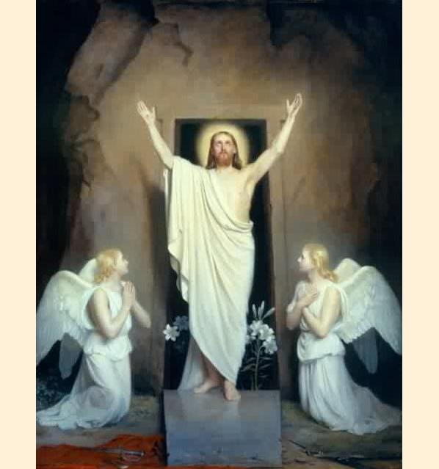
After being crucified, Jesus returned…

Slide 3
The Resurrection of Jesus: Mark 16: 1-8
16 When the Sabbath was over, Mary Magdalene, Mary the mother of James, and Salome bought spices so that they might go to anoint Jesus’ body. ² Very early on the first day of the week, just after sunrise, they were on their way to the tomb ³ and they asked each other, “Who will roll the stone away from the entrance of the tomb?”
⁴ But when they looked up, they saw that the stone, which was very large, had been rolled away. ⁵ As they entered the tomb, they saw a young man dressed in a white robe sitting on the right side, and they were alarmed.
⁶ “Don’t be alarmed,” he said. “You are looking for Jesus the Nazarene, who was crucified. He has risen! He is not here. See the place where they laid him. ⁷ But go, tell his disciples and Peter, ‘He is going ahead of you into Galilee. There you will see him, just as he told you.’”
⁸ Trembling and bewildered, the women went out and fled from the tomb. They said nothing to anyone, because they were afraid.

Slide 4
What is the Resurrection?
The Resurrection refers to the event in which Jesus was raised from the dead by God.
Each Gospel describes Jesus’ Resurrection.
The Resurrection played an important role in the development of the Church.
The Resurrection transformed Jesus’ followers into a community of courageous witnesses.

Slide 5
Gospel Accounts of Jesus’ Resurrection
All four Gospels accounts:
agree that Jesus’ body was claimed by a wealthy disciple of Jesus’ named Joseph of Arimathea.
state that Joseph wrapped Jesus’ body in a burial cloth called a shroud and laid it in a tomb made of stone
state that a large stone was rolled into place at the entrance of the tomb
express the Jewish leaders’ fear that the disciples would steal Jesus’ body and then claim that Jesus had risen from the dead

Slide 6
Gospel Accounts of Jesus’ Resurrection
The Gospels also agree that:
Jesus’ body was no longer in the tomb when various people visited
the people who go to the tomb find out that Jesus is no longer dead but alive, and that he will reveal himself to them again, soon
witnesses experience Jesus among them in striking ways
witnesses are left with no doubt that Jesus is alive again but very different from when he walked among them before his death

Slide 7
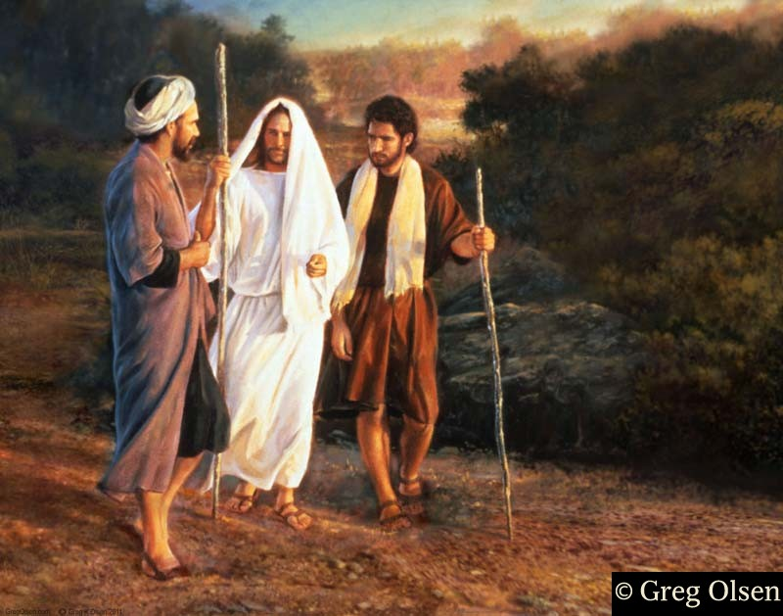
After his resurrection, Jesus’ disciples did not immediately recognize him…

Slide 8
The Road to Emmaus
¹³ Now that same day two of them were going to a village called Emmaus, about seven miles^{[a]} from Jerusalem. ¹⁴ They were talking with each other about everything that had happened. ¹⁵ As they talked and discussed these things with each other, Jesus himself came up and walked along with them;¹⁶ but they were kept from recognizing him.
¹⁷ He asked them, “What are you discussing together as you walk along?”
They stood still, their faces downcast. ¹⁸ One of them, named Cleopas, asked him, “Are you the only one visiting Jerusalem who does not know the things that have happened there in these days?”

Slide 9
¹⁹ “What things?” he asked.
“About Jesus of Nazareth,” they replied. “He was a prophet, powerful in word and deed before God and all the people. ²⁰ The chief priests and our rulershanded him over to be sentenced to death, and they crucified him; ²¹ but we had hoped that he was the one who was going to redeem Israel. And what is more, it is the third day since all this took place. ²² In addition, some of our women amazed us. They went to the tomb early this morning ²³ but didn’t find his body. They came and told us that they had seen a vision of angels, who said he was alive. ²⁴ Then some of our companions went to the tomb and found it just as the women had said, but they did not see Jesus.”

Slide 10
²⁵ He said to them, “How foolish you are, and how slow to believe all that the prophets have spoken! ²⁶ Did not the Messiah have to suffer these things and then enter his glory?” ²⁷ And beginning with Moses and all the Prophets, he explained to them what was said in all the Scriptures concerning himself.
²⁸ As they approached the village to which they were going, Jesus continued on as if he were going farther. ²⁹ But they urged him strongly, “Stay with us, for it is nearly evening; the day is almost over.” So he went in to stay with them.

Slide 11
³⁰ When he was at the table with them, he took bread, gave thanks, broke it and began to give it to them. ³¹ Then their eyes were opened and they recognized him, and he disappeared from their sight. ³² They asked each other, “Were not our hearts burning within us while he talked with us on the road and opened the Scriptures to us?”
³³ They got up and returned at once to Jerusalem. There they found the Eleven and those with them, assembled together ³⁴ and saying, “It is true! The Lord has risen and has appeared to Simon.” ³⁵ Then the two told what had happened on the way, and how Jesus was recognized by them when he broke the bread.

Slide 12
Let’s consider the significance of the Road to Emmaus:
https://outsidedabox.com/film/on-the-road-to-emmaus/

Slide 13
Why do you think Jesus’ disciples did not immediately recognize him after the Resurrection?

Slide 14
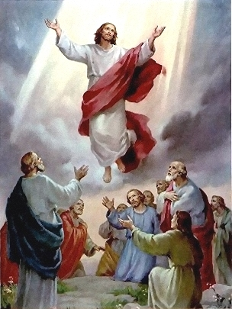
The Ascension of Jesus

Slide 15
The Ascension of Jesus
Mark 16:19-20 New International Version (NIV)
¹⁹ After the Lord Jesus had spoken to them, he was taken up into heaven and he sat at the right hand of God. ²⁰ Then the disciples went out and preached everywhere, and the Lord worked with them and confirmed his word by the signs that accompanied it.

Slide 16
The Ascension of Jesus
The Ascension refers to the time when Jesus left the earth and entered the Kingdom of Heaven
Jesus ascended into Heaven 40 days after resurrecting from the dead
The disciples witnessed this remarkable event

Slide 17
Your Task:
Pretend that you are one of Jesus’ disciples. You have witnessed the life, death, resurrection, and ascension of Jesus. Moving forward, how would you keep Jesus’ memory alive?
Write reflection about a) what you would do to keep Jesus’ memory alive and b) the challenges that you think you might face.
Write in full and complete sentences.
You may type or hand write your reflection.
Your reflection should be a minimum of 300 words.
You will receive a thinking/inquiry and communication mark.

Slide 18
What am I Looking for in Your Reflection?
Thinking/Inquiry: Use your critical thinking skills to examine some of the challenges that you might face as you strive to preserve Jesus and his message.
Good communication skills: Please write in full and complete sentences in paragraph format. Each time you begin discussing a new idea, start a new paragraph. Use proper spelling, grammar, and punctuation. Editing your work can help you ensure that your ideas are organized and clear.
Application: Put yourself in the shoes of a disciple of Jesus. Identify creative and meaningful ways that you could keep Jesus’ memory alive if you were one of his disciples.

