Slide 1
The Role of Symbols and Rituals in Human Communication

Slide 2
Think-pair-share
What is the difference between a sign and a symbol?
What are some examples of signs and symbols?
What is the difference between a ritual and a routine?
What are some examples of rituals and routines?

Slide 3
Symbols vs Signs:
What’s the difference?

Slide 4
Symbols vs Signs
Symbol:
Something that you can touch or see
Has more than one meaning
Represents something abstract or universal
Example: The cross symbolizes Jesus’ life, death and resurrection
Sign:
An object or gesture
Expresses one specific message or meaning
Example: A STOP sign means “stop” and nothing else

Slide 5
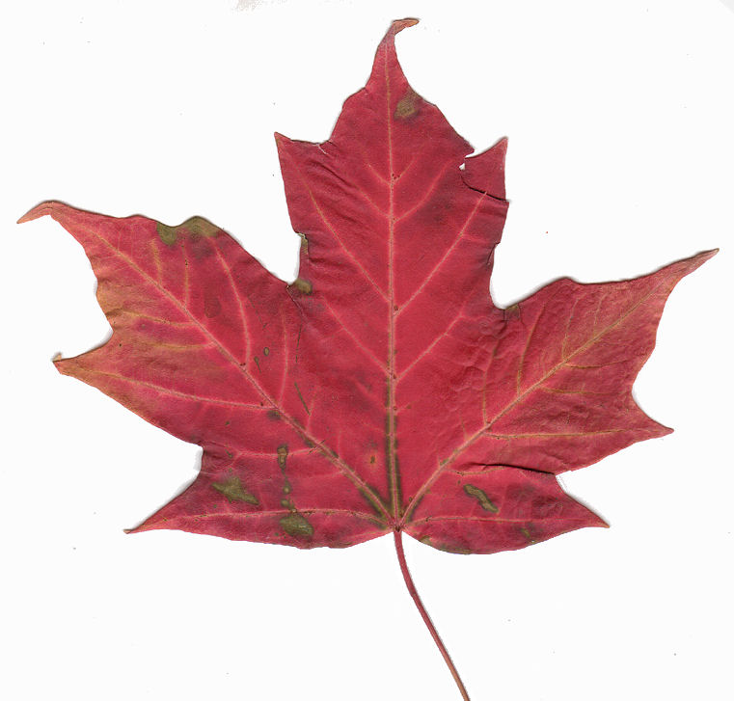
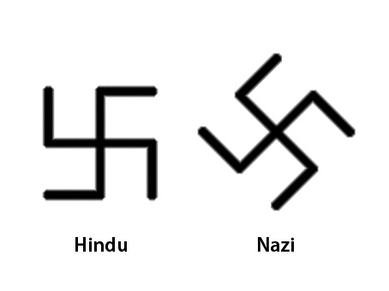
Cultural vs Universal Symbols
Cultural Symbol:
Closely dependent on a specific situation, place, or group
Example: The maple leaf represents Canada and the sense of pride and freedom Canadians feel
Universal Symbol:
Clearly recognized throughout the world
Can have complex and contradictory meanings
Example: The swastika was a symbol of hate during WW2 but for Hindus, it means good fortune.

Slide 6
Rituals vs Routines:
What’s the difference?

Slide 7
Rituals vs Routines
Ritual:
Symbolic action
Has a deeper, multilevel meaning
Help us concretely, or physically, express our beliefs, values, and deepest concerns
Example: being sealed with the Holy Spirit and being made part of the Eucharistic community during the sacrament of Confirmation
Routine:
Practical action
Has no deeper meaning – just one dimensional in meaning
Performed for a specific, practical purpose
Example: dusting furniture

