Slide 1
Technological Advancements of the 1920’s

Slide 2
A Canadian discovery
Before 1920, millions of people throughout the world had diabetes, a life-threatening disease.
Prior to the 20’s, there was no treatment for diabetes.
In people who have diabetes, the pancreas does not produce sufficient insulin for the body to process sugar and other carbohydrates.

Slide 3
After considerable research, Frederick Banting, a Toronto doctor, arrived at a formula for insulin.
Banting was assisted by Professor J. Macleod, Charles Best, and Dr. J.B. Collip.
In 1921, Banting and his team successfully produced insulin that controlled diabetes in dogs.

Slide 4
With very little money, Banting and his research associates managed to continue with their experiments and in 1922 Leonard Thompson, a 14 year-old boy, was the first person to be injected with insulin.
Within weeks, it became obvious that insulin controlled diabetes.
People suffering from the disease would now be able to lead normal lives.
Although not a cure, when injected daily insulin successfully controls the disease and extends the life of a diabetic.

Slide 5
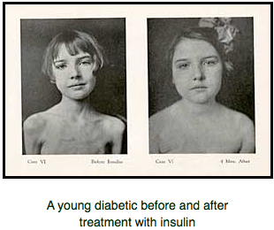

Slide 6
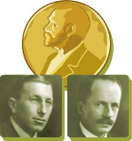
Nobel Prize Winners
The four men became world famous.
In 1923, Banting and Macleod received the Nobel Prize for Medicine and shared their prize money with their two fellow colleagues.
The federal government provided funds for research to Banting and other researchers to find cures for other diseases.

Slide 7
The Telephone
When Alexander Graham Bell invented the telephone in Brantford, Ontario, the lives of Canadians and people around the world changed forever.
In 1920, only one family in four had a telephone; by 1929 this had grown to three out of four.

Slide 8
The Automobile
In 1893, Henry Ford built his first car, but it took a long time to make because it had 5000 parts.
By 1908, he had built the car that would make him famous and rich – the Model T.
Initially, Ford struggled to keep up with the demand for his car.

Slide 9
Mass Production
Ford decided to mass produce the Model T so that it would take less time to produce and make it more affordable.
Ford built a moving belt assembly line.
Each car moved along the belt at 15 cm a minute and each worker added only one part.
Each part was the same, or standardized, and mass produced.
This made the parts cheaper and lowered the price of the car.
The Model T’s were built in Canada in Windsor, Ontario.

Slide 10
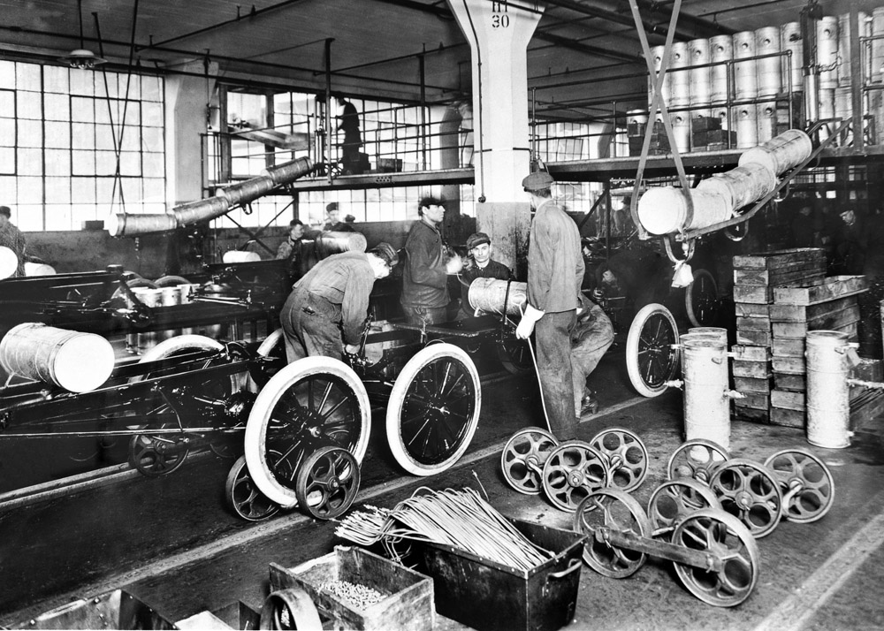

Slide 11
The Airplane
Air transport expanded rapidly between 1920 and 1937.
The airplane helped bring Canadians closer together and shrink the world around them.
In 1920, for instance, the first commercial flight took place.

Slide 12
Bush Pilots
After World War I some of the aces returned to Canada and became bush pilots.
Bush pilot: a person who flies a small aircraft into remote areas.
In the 1920’s, Bush pilots flew prospectors, mail, and supplies into remote, northern areas of Canada where there were no roads.
Many vets became stunt flyers, performing aerial tricks in front of crowds that were astonished at their maneuvers and death-defying tricks.

Slide 13
Radio
The first radio broadcast in North America was on May 20th, 1920 on station XWA in Montreal.
It was a musical program that was heard by such famous personalities as Robert Borden and Mackenzie King.
Although the first radios were very crude, the quality of them quickly improved.

Slide 14
A New Type of Entertainment
The radio became a new type of entertainment for everyone.
People no longer relied on themselves, their families, or friends for amusement.
Most of the radio shows were American, though.
Foster Hewitt’s Hockey Night in Canada was the first Canadian program to be widely broadcast.

Slide 15
Think-Pair-Share:
Consider your life so far. What have been the biggest technological advancements during your lifetime?
How have these advancements helped improve your learning?

