Slide 1
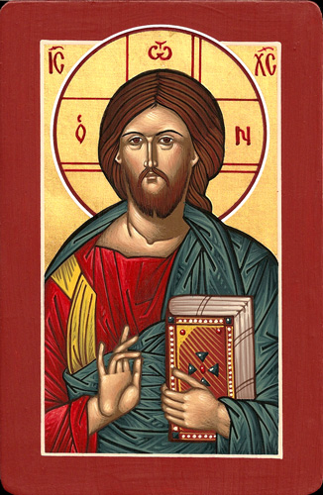
The Great Schism
THE SPLIT BETWEEN CHRISTIANITY IN THE WEST AND THE EAST

Slide 2
Why would a Married couple separate/Divorce
List some reasons why a married relationship would break down.

Slide 3
INTRODUCTORY POINTS
In the first centuries of the Church there was no “Greek” East and “Latin” West.
The Christian Church was (for the most part) united.
The word “schism” means separation.

Slide 4
INTRODUCTORY POINTS
The 5 major patriarchs (Bishops) were responsible for the organization of the Church and shared power with the other bishops.
ROME CONSTANTINOPLE ALEXANDRIA ANTIOCH JERUSALEM

Slide 5
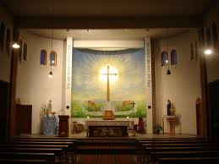
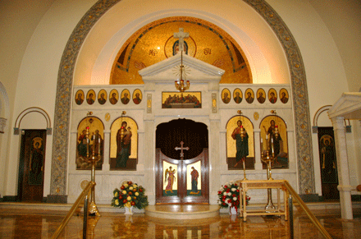
Over time, two cultural and religious traditions began to develop in East and the West.
Orthodox Church Interior
Catholic Church Interior

Slide 6
Why did the Christian Church Split?
The split between the east and west happened because of geographical, cultural, and religious differences that developed over a long period of time.
The split did not happen overnight!

Slide 7
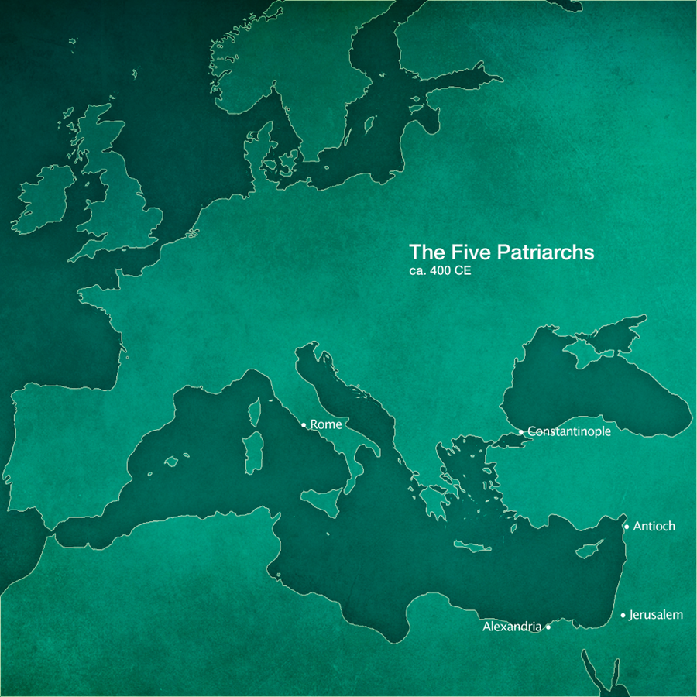
GEOGRAPHICAL
One Factor that led to the Split was distance.
Rome was isolated and this made it difficult to develop a relationship.

Slide 8
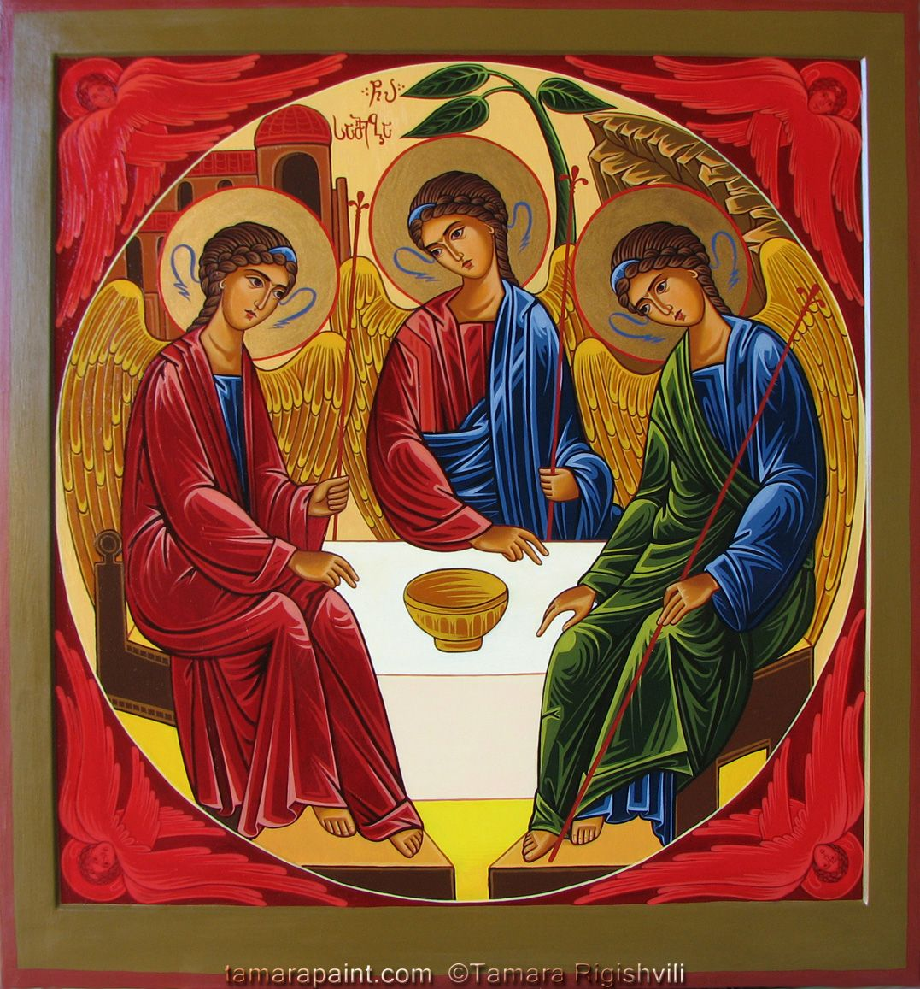
CULTURAL - ICONS
A second factor that led to the Split was a misunderstanding over the use of Icons (images) in worship.
Icons were destroyed and this was known as the (Iconoclasm).

Slide 9
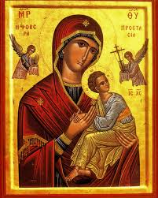
IMPORTANT POINT
Catholics and Orthodox Christians do not “worship” icons or statues depicting Mary, Jesus, or the saints.
Catholics and Orthodox Christians “venerate” icons or statues.
Venerate = to treat with reverence or respect because it is a holy object.

Slide 10
RELIGIOUS - CREED
A third factor that led to the Split was an addition made to the Nicene Creed.
Filioque is a combination of Latin words meaning “and the son”
These words were added to the Nicene Creed by the Bishop of Rome in the 11th century.
The Eastern Bishops did not accept this addition to the Creed.

Slide 11
I believe in the Holy Spirit,
the Lord, the giver of life,
who proceeds from the Father and the Son,
who with the Father and the Son
is adored and glorified,
who has spoken through the prophets.
I believe in one, holy, catholic,
and apostolic Church.
I confess one baptism for the forgiveness of sins
and I look forward to the resurrection
of the dead and the life of the world to come.
Amen.
NICENE CREED
*Catholic

Slide 12
THE EAST AND THE WEST
ROMAN CHURCH (WEST) | ORTHODOX CHURCH (EAST)
Spoke Latin Unmarried Priests Icons are less prominent Unleavened Bread Rome is the Centre Pope is the 1st among the Bishops Without beards Fast on Friday Added the Filioque (H.S. proceeds from the Father and the Son) | Spoke Greek Married Priests Icons are prominent Leavened Bread Istanbul was the Centre Bishops share power equally Bearded Fast on Saturday Do not add Filioque

Slide 13
1054
The official split between the Eastern and Western Christians occurred in the year 1054 when the Pope at the time excommunicated the Patriarch of Constantinople (Michael Cerularius) and the Patriarch excommunicated the Pope (Pope Leo IX)
The excommunications were not lifted until 1965!

Slide 14
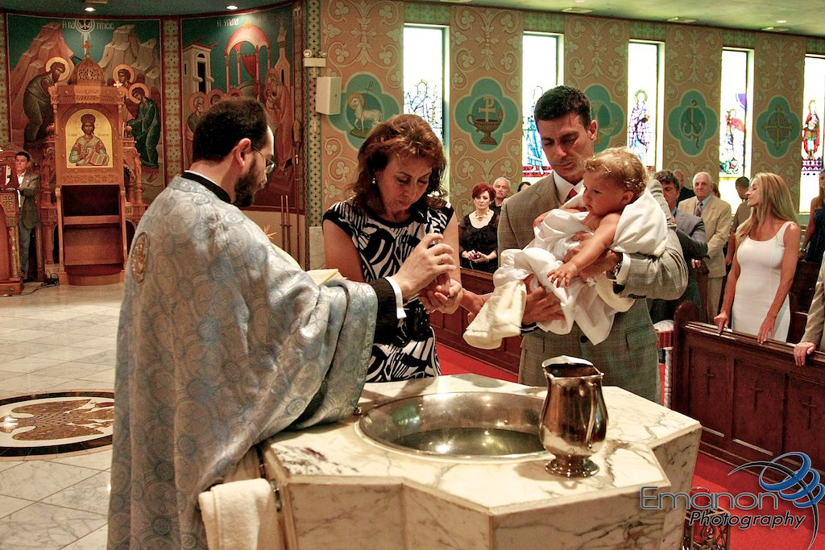
ORTHODOX BAPTISM AND CHRISMATION
Video Clip - 10 min
My Big Fat Greek Wedding - Play at 4.30
Baptism and Chrismation Documentary 45 min

Slide 15
ROMAN CATHOLIC BAPTISM
Roman Catholic Baptism Video
Why do we (Catholics) Baptize?

