Slide 1
The group of Seven:
Did they effectively capture Canada?

Slide 3
Stories in art
Art can tell a story … but did the Group of Seven effectively tell stories about Canada through their artwork?
This is a question that has been debated over the years.
There are many supporters and critics of the Group of Seven.
We’ll explore this debate today.

Slide 4
Canadian art before the Group of seven
Canadian art was not distinct or popular.
1924: Only 2% of paintings sold in Canada were by Canadian artists.
Canadian art had “not wrestled its independence from old world traditions.”
There was a strong European flavor in Canadian art.

Slide 5
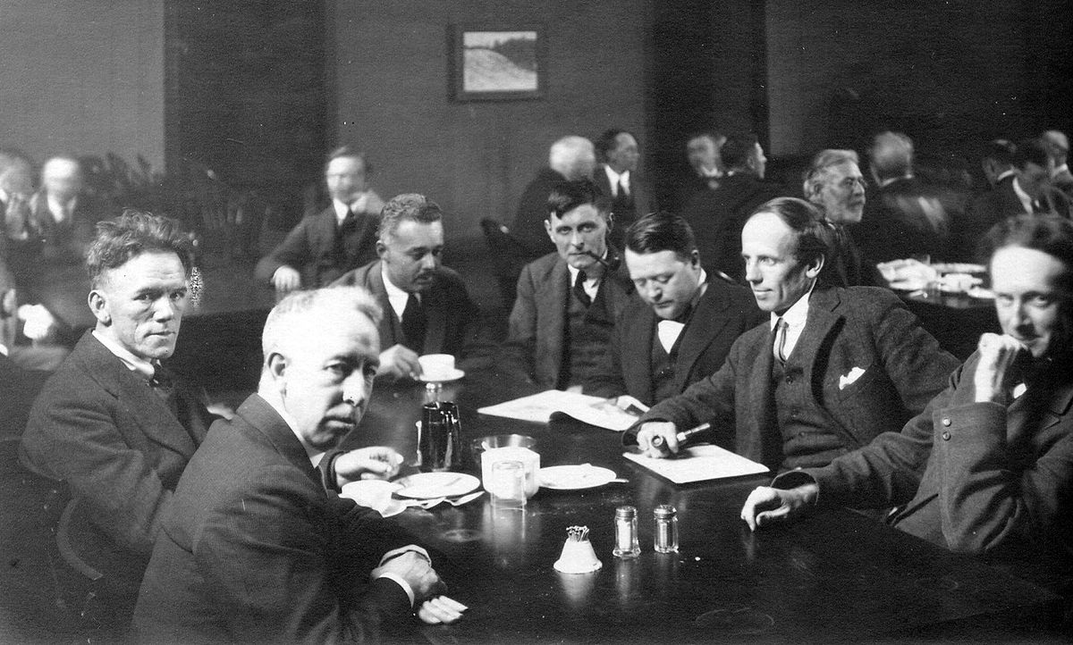
The Original members of the Group of Seven
Frank Carmichael
Lawren Harris
A.Y. Jackson
Frank Johnston
Arthur Lismer
J.E.H. MacDonald
F.H. Varley

Slide 6
Background info
The members met prior to World War One.
Most belonged to the Arts & Letters Club.
Tom Thomson: friend and early inspiration for the Group.
He drowned in 1917 as a result of a canoe accident.
May of 1920: Group of Seven’s first exhibit.
Common ties: a “common sense of frustration with the conservative and imitative quality of Canadian art.”

Slide 7
The group’s style
Strong colours and brushstrokes
Vivid light and shade
Non-conformist
Different from hyper-realism
not detailed artwork

Slide 8
The group’s claim
According to the Group, “art must reflect the spirit of a nation’s growth.”
Where is the spirit of Canada?
The group said that the spirit was most evident in the land (ex. Trees, rocks, lakes, etc.).
The group argued that “the Ontario northland symbolized the nation in the same way that the West did in the American tradition.”

Slide 9
The Criticism
Some critics did not like the Group’s artistic style.
“The contents of a drunkard’s stomach”
The “Hot Mush School”
Some argued that the group did not capture the spirit of the nation.
It was argued that most of their artwork only captured one region of Ontario: the Algoma district.

Slide 10
The Group’s legacy
1924: Their artwork was shown in the Canada display at the British Empire Exhibition.
By the time the Group disbanded in 1931, they “had been elevated to the status of Canadian cultural heroes and their work enshrined as national icons.”

Slide 11
Placemat activity
Write down 5 points about the artist based on the biography you are given.
Write down some words that come to mind when you look at the artist’s painting.
What do you think the artist is trying to say in his or her painting?
Would you recommend that this painting be included in a “Nationhood” display at the National Gallery of Canada in Ottawa?
If you were to name this painting, what would you name it?
Examine the political cartoon. What kind of message do you think the cartoonist is trying to send about the Group of Seven?

Slide 12
Sources
AGW. 2011. “Seasons of Mist and Mellow Fruitfulness: Group of Seven Works from the Collection.” http://www.agw.ca/exhibitions/current/306
Bolotta, A. Canada: Face of a Nation. Toronto: Gage Educational Publishing Company.
Historica Canada. https://www.historicacanada.ca/heritage-minute-categories/arts-and-culture

