Slide 1
The Halifax explosion

Slide 2
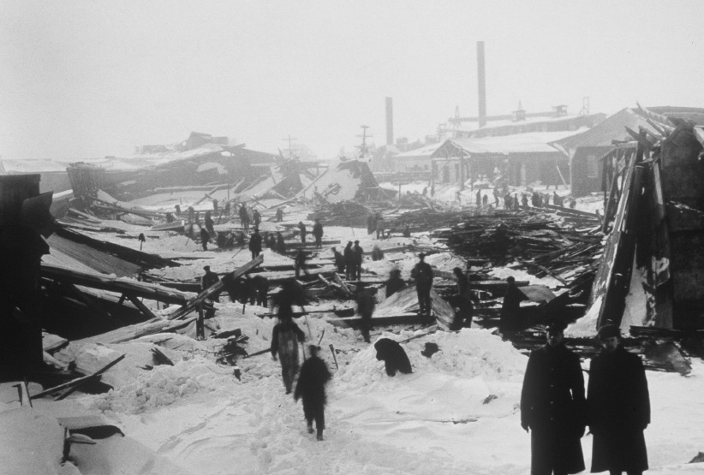
The Halifax Explosion

Slide 3
What happened?
Over the years, it was not unusual to see many ships passing through the Halifax harbour.
However, what happened between two ships in the harbour on the morning of December 6th, 1917 was very uncommon.
On this morning the French munitions ship, Mont Blanc, collided with the Belgian Relief vessel, Imo.
The Mont Blanc caught fire immediately.
The crew of the Mont Blanc were not successful in dousing the flames.
The French crew attempted to warn the people of Halifax about the dangers that lurked but for many people the warning came too late.

Slide 4
What happened?
The explosives in the Mont Blanc ignited and the results were horrific.
It became the largest non-atomic explosion in history.
Over 1600 people were killed and 9000 were injured.
Many people believed the explosion was the result of a German attack or the work of spies.
It took the city many years to recover from the disaster.

Slide 5
Source
Bolotta, Angelo, and Charles Hawkes, Fred Jarman, Marc Keirstead, Jennifer Watt. Canada: The Face of a Nation. Toronto: Gage Educational Publishing Company. 2000.

Slide 6
Video clips
Shattered City: The Halifax Explosion
https://www.youtube.com/watch?v=e3DU95ZLxw8
Heritage Minutes: The Halifax Explosion
https://www.youtube.com/watch?v=rw-FbwmzPKo

